Slide 1
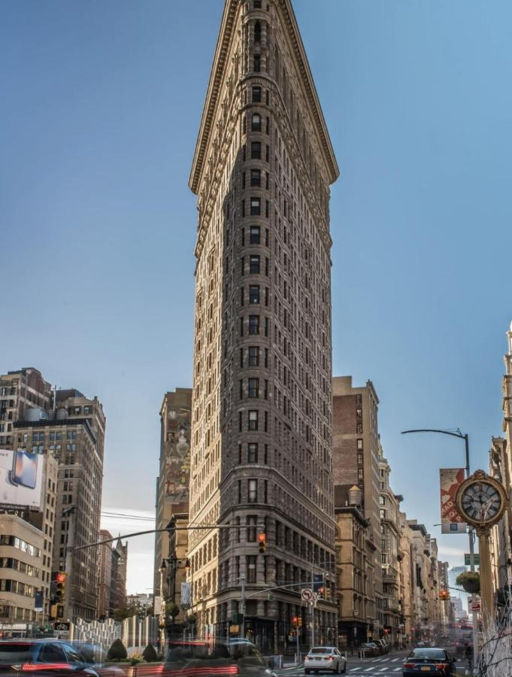
A Good Place to Travel: Unique Building, Strongly Recomend
Same style and spectular view to Shanghai Wukang Building and New York Flatiron Building.
One time travel is enough, but have to travel one time in life.

