Slide 1
Precise Mind
量化策略
总结汇报

Slide 2
模型优化 - Annual - 含股息因子
1. 优化后模型的结果
2. 数据的验证
3. 模型后续发展方向

Slide 3
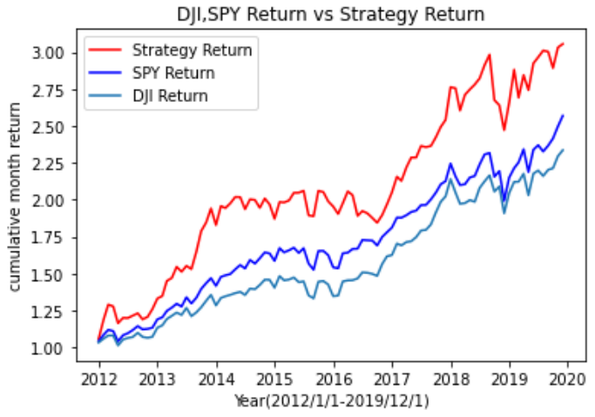
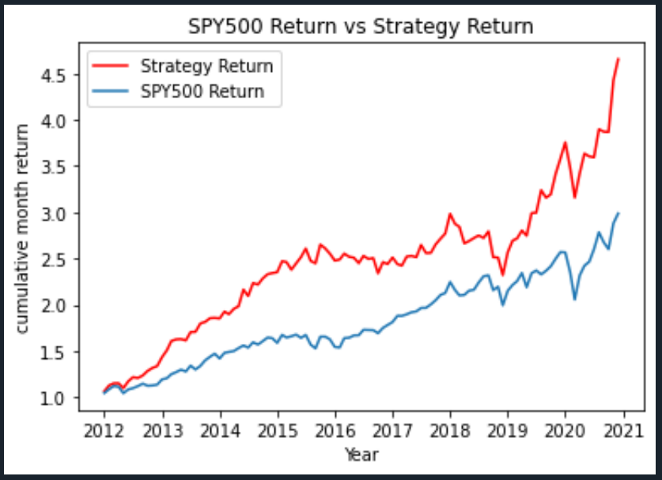
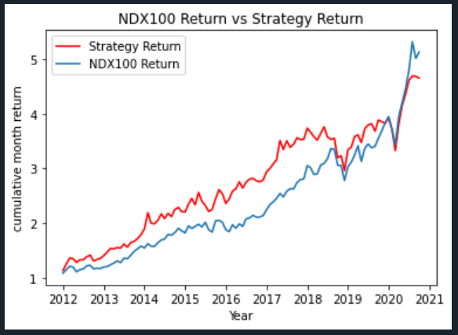
优化模型实证结果： - Annual - 含股息因子
模型构建基本假设：
回测时间
调仓频率
配置策略： 等权
CAGR(Strategy): 0. 15
SharpRatio(Strategy): 0. 85
Max-Drawdown(Strategy): 0. 17
CAGR(SPY): 0. 12
SharpRatio(SPY): 0. 9
Max-Drawdown(SPY): 0. 14
CAGR(DJI): 0. 11
SharpRatio(DJI): 0. 77
Max-Drawdown(DJI): 0. 12
CAGR(Strategy): 0.18
SharpRatio(Strategy): 0.98
Max-Drawdown(Strategy): 0.22
CAGR(SPY): 0.13
SharpRatio(SPY): 0.78
Max-Drawdown(SPY): 0.20
CAGR(Strategy): 0.19
SharpRatio(Strategy): 0.99
Max-Drawdown(Strategy): 0.21
CAGR(NDX100): 0.19
SharpRatio(NDX100): 1.14
Max-Drawdown(NDX100): 0.17

Slide 4
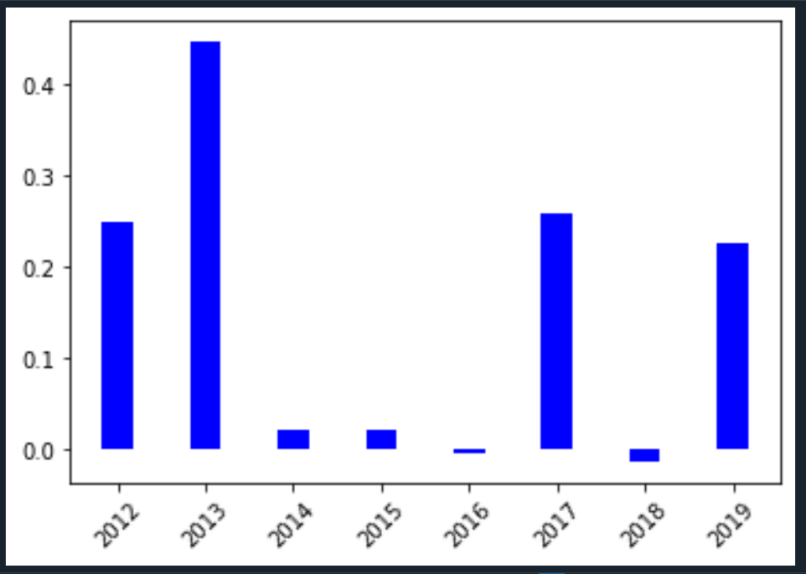
Portfolio Monthly Returns(%)
Portfolio Yearly Returns(%)

Slide 5
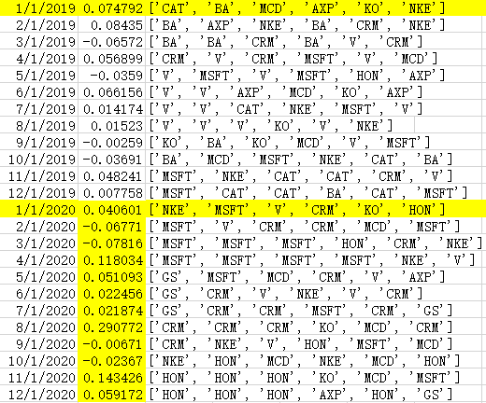
数据验证
投资组合及收益
验证结果

Slide 6
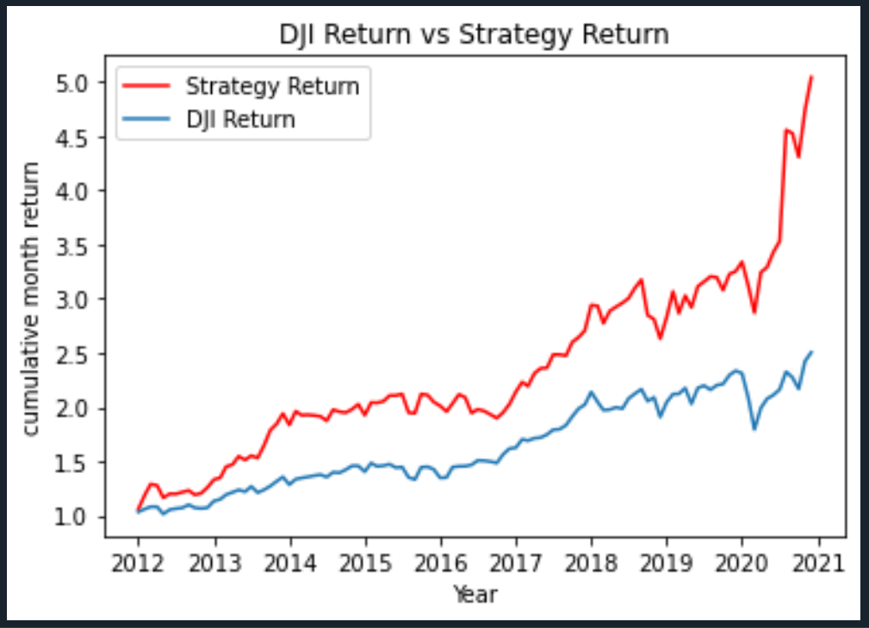
模型优化 - Annual - 含股息因子
CAGR(Strategy): 0.197
SharpRatio(Strategy): 0.95
Max-Drawdown(Strategy): 0.17
CAGR(DJI): 0.10
SharpRatio(DJI): 0.59
Max-Drawdown(DJI): 0.23
CAGR(Strategy): 0.18
SharpRatio(Strategy): 0.98
Max-Drawdown(Strategy): 0.22
CAGR(SPY): 0.13
SharpRatio(SPY): 0.78
Max-Drawdown(SPY): 0.20
CAGR(Strategy): 0.19
SharpRatio(Strategy): 0.99
Max-Drawdown(Strategy): 0.21
CAGR(NDX100): 0.19
SharpRatio(NDX100): 1.14
Max-Drawdown(NDX100): 0.17

Slide 7
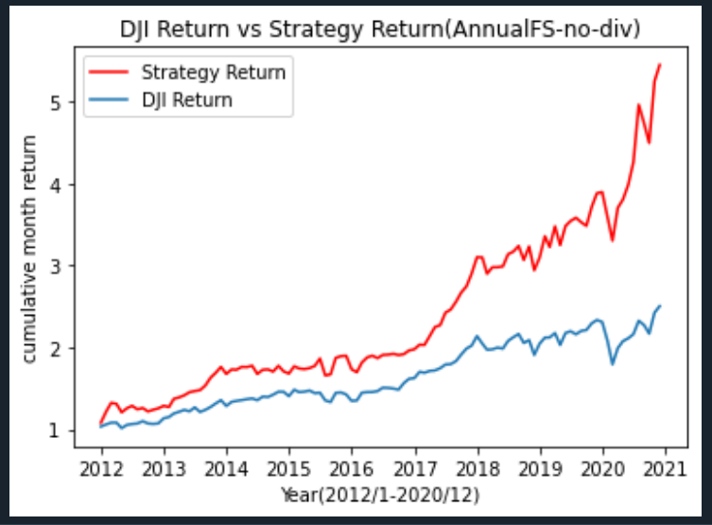
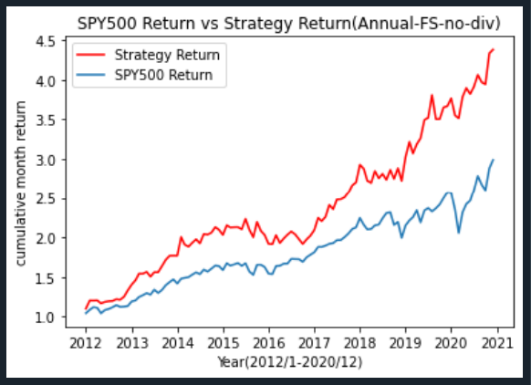
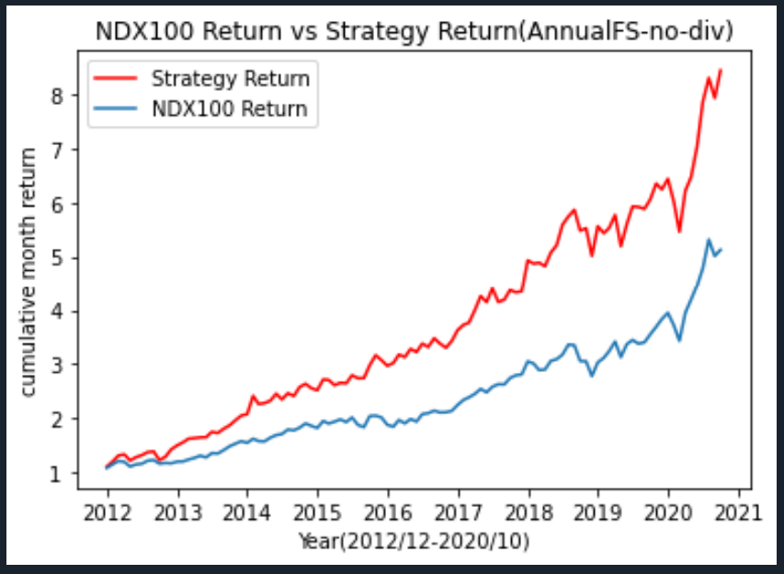
模型优化 - Annual -去除股息因子
CAGR(Strategy): 0.21
SharpRatio(Strategy): 1.06
Max-Drawdown(Strategy): 0.15
CAGR(DJI): 0.10
SharpRatio(DJI): 0.59
Max-Drawdown(DJI): 0.23
CAGR(Strategy): 0.18
SharpRatio(Strategy): 1.03
Max-Drawdown(Strategy): 0.14
CAGR(SPY): 0.13
SharpRatio(SPY): 0.78
Max-Drawdown(spy): 0.20
CAGR(Strategy): 0.29
SharpRatio(Strategy): 1.43
Max-Drawdown(Strategy): 0.15
CAGR(NDX100): 0.19
SharpRatio(NDX100): 1.14
Max-Drawdown(NDX100): 0.17

Slide 8
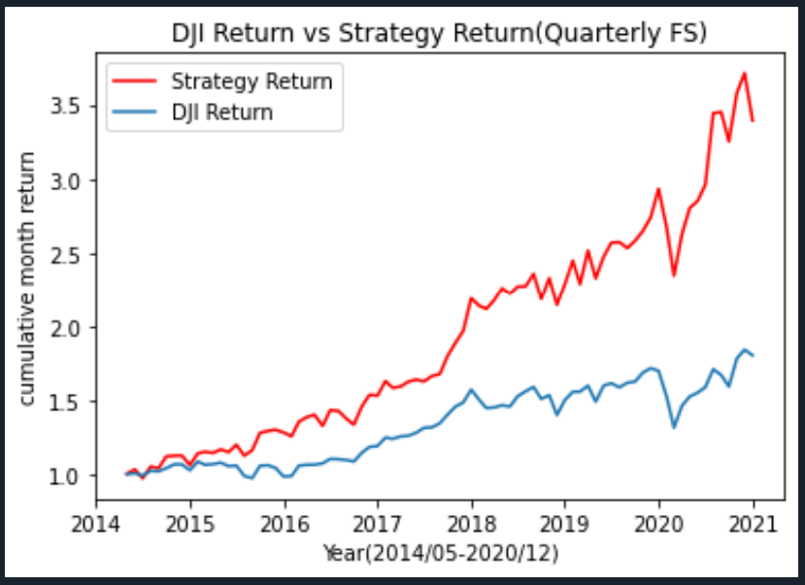
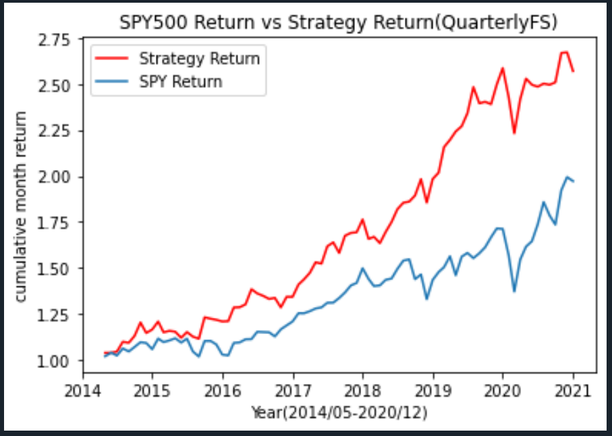
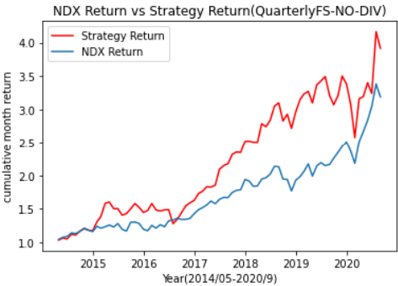
模型优化 - Quarter - 去除股息因子
CAGR(Strategy): 0.2
SharpRatio(Strategy): 0.93
Max-Drawdown(Strategy): 0.20
CAGR(DJI): 0.09
SharpRatio(DJI): 0.45
Max-Drawdown(DJI): 0.23
CAGR(Strategy): 0.15
SharpRatio(Strategy): 1.0
Max-Drawdown(Strategy): 0.14
CAGR(SPY): 0.10
SharpRatio(SPY): 0.55
Max-Drawdown(SPY): 0.20
CAGR(Strategy): 0.25
SharpRatio(Strategy): 1.1
Max-Drawdown(Strategy): 0.24
CAGR(NDX100): 0.19
SharpRatio(NDX100): 1.03
Max-Drawdown(NDX100): 0.17

Slide 9
模型优化 - Annual VS Quarter -去除股息因子

Slide 10
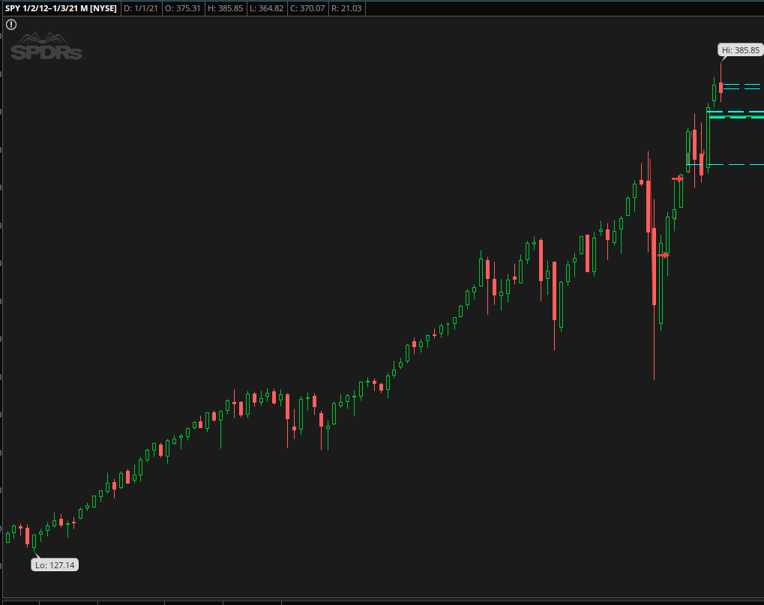
模型数据的验证：
SPY:137-375
CAGR: 13.37%
DJI:13840- 29360
10.9%

