Slide 1
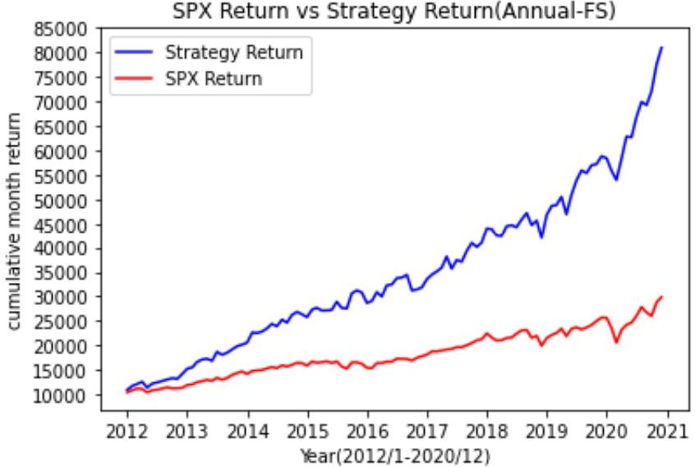
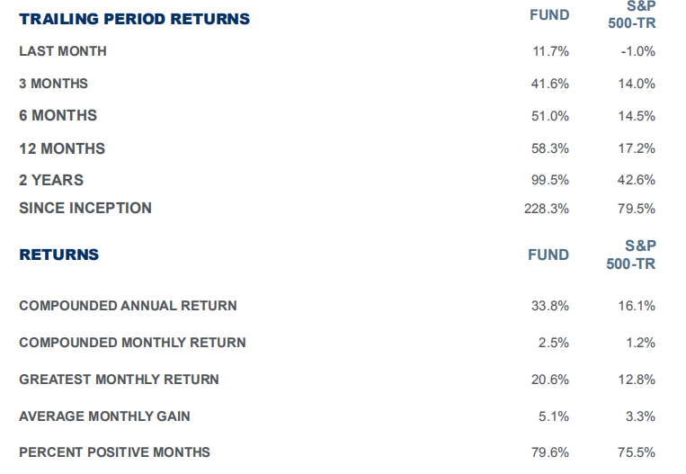
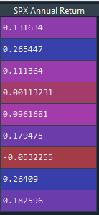
STRATEGY
A specialist in the technology, media and telecom sectors, SEABRIDGE concentrated, high conviction portfolio of rapidly growing, profitable companies. Our quantitative methodology, measuring profitable growth, free cash flow yield and forward visibility, brings substantial efficiency and discipline to our fundamental based bottom-up research.
The managers have decades of experience in public investing, venture capital, corporate governance and executive management in public and private technology companies.
MARKET CAP ALLOCATIONS
dollar weighted
Below $3B | 2%
$3B - $10B | 54%
Above $10B | 44%
Results are for the period from January 1, 2017 (fund inception) through January 31, 2021.
Monthly return percentages are derived from a hypothetical test account and do not represent actual capital accounts.

Slide 2
RISK MEASUREMENTS | FUND | S&P 500-TR
Standard Deviation | 25.2% | 16.1%
Tracking Error |  | 4.4%
Upside Capture |  | 187.6
Downside Capture |  | 83.5
Downside Deviation (below 0%) | 15.1% | 10.3%
Sortino Ratio (0%) | 2.2 | 1.5
Greatest Monthly Loss | -25.0% | -12.4%
Maximum Drawdown | -29.6% | -19.6%
REGRESSION STATISTICS Monthly Alpha |  | S&P 500-TR 1.1%
Annualized Alpha |  | 13.4%
Beta |  | 1.3
R-Squared |  | 0.7
Correlation |  | 0.8
RISK VS RETURN
ANNUALIZED RATE OF RETURN
40%
35%
30%
25%
20%
15%
10%
5%
0%
Fund
S&P 500-TR
0% 5% 10% 15% 20%
25% 30%
STANDARD DEVIATION
(greater numbers = greater risk)
Latest AI Poftfolio:
NKE PG MSFT V AMGN CRM
PERFORMANCE NOTES
This document is not intended as and does not constitute an offer to sell any securities to any person, or a solicitation of any person of any offer to purchase any securities. Such an offer or solicitation can only be made by the confidential Offering Circular of the Partnership.
The foregoing data have not been compiled, reviewed, or audited by an independent accountant and non-year-end results are subject to adjustment. The results portrayed for the Partnership reflect the reinvestment of dividends and other earnings and the deduction of costs, and the management fees charged to the partnership.
While the General Partner believes that to-date, the Partnership has been managed with an investment philosophy and methodology similar to that described in the Partnership’s Offering Circular and that will be used to manage the Partnership in the future, future investments will be made under different economic conditions and in different securities. It should not be assumed that investors will experience returns in the future if any, comparable to those discussed above. The performance discussed herein does not reflect the General Partner’s performance in all different economic cycles.
The information given above is historic and should not be taken as any indication of future performance. The General Partner believes that the comparison of Partnership performance to any single market index is inappropriate. The Partnership’s portfolio may contain cash, fixed-income securities, options and other derivative securities, may include short sales of securities, and margin trading and may not be as diversified as the market indices shown.
Both of the indices are unmanaged, market weighted, and reflect the reinvestment of dividends. Due to the differences among the Partnership’s portfolio and the performance of the equity market indices shown above, however, the General Partner cautions potential investors that no such index is directly comparable to the investment strategy of the partnership.
This information omits most of the information material to a decision whether to invest in the partnership. No person should rely on any information in this document, but should rely exclusively on the Offering Circular in considering whether to invest in the Partnership.
S&P 500-TR is the total return of the S&P 500, which refers to the capital Standard & Poor’s 500 Index with dividends reinvested. It generally represents the aggregate price changes in the largest 500 U.S. publicly traded companies. Planting Ground Fund seeks absolute returns irrespective of indices and cites them for comparative purposes only.
Numerical data compiled by ALPS Fund Services, Inc., Administrator to the Fund. Fund returns reflect the net investment results of a single contribution at the beginning of the period with no subsequent additions or withdrawals. Based on information believed to be correct, but subject to revision and audit adjustment.

