Slide 1
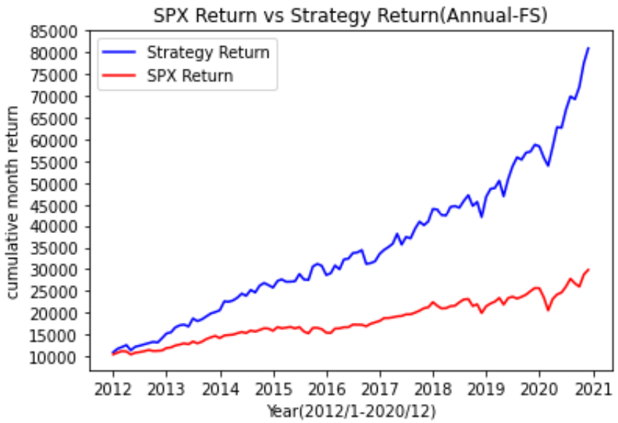
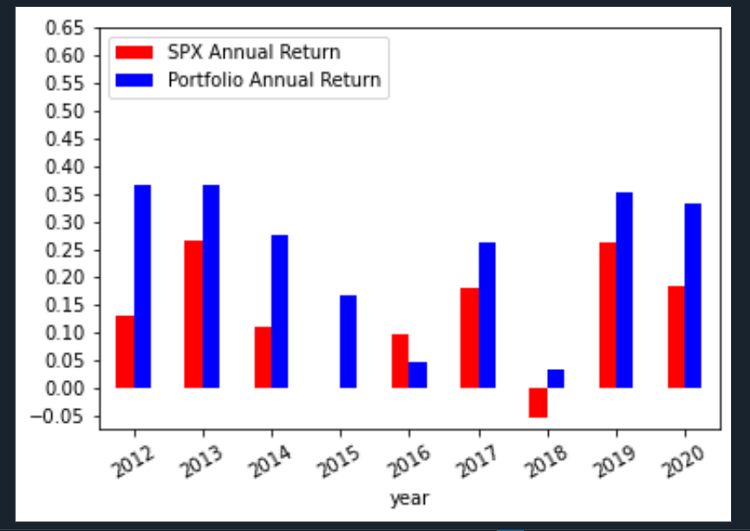
Portfolio Performance (2012-2020)
80% Momentum score & Fscore > 6
CAGR(Strategy): 0. 26
SharpRatio(Strategy): 1.57
Max-Drawdown(Strategy): 0. 11
Volatility(Strategy): 0.15
CAGR(SPY): 0. 13
SharpRatio(SPY): 0. 78
Max-Drawdown(SPY): 0. 2
Volatility(Strategy): 0.13
Portfolio Link
https://docs.google.com/spreadsheets/d/1aO_91jp6CCWlfiBTKGe5ASzKmSHf4v67mxBCrtoEXGs/edit?usp=sharing

Slide 2
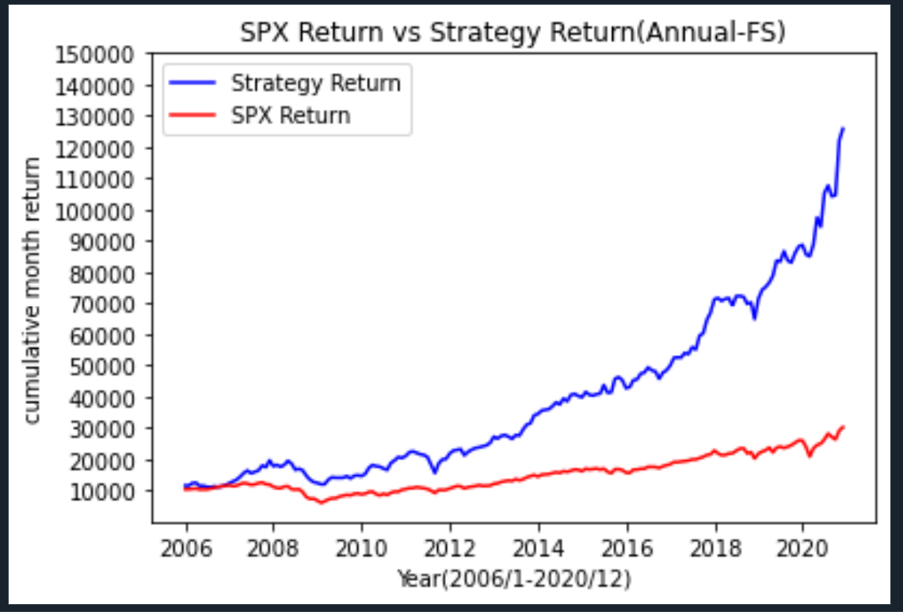
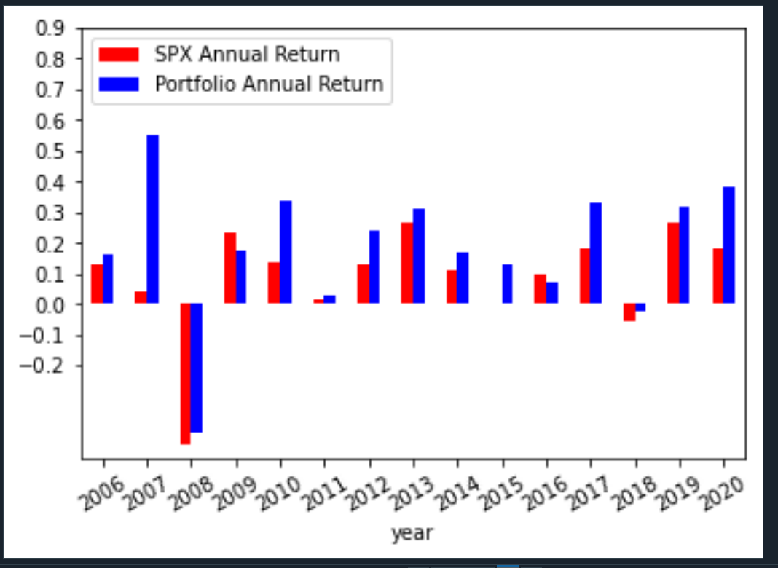
Portfolio Performance (2006-2020)
CAGR(Strategy): 0. 18
SharpRatio(Strategy): 0.89
Max-Drawdown(Strategy): 0. 39
Volatility(Strategy): 0.17
CAGR(SPY): 0. 07
SharpRatio(SPY): 0. 34
Max-Drawdown(SPY): 0. 52
Volatility(Strategy): 0.15

Slide 3
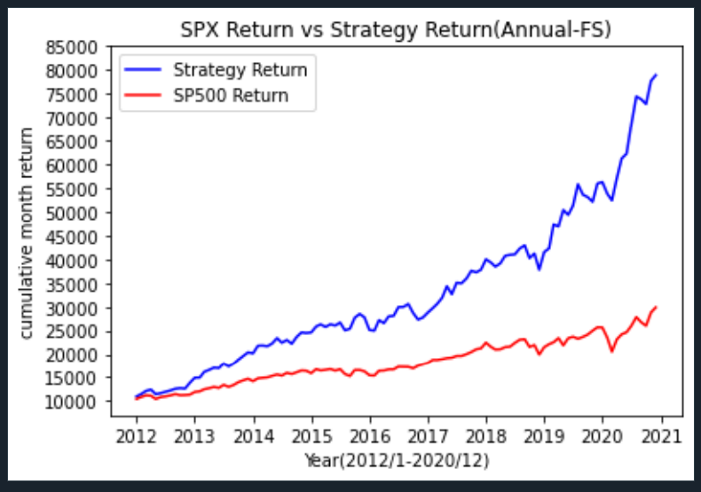
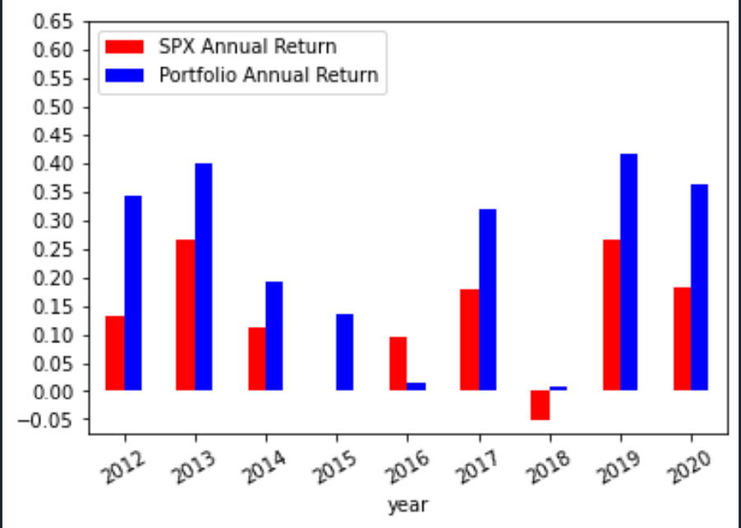
Portfolio Performance (2012-2020)
Momentum score >0 & Fscore >=6 (2012-2020)

