Slide 1


Precise Mind
量化策略
总结汇报

Slide 2
目录
优化模型实证优化：
股票池的选择
动量策略
回测时间： 2006-2021
调仓频率： 每月调仓一次
配置策略： 等比例

Slide 3
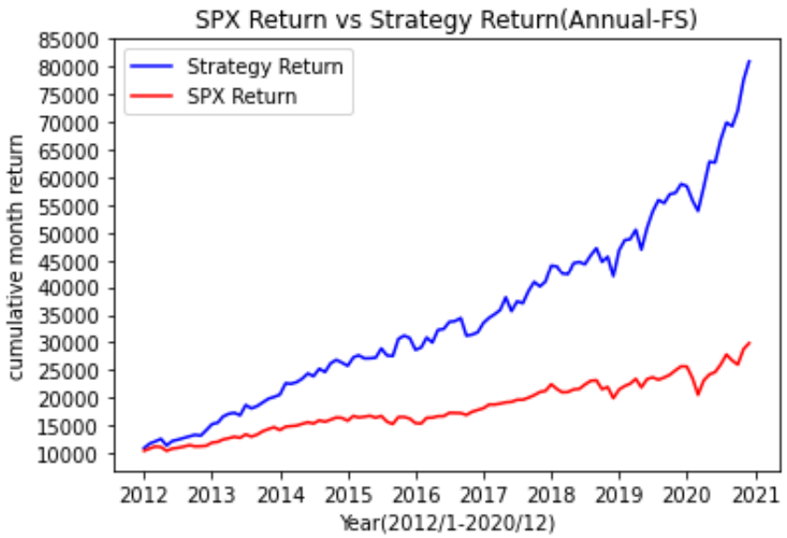
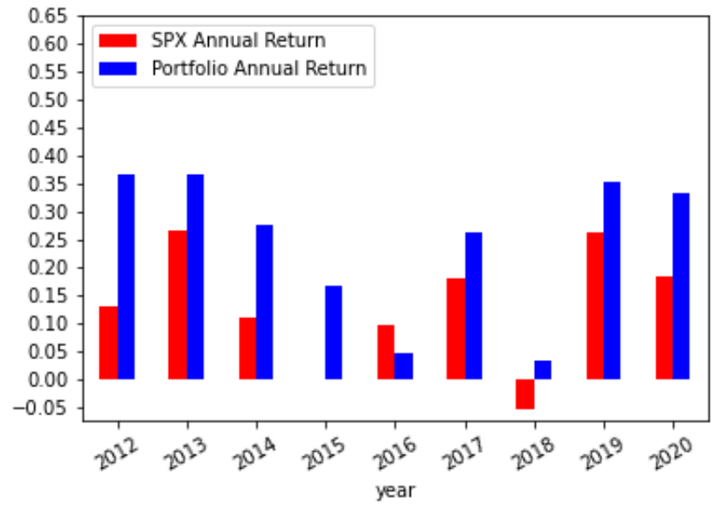
优化模型实证结果： 牛市 2012-2019 （年度财报股池）
CAGR(Strategy): 0. 26
SharpRatio(Strategy): 1.57
Max-Drawdown(Strategy): 0. 11
Volatility(Strategy): 0.15
CAGR(SPX): 0. 13
SharpRatio(SPX): 0. 78
Max-Drawdown(SPX): 0. 2
Volatility(SPX): 0.13
Portfolio Link:
https://docs.google.com/spreadsheets/d/1aO_91jp6CCWlfiBTKGe5ASzKmSHf4v67mxBCrtoEXGs/edit?usp=sharing
80% Momentum score & Fscore > 6

Slide 4
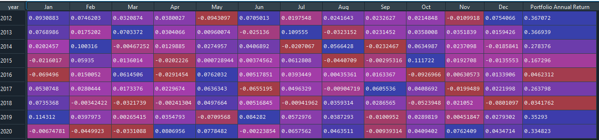
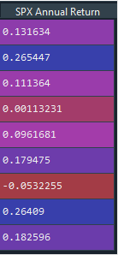
优化模型实证结果： 牛市 2012-2019 （年度财报股池）
SPX & Portfolio Monthly Returns(%) 2012-2020

Slide 5
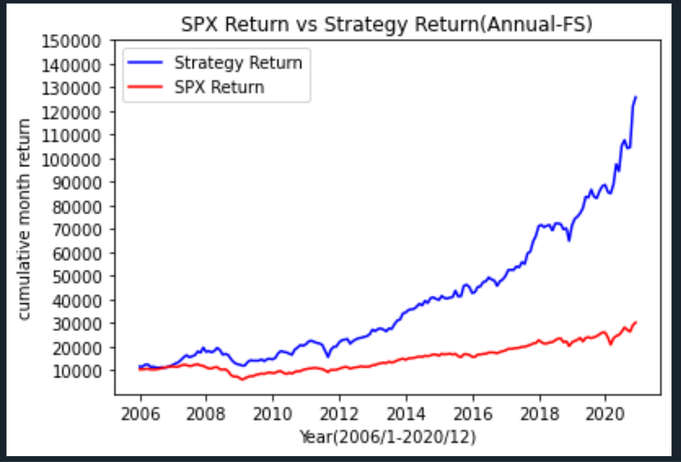
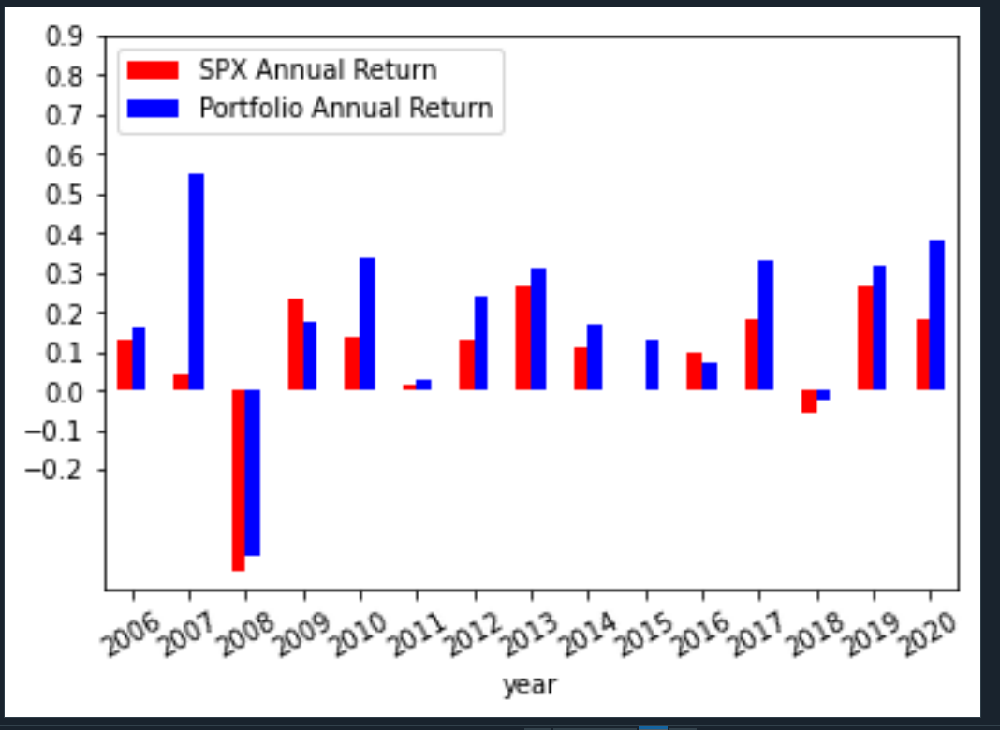
优化模型实证结果： 2006-2020 （年度财报股池）
CAGR(Strategy): 0. 18
SharpRatio(Strategy): 0.89
Max-Drawdown(Strategy): 0. 39
Volatility(Strategy): 0.17
CAGR(SPX): 0. 07
SharpRatio(SPX): 0. 34
Max-Drawdown(SPX): 0. 52
Volatility(SPX): 0.15

Slide 6
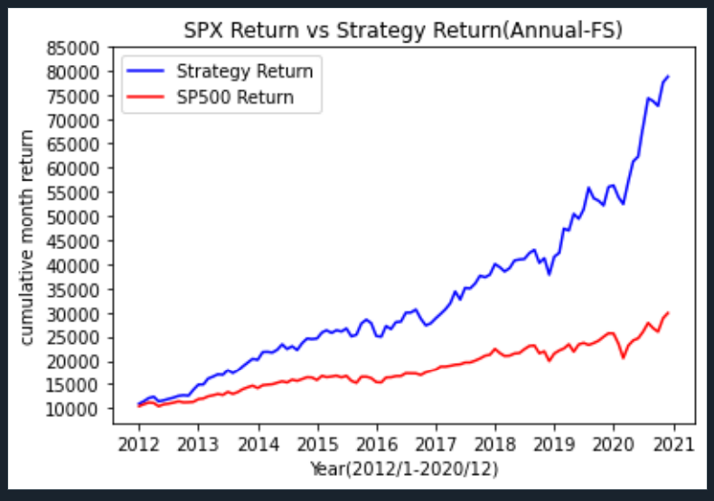
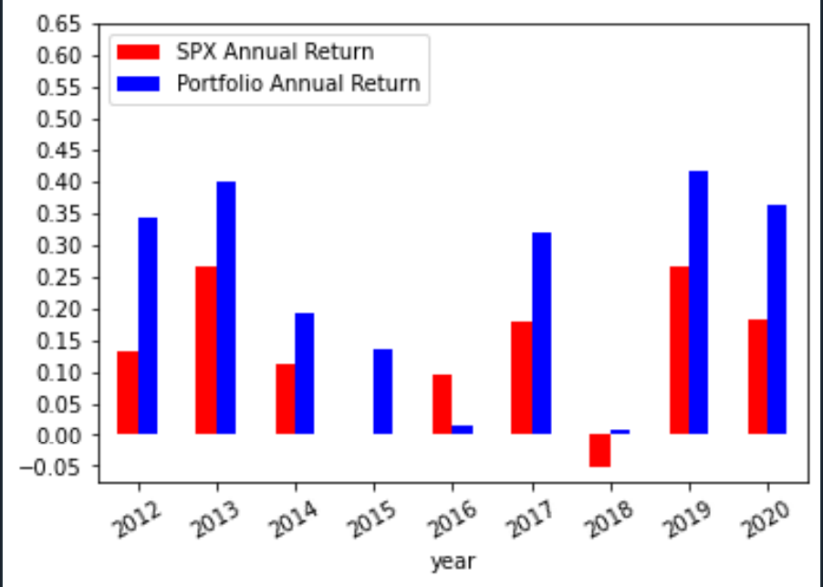
优化模型实证结果： 2012-2020 （年度财报股池）
Momentum score >0 & Fscore >=6 (2012-2020)

Slide 7
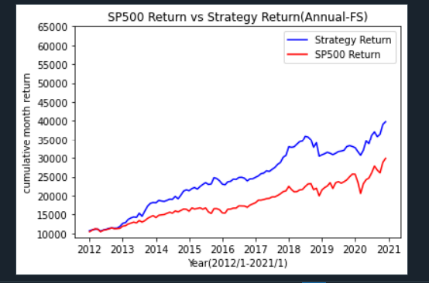
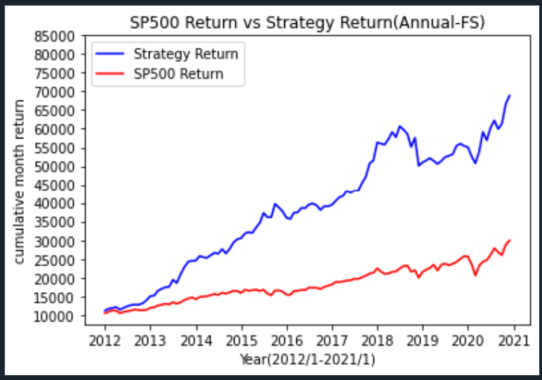
优化模型实证结果：等权 VS 非等权（10P) （年度财报股池）
权重：
[0.1,0.1,0.1,0.1,0.1,0.1,0.1,0.1,0.1,0.1]
权重：[0.15,0.15,0.1,0.1,0.1,0.08,0.08,0.08,0.08,0.08]

Slide 8
SPY 期权-Sell Covered Call

Slide 9
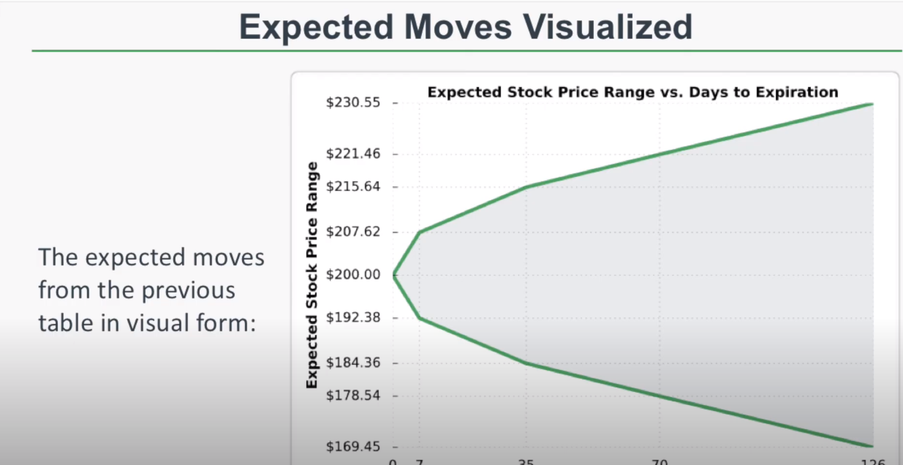
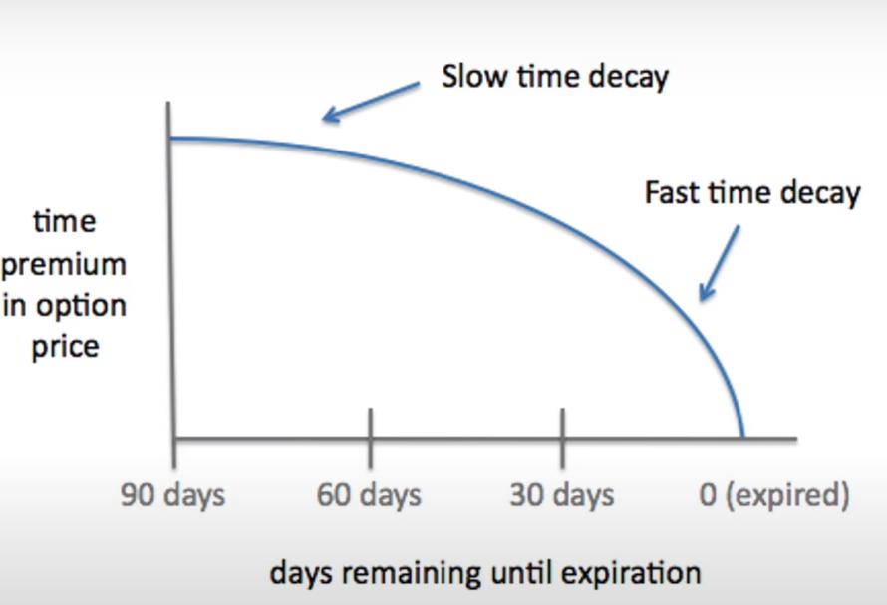
Sell Covered Call - SPY(weekly) (7/10/2020-2/5/2021)
NEXT_WEEK_PRICE <= STRIKE_PRICE
期权收益 : Premium（不包括正股）
NEXT_WEEK_PRICE > STRIKE_PRICE
期权收益: strike_price + premium - next_week_price
NEXT_WEEK_PRICE 和 STRIKE_PRICE 比较
strike price = this_week_price + ratio* ATM_premium
（类似于expected movement）

Slide 10
Sell Covered Call - SPY (7/10/2020-2/5/2021)
ratio -0.5
###################################
total option return: 8.900000000000032
min option return: -4.4500000000000455
min option return date: 11/6/2020
max option return: 4.76
max option return date: 11/13/2020
ratio 0
###################################
total option return: 8.910000000000037
min option return: -3.9699999999999704
min option return date: 11/20/2020
max option return: 3.56
max option return date: 11/13/2020
ratio 0.5
###################################
total option return: 8.910000000000073
min option return: -3.4799999999999613
min option return date: 11/20/2020
max option return: 2.78
max option return date: 10/16/2020
ratio 0.8
###################################
total option return: 7.960000000000008
min option return: -2.930000000000007
min option return date: 11/20/2020
max option return: 2.33
max option return date: 10/16/2020
ratio 1.2
###################################
total option return: 6.579999999999983
min option return: -2.3100000000000023
min option return date: 11/20/2020
max option return: 1.65
max option return date: 10/9/2020
ratio 1.4
###################################
total option return: 8.020000000000035
min option return: -1.6299999999999955
min option return date: 11/20/2020
max option return: 1.58
max option return date: 10/16/2020
ratio1.5
###################################
total option return: 7.5800000000000045
min option return: -1.6299999999999955
min option return date: 11/20/2020
max option return: 1.33
max option return date: 10/23/2020
ratio 2
###################################
total option return: 6.430000000000004
min option return: -0.8799999999999955
min option return date: 11/20/2020
max option return: 1.03
max option return date: 10/16/2020
ratio 3
###################################
total option return: 3.2700000000000005
min option return: 0
min option return date:
max option return: 0.39
max option return date: 10/23/2020
ratio 4
###################################
total option return: 1.5599999999999996
min option return: 0
min option return date:
max option return: 0.19
max option return date: 12/4/2020
ratio 5
###################################
total option return: 0.6299999999999999
min option return: 0
min option return date:
max option return: 0.09
max option return date: 12/11/2020
ratio 6
###################################
total option return: 0.31
min option return: 0
min option return date:
max option return: 0.07
max option return date: 12/11/2020
ratio 7
###################################
total option return: 0.15
min option return: 0
min option return date:
max option return: 0.04
max option return date: 12/11/2020
Best Ratio: 0.5
Max Total Option Return: 8.910000000000073
Additional Option Return Percentage:2.60%

