Slide 1
DATA QUALITY
Aymen Ibhi
Ikram Mourad
Peipei Wu
Tahseen Ahmad

Slide 2
AGENDA
INTRODUCTION
FINDING 1
FINDING 2
FINDING 3
LESSONS LEARNED
REFERENCES

Slide 3
INTRODUCTION: Importance of data quality
Adds value to the data
Optimizes the usage of data
Delivers trusted analytics
(Russom, P., 2019)

Slide 4
Data quality in the era of big data
Traditional data quality processes are still relevant if adjusted.
(Russom, P., 2019)

Slide 5
Adjustment Process :
Standardization: Data quality’s standardization makes big data more conducive to ad hoc browsing, visualizing, and querying.
Deduplication: Data quality’s multiple approaches to matching and deduplication can remediate data redundancy.
Matching: Data quality’s data matching capabilities help validate diverse data and identify dependencies among data sets.
Profiling and monitoring: Data quality’s business rule engines and new smart algorithms can remediate these automatically at scale.
Customer data: All mature data quality tools have functions designed for the customer domain.
(Russom, P., 2019)

Slide 6
FINDING 1

Slide 7
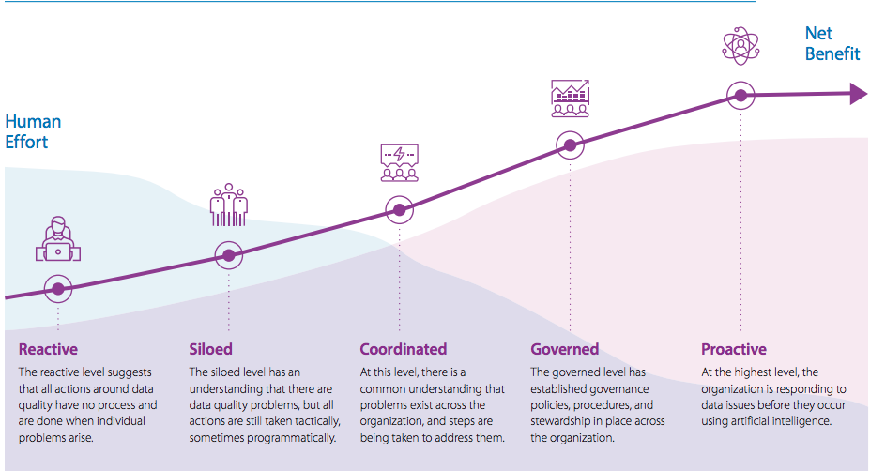
The data quality maturity Model
(Stovall, J., & McDougall, J., 2019)

Slide 8
FINDING 2

Slide 9
Completeness
Completeness does not have influence on non-critical data. (Customer name, emails address, Phone number)
Consistency
Consistency measures whether data is equivalent between different systems or storage locations.
Attributes of Data
Accuracy
Whether data is correct or associated with real-world object.
Conformity
Follow the set of standard data definitions. (Data type, standard size)
No Duplicates
Only unique data value exists for each attributes.
Integrity
The structural testing of data to ensure that the data complies with procedures.
(Lebied, M., 2018)
(Stodder, D., 2016)

Slide 10
FINDING 3

Slide 11
Four future trends in data operations
Ever increasing sources of valuable data will intensify the need for smart, automated data analysis.
Increased automation via AI & Machine learning will this diverse and dynamic data be manageable economically.
Custom solution from purpose-build components.
Unique applications will be required to acquire, organize, prepare, and analyze/visualize their own unique types of data.
User sophistication will increase and advanced tools will become more approachable.
Need for knowledgeable workers will increase who can bridge the gaps that technology can’t fill completely.
Subject matter experts will become data curators.
They will assess the quality of the data and contribute their expertise to projects to improve data integrity.
( Marinelli, M., 2019 )

Slide 12
Lessons Learned
Importance of data quality.
Data quality maturity model.
Attributes of data
Future trends in data operations.

Slide 13
Reference
Lebied, M.(2018, June 28). The ultimate guide to modern data quality management (DQM) for an effective data quality control driven by the right metrics. Retrieved from: https://www.datapine.com/blog/data-quality-management-and-metrics/
Marinelli, M. (2019, April 30). The future of data-ops: Four trends to expect. Retrieved from https://tdwi.org/articles/2019/04/30/adv-all-future-of-dataops-four-trends.aspx
Russom, P. (2019, April 19). Data quality in the age of big data. Retrieved from https://tdwi.org/Articles/2019/04/19/DIQ-ALL-Data-Quality-in-the-Age-of-Big-Data.aspx?Page=2
Stodder, D. (2016, June 3). Data preparation: Advanced analytics to the rescue. Retrieved from https://tdwi.org/articles/2016/06/03/data-preparation-advanced-analytics-rescue.aspx
Stovall, J., & McDougall, J. (2019, March 7). Data quality maturity model and why we need It. Retrieved from https://tdwi.org/whitepapers/2018/05/diq-all-information-builders-data-quality-maturity-model-and-why-we-need-it.aspx

Slide 14
Thank You.

