Slide 1
Bank Cusotmer Segmentation Via Cluster Analysis In SAS
MKTG 525 Data Driven Marketing
Peipei Wu

Slide 2
Agenda
Overview
Background & Data Preparation
Exploration of the data
1.Any issues2.Preliminary findings
Segmentation & Profile Analysis

Slide 3
Overview
Goal:
to classify and predict the clients will subscribe (yes/no) a term deposit
Data:
Bank client data
Age (numeric)
JobType : type of job
Marital : marital status
Education
HousingLoan: has housing loan? (“yes”,“no”)
Consumer Index

Slide 4
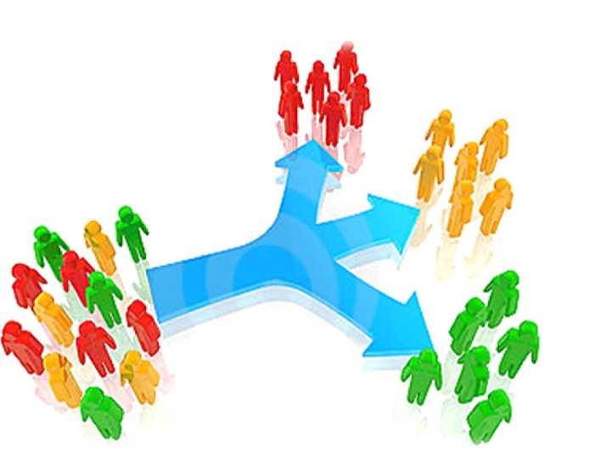
Overview
Customer segementation:
the process of dividing your cusotmers into smaller groups which have similar characteristics like, age, income, personality traits or behavior
Key components in developing apropriate cusotmer segmentation
objectives Customer
Types of Segmentation
Available customer information
Demographic
Behavioral
Attitudinal

Slide 5
Background& Data Preparation

Slide 6
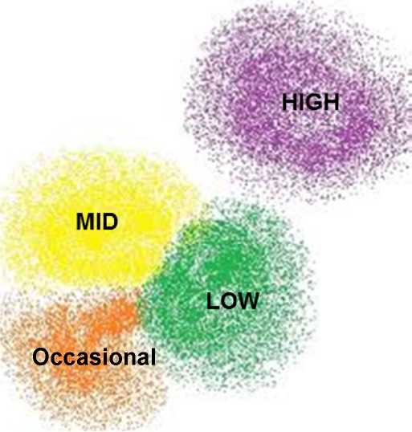
Segmentation Type
Data source
• Demographic Profile: age, gender, marital status,Income
• Behavior, attitudinal
Approach
• UnSupervised clustering
- K-means clustering
• One Way Frequnecy
T- Test
Bar Chart

Slide 7
K-means Clustering Results
K-means clustering
Using the distances to group customers into K clusters where each customer is with the nearest centroid
• The centroid is calculated as the multi-dimensional set of the means of the variables used for the particular cluster
• Pre-determine a range of number of clusters, use bottom-up approach
• Test the FASTCLUS procedure repeatedly using different starting points and different number of clusters until we obtain stabilized centroids and desired distance between clusters

Slide 8
Segmentation Building ProcessI

Slide 9
Segmentation Building ProcessI

Slide 10
Segmentation Building ProcessI

Slide 11
Segmentation Building ProcessI

Slide 12
Segmentation Building Process Ii
Segments profiling
Data preparation
• Data merge purge, data cleaning, dealing with missing
• Convert all attributes to numeric metrics, cap outliers
• Standardize all metrics/variables
• Standardization enables each metric have similar contribution to the future cluster building

Slide 13
Segmentation Building Process III
• Using the distances to group customers into K clusters where each customer is with the nearest centroid
• The centroid is calculated as the multi-dimensional set of the means of the variables used for the particular cluster
• Pre-determine a range of number of clusters, use bottom-up approach
• Test the FASTCLUS procedure repeatedly using different starting points and different number of clusters until we obtain stabilized centroids and desired distance between clusters

Slide 15
Question?

