Slide 1
MKTG525
Midterm group project PEIPEIWU

Slide 2
AGENDA
The purpose of the analysisS
data used
Exploration of the data:
issues
Preliminary findings
A model for the researchhe data:
The equation
How your group arrived at the model
An interpretation of the model:
Which predictors are significant
An interpretation of each coefficient: what it means in terms of the dependent variable

Slide 3
THE purpose of the analysisS
With the current marketing efforts, who are most likely to subscribe to a term deposit?

Slide 4
data used
data from: Bank.csv
rows:41188
Columns:21
10 classification varibales
10 continuous variables

Slide 5
Exploration of the data:
Issues: mISSING vALUE/ INSUFICENT DATA
PRELIMINARY FINDINGS:

Slide 6
A model for the researchhe data
the folling tables are resluting model we created.

Slide 7
A model for the researchhe data we created: Equation

Slide 8
A model for the researchhe data we created: Equation

Slide 9
A model for the researchhe data
WE USE THE BINARY logistic regression in SAS to create the model
rEsponse: y
link function； LOGIT
explanatory vARIAbles
using THE BACKWARD ELImination method, WITH 0.05 significance level. WE USE TWO WAY INteractions ABOUT THE COFFFICIENT to filter out all the variables we donot needs.

Slide 10
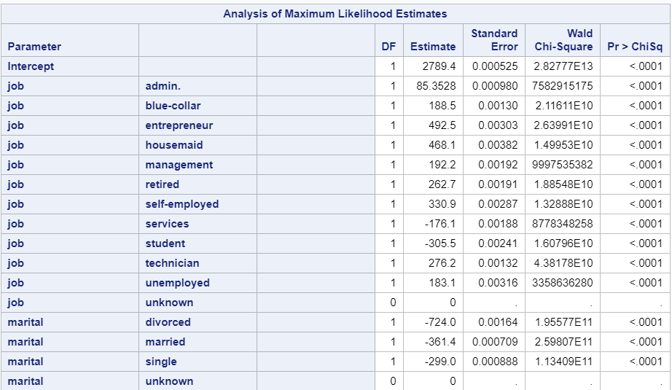
An interpretation of the model:

Slide 11
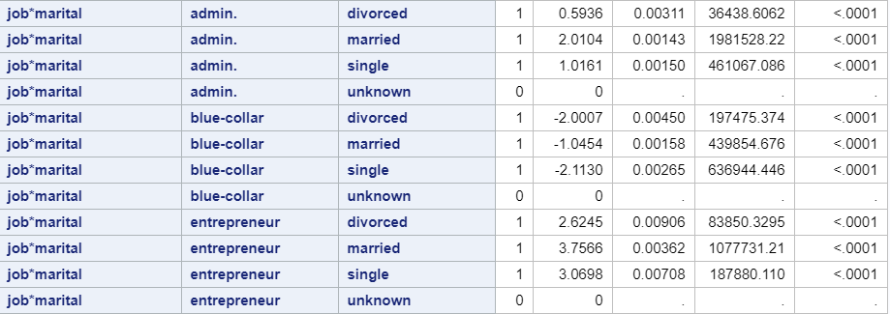
An interpretation of the model:

Slide 12
An interpretation of the model:
SIGNIFICANT:
all significant predictors are listed in Equation.
DIVOICED PEOPLE are less likly to open up the term deposit, due to the estimates of devoiced people SAMLLER THAN MARRIED PEOPLE.
comparing the table, PEOPLE ARE MARRIED in ADMIAN JOB or blue-collar are more LIKeLY TO OPEN term deposit. ( but married cat not say a determined factor)
marital related entrepreneur, the coefficient higher, they are more likly to open term deposit in general. maried people shows highest to open term deposit.
over all married people no matter what job they have are likely to open term deposit.

Slide 13
An interpretation of the model:
2. An interpretation of each coefficient: what it means in terms of the dependent variable
ACCORING TO THETABLE. DIVOICED PEOPLE are less likly to open up the term deposit, because the estimates of devoiced people RE SAMLLER THAN MARRIED PEOPLE.
IN THIS SITUATION , IT IS SIGNICANTLY TO SAY MARRITLE STATUS ARE NOT DETERMINED YOU ARE NOT TO OPEN UP A TERM DEPOSIT. PEOPLE ARE MARRIED WITH ADMIAN JOB ARE LIKLY TO OPEN term deposit.
as for job martile related with entreprent, the coefficient are really higher, they are more likly to open term deposit in general. agin maried people shows highestto open term deposit.over all married people no matter what job they have are likely to open term deposit, open term
postive or negative ,more likly or less likly to subarube the term deposit, IT DEPEND ON THE JOB YOU HAVE.
P VALUES ARE TINY SELECT WHAT YOU GONNA DESCRIBE
REALLY INTERESTING
PEOPLE ARE LIKELY TO OPEN UPA TERM DEPOSIT ARE MARRIED PEOPLE.,
COMAPRING TO ENTEORE ARE ,ORE LIKELY TO OPEN UP ATERM DEPOSIT,
Interprementing
retire people are likly to signup the

