Slide 1
MKTG525
Midterm group project PEIPEIWU

Slide 2
AGENDA
The purpose of the analysisS
data used
Exploration of the data:
issues
Preliminary findings
A model for the researchhe data:
The equation
How your group arrived at the model
An interpretation of the model:
Which predictors are significant
An interpretation of each coefficient: what it means in terms of the dependent variable

Slide 3
THE purpose of the analysisS
The purpose of this analysis is to find the profile of people susceptible to subscribe for a term deposit.

Slide 4
data used
Dataset: Bank.csv
> 41188 observations.
> 21 Variables

Slide 5
Exploration of the data:
Issues: missing data
PRELIMINARY FINDINGS:
married and people who have a good job or more revenue are more likely to open up a term deposit.

Slide 6
A model for the researchhe data
the folling tables are resluting model we created.

Slide 7
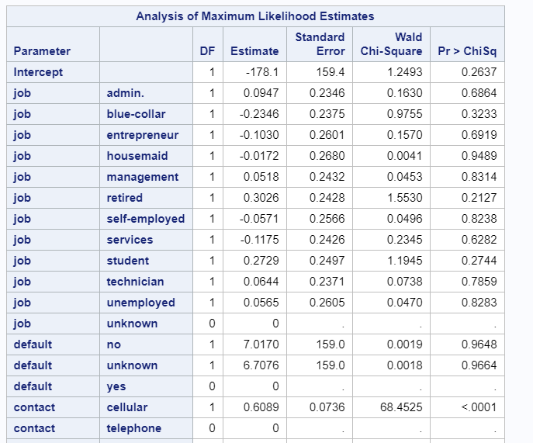
A model for the researchhe data we created: Equation

Slide 8
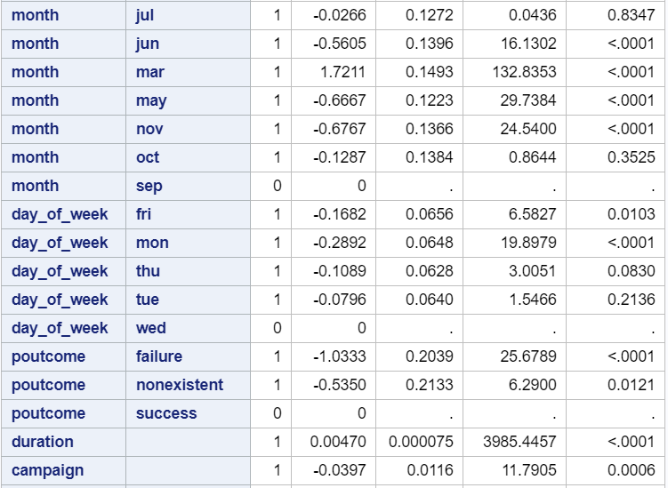
A model for the researchhe data we created: Equation

Slide 9
A model for the researchhe data
WE USE THE BINARY logistic regression in SAS to create the model
rEsponse: y
link function； LOGIT
explanatory vARIAbles
using THE BACKWARD ELImination method, WITH 0.05 significance level. WE USE TWO WAY INteractions ABOUT THE COFFFICIENT to filter out all the variables we donot needs.

Slide 10
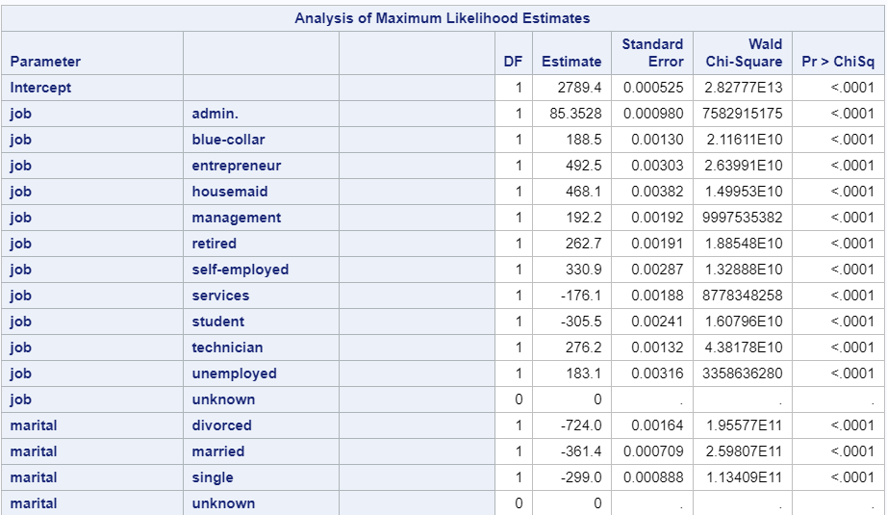
An interpretation of the model:

Slide 11
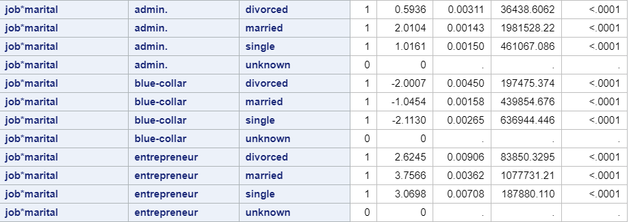
An interpretation of the model:

Slide 12
An interpretation of the model:
SIGNIFICANT:
all significant predictors are listed in Equation.
summary:
due to the estimates of divorced are SAMLLER THAN MARRIED PEOPLE,
DIVOrCED PEOPLE are less likely to open up the term deposit,
that might be they neeed to support more housing, eduaction.
comparing the table, PEOPLE ARE MARRIED in ADMIAN JOB or blue-collar or Entreneure are more LIKeLY TO OPEN term deposit. ( but married cat not say a determined factor)
entrepreneurand, maritle have preety higher coefficient comparing to others, they are more likly to open term deposit in general. maried people shows highest to open term deposit.
over all married people no matter what job they have are likely to open term deposit.

