Slide 1
Multicultural Perspective
Presented by International Center for Students and Scholars

Slide 2
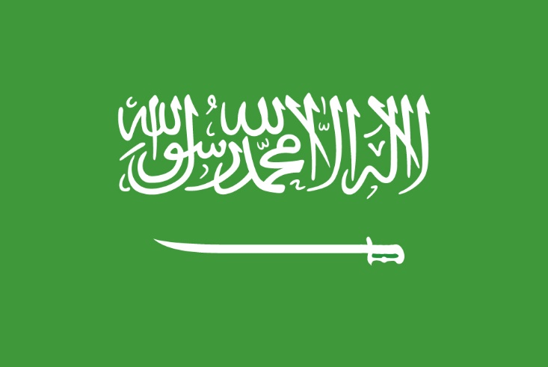
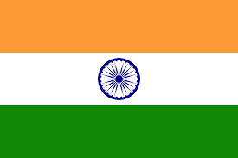
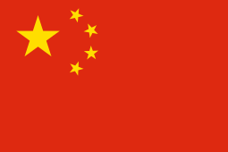
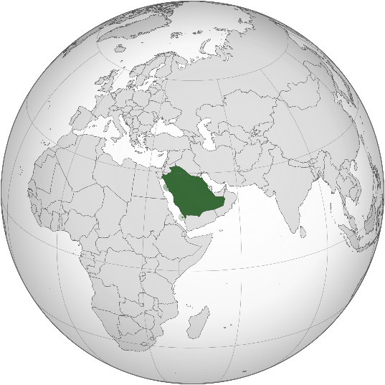
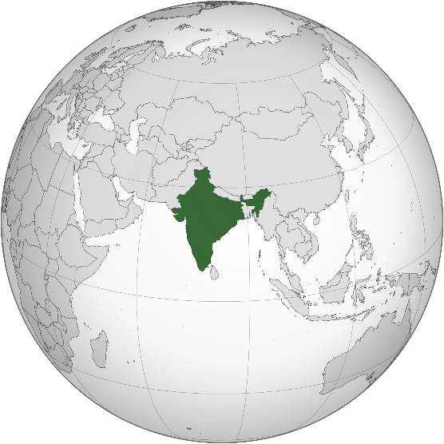
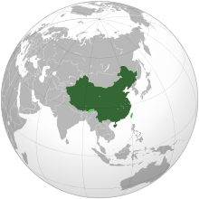
The Kingdom of Saudi Arabia
India
People’s Republic of China

Slide 3
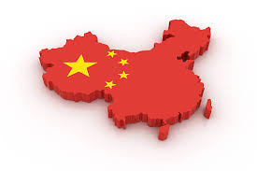
China

Slide 4
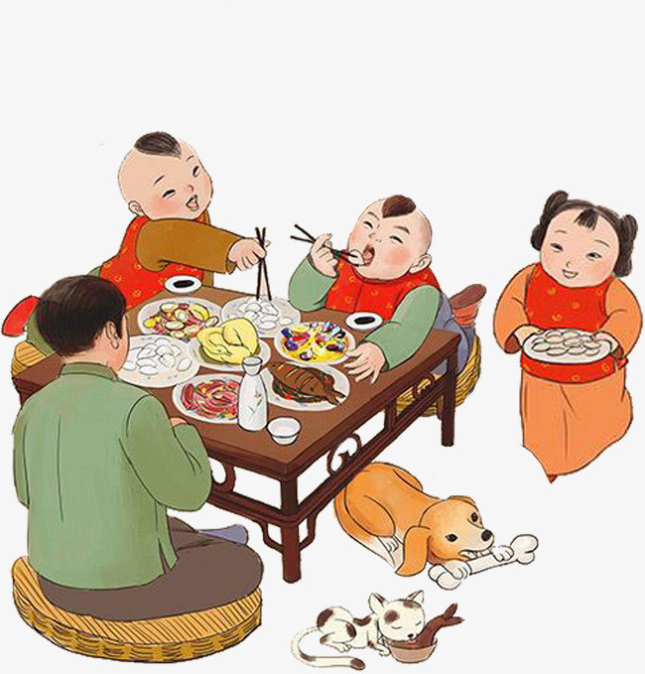
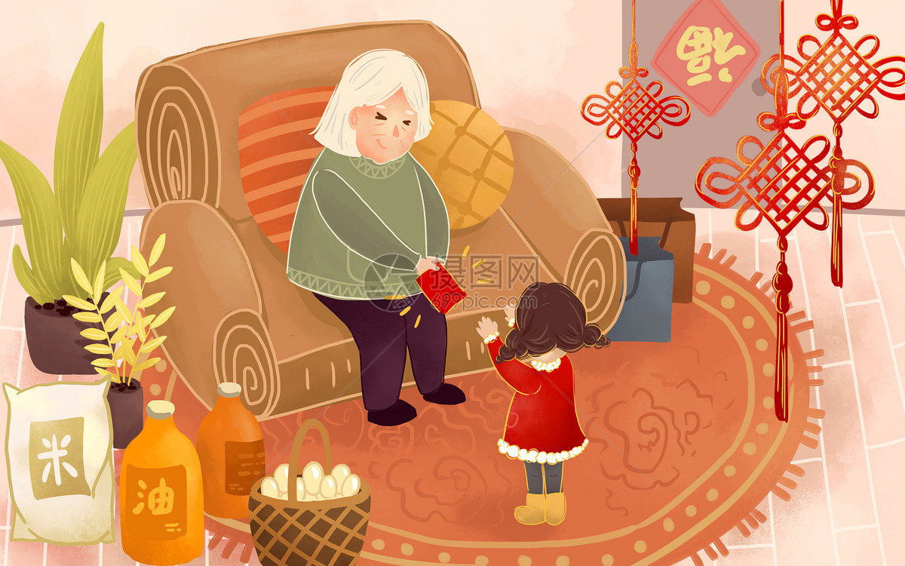
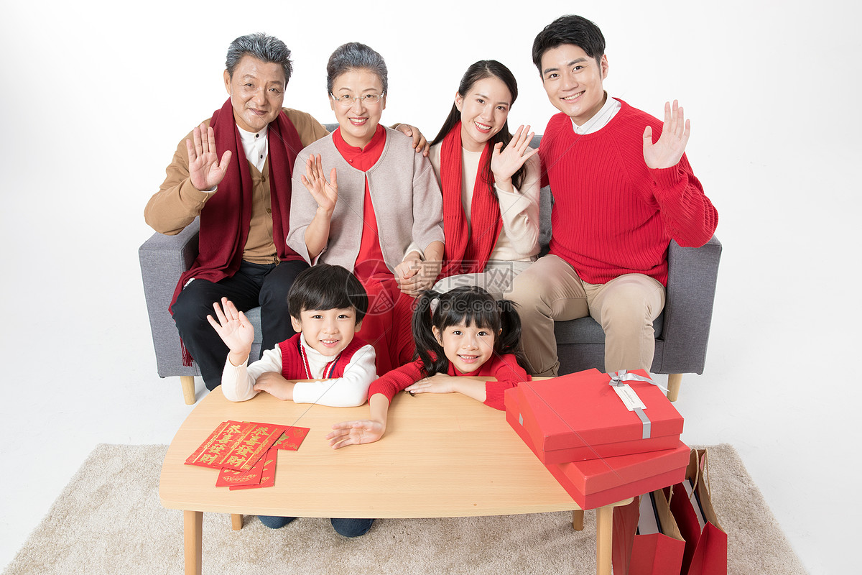
Chinese luna new year
Reunion
NewYear Eve Dinner
Red pack

Slide 5
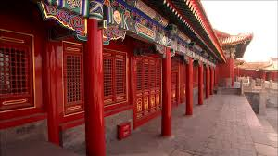
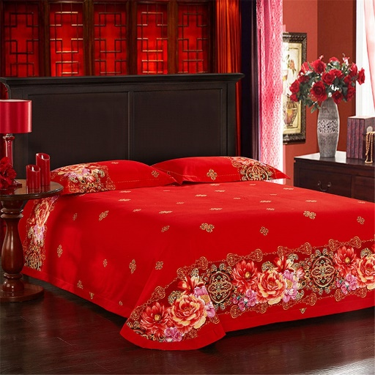
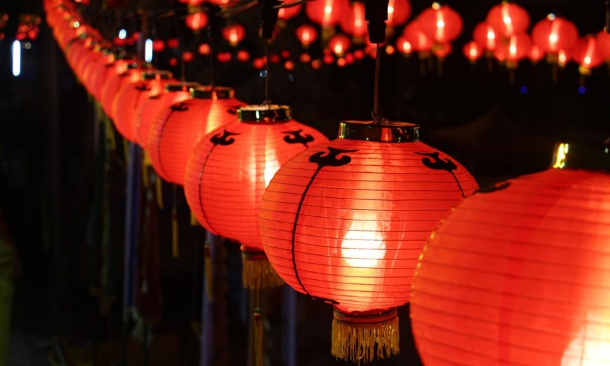
Color of China
What is the color that represents Chinese culture?
Red
it’s considered a lucky color in china
It represents beauty, happiness and good fortune
People wear red in weddings
Red envelopes are giving out during Chinese New Year
Why? What does red mean to you?

Slide 6
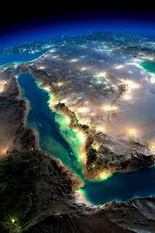
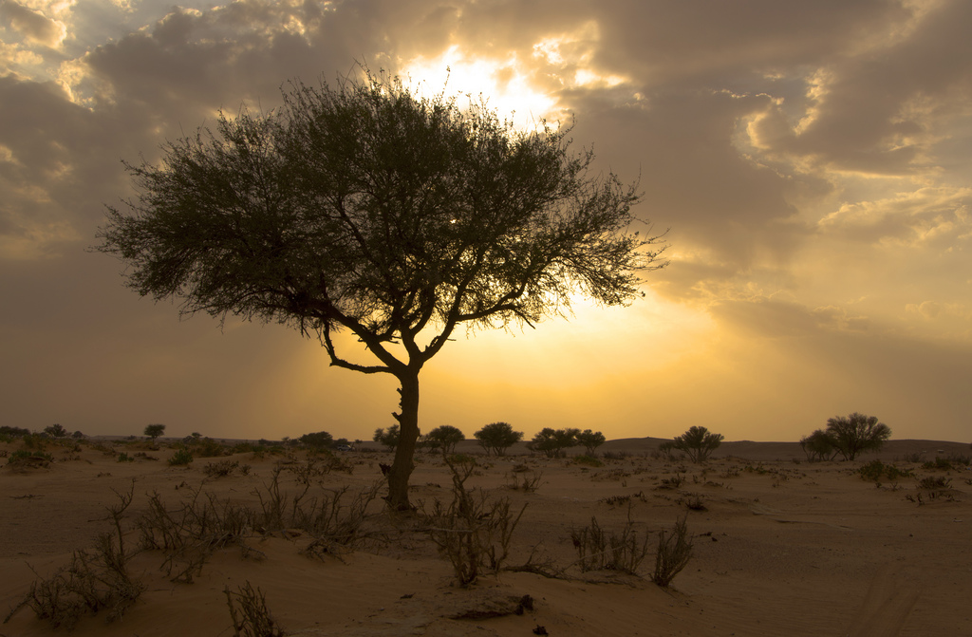
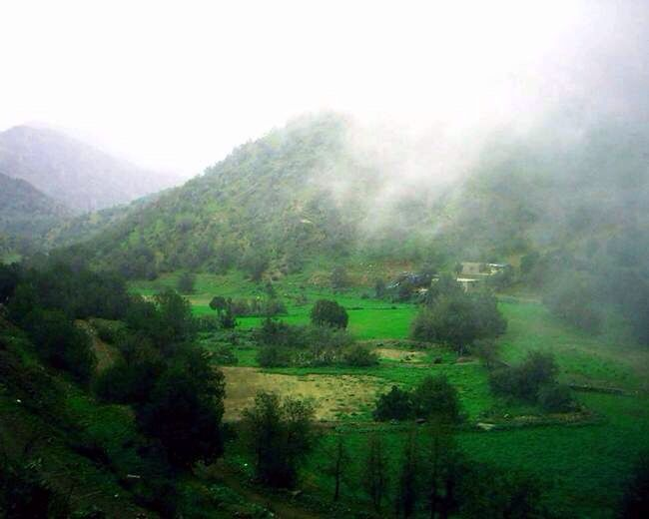
The Kingdom of Saudi Arabia

Slide 8
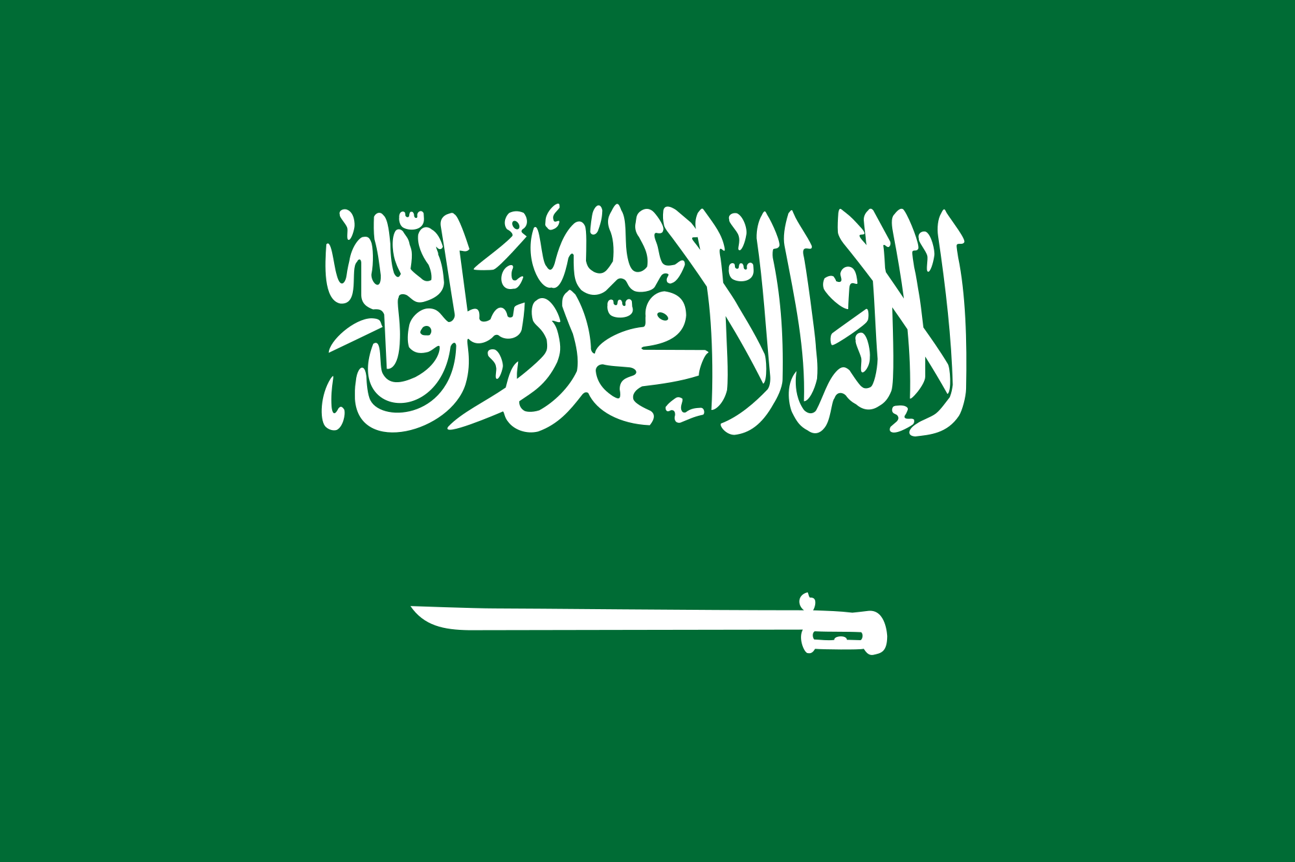
Color of Saudi Arabia and flag
What is the color that represents Saudi culture?
Green ( a color that globally used to represent Islam
The writing on the flag “لَا إِلٰهَ إِلَّا الله مُحَمَّدٌ رَسُولُ الله “
lā ʾilāha ʾillā-llāh, muhammadun rasūlu-llāh
There is no god but God; Muhammad is the Messenger of God.“
The sword
The flag never to be lowered to half-mast

Slide 9
Flag of the Umayyad Caliphate, from 661 to 750.
Flag of the Abbasid Caliphate, from 750 to 1517.f
Flag of the Emirate of Ha'il, from 1835 to 1920.
Flag of the Emirate of Ha'il, from 1920 to 1921.
Flag of the First Saudi State, from 1744 to 1818.
Flag of the Second Saudi State from 1824 to 1891
Flag of Nejd from 1921 to 1926
fFlag of Nejd from 1926 to 1932, with a white border and no sword.
Flag of the First Saudi State, from 1744 to 1818.
Provisional Flag of Hejaz, 1916 to 1917.
Flag of Hejaz from 1917 to 1920
Flag of Hejaz from 1920 to 1926..
Flag of Idrisid Emirate of Asir from 1906 to 1934.
Flag of Upper Asir from 1918 to 1923.

Slide 12
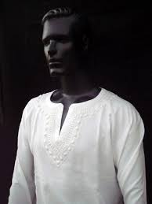
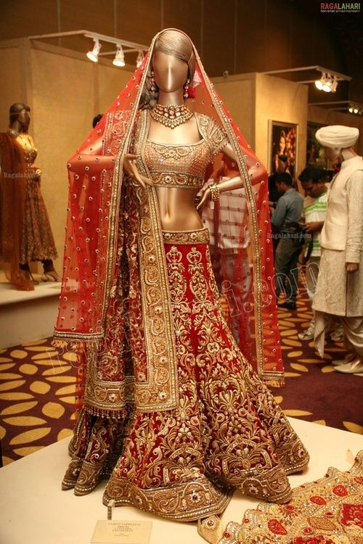
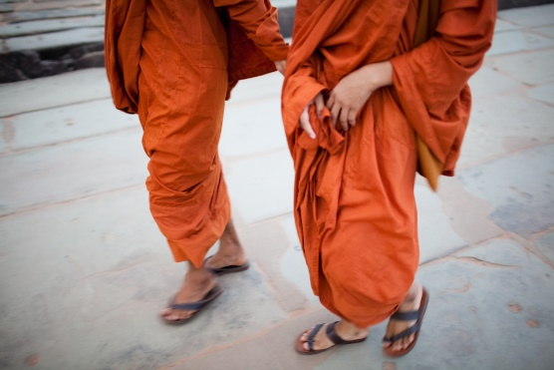
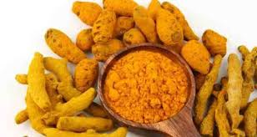
Colors of India
Red: In Northern India it stands for Purity and in the southern half for violence and disruption.
White: Color for peace and purity. Mostly worn during funerals and ceremony.
Orange (Saffron) : Dominant Color in India. Stands for courage and Sacrifice.
Green: Symbolizes harvest, new beginning and happiness and nature. A large part of religious group Islam is revered by green
Yellow: Sanctity. That’s the color of “haldi”. Used in most of the Food recipes (Curry)
Black: Evil, Negativity, desirability. Represents anger and darkness.

Slide 13
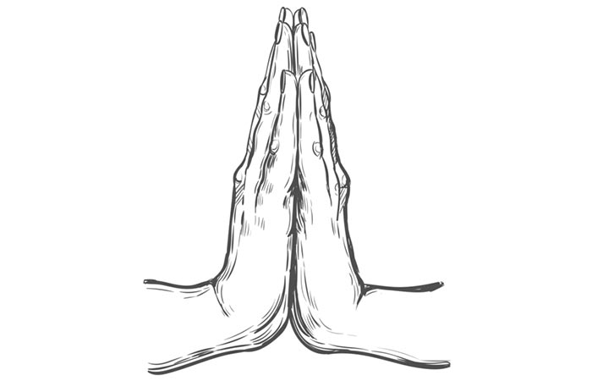
Etiquettes in India
The meet and Greet : Fold your hands and say ‘Namaste’. If you are the urban areas a simple hello is common.
Etiquette of Eating : Tradition to eat with right hand without the use of cutlery.
Giving and receiving gifts: Generally given with both the hands or the right hand.
Visit to an Indian Home: Indians love to host people and you often will be
invited to people home. Remove your shoes before steeping into the house,
some modern homes might allow you in with footwear.
Temple: Open your shoes before entering temples, mosques or other
religious places. Use right hand to accept prasad, usually given in these paces.

Slide 14
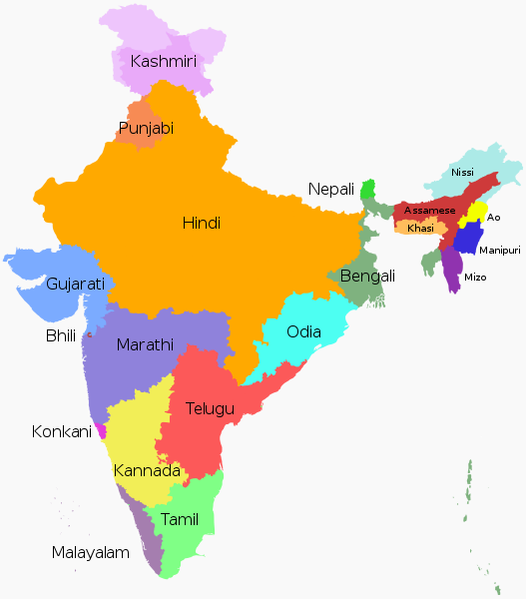
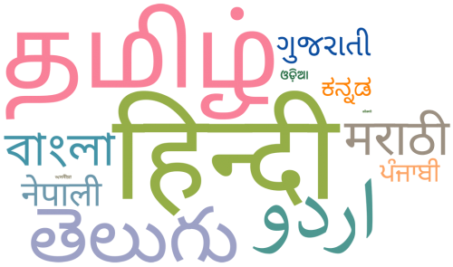
Languages spoken in India.
India has 23 constitutionally recognized official languages.
Hindi and English are the official languages used by the Central Government.
29 Languages with more than million speakers each.
Top 5 languages with number of speakers :
Hindi
Bengali
Telugu
Marathi
Tamil

Slide 15
Languages spoken in China.
Official language: Mandarin-Pu Tong Hua
Other languages spoken in China (Location based)
Cantonese-Guang Dong Hua
Min-Min Nan Hua
Wu
Xiang
Mongolian
Korean
And many more

Slide 16
Language spoken in Saudi Arabia
Arabic is the only language spoken and official in Saudi
English is considered a secondary language, but not used or officially presented.

Slide 17
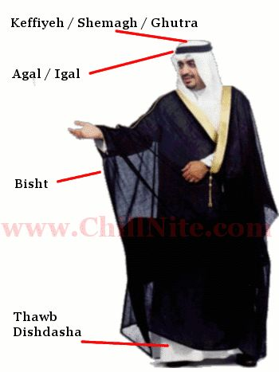
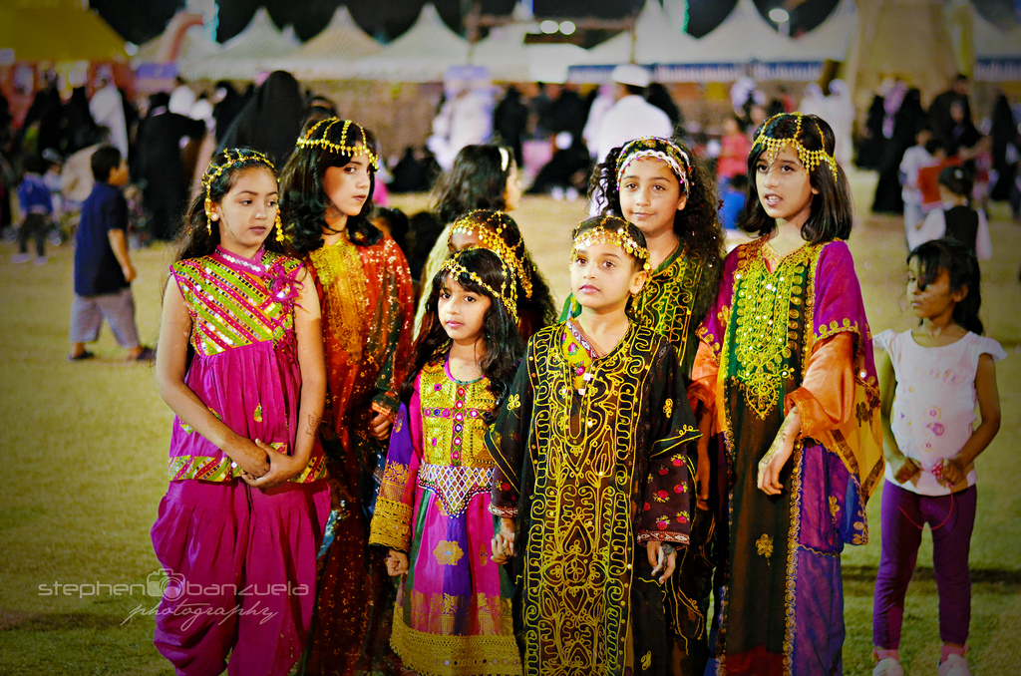
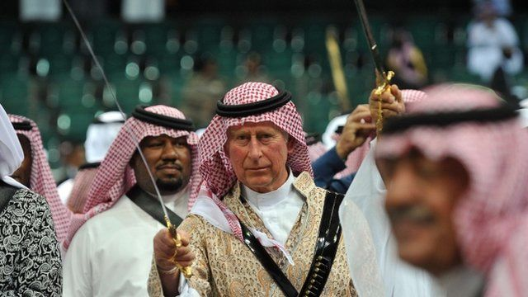
Clothing in Saudi Arabia

Slide 18
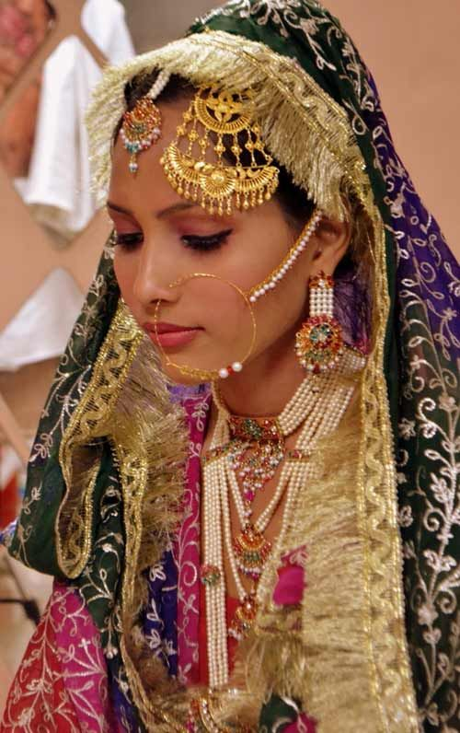
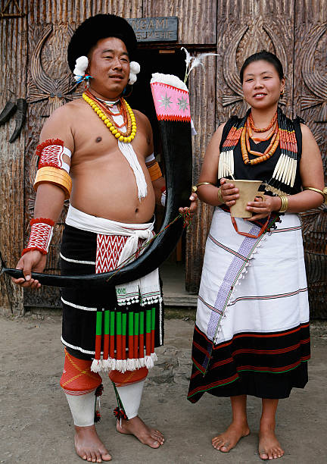
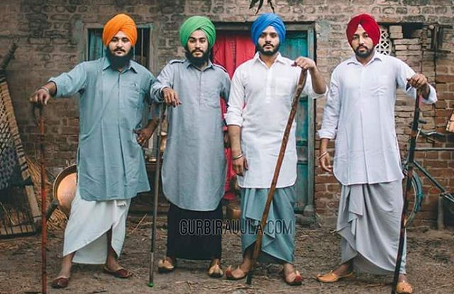
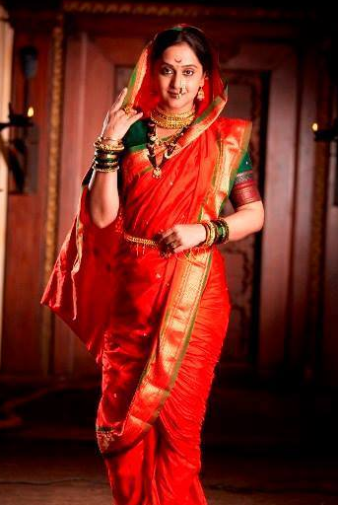
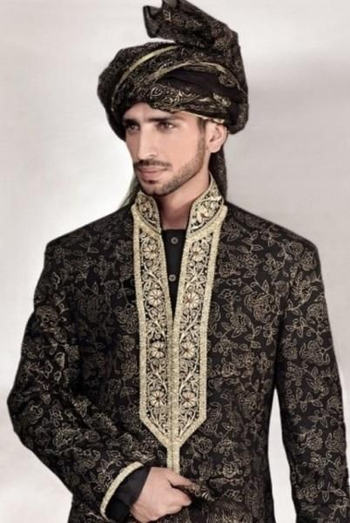
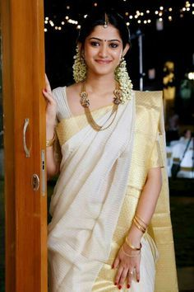
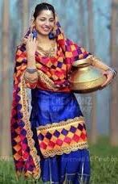
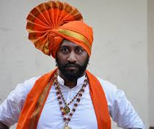
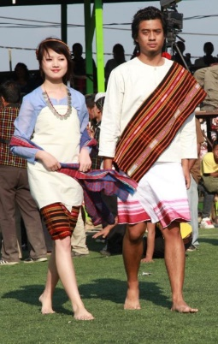
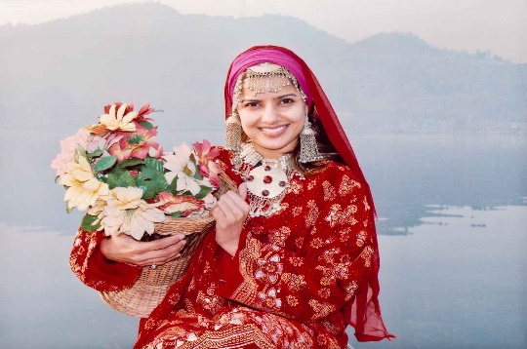
Clothing

Slide 19
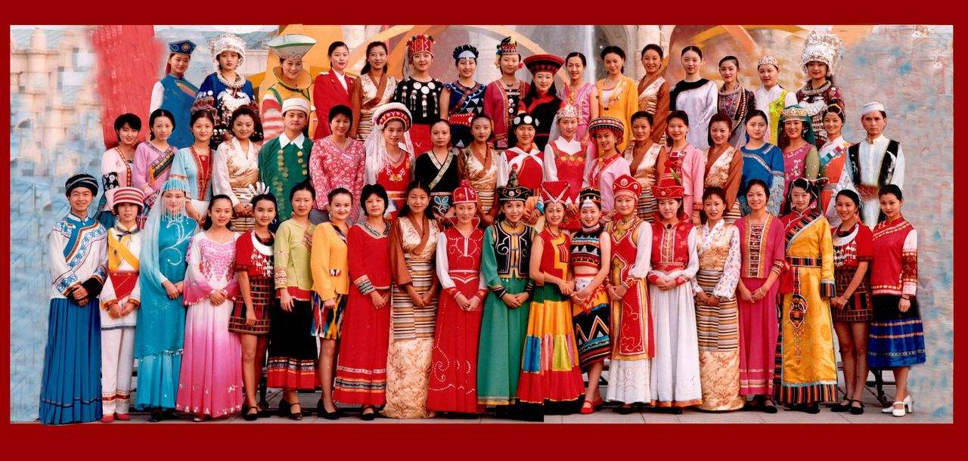
Ethnic Groups in China
56 different ethnic groups
Han and 55 minorities
Clothing-different ethnic have different clothing style.

Slide 20
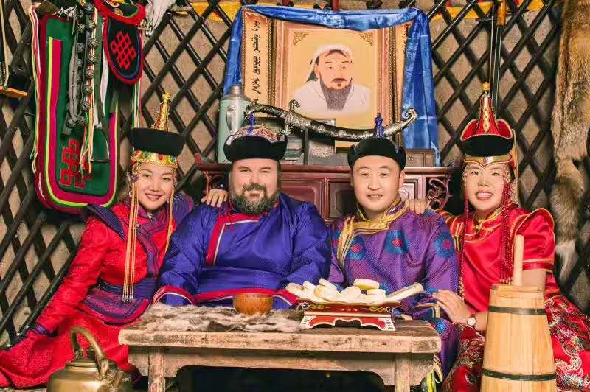
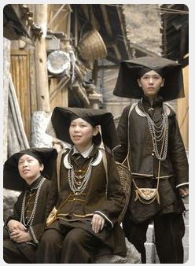
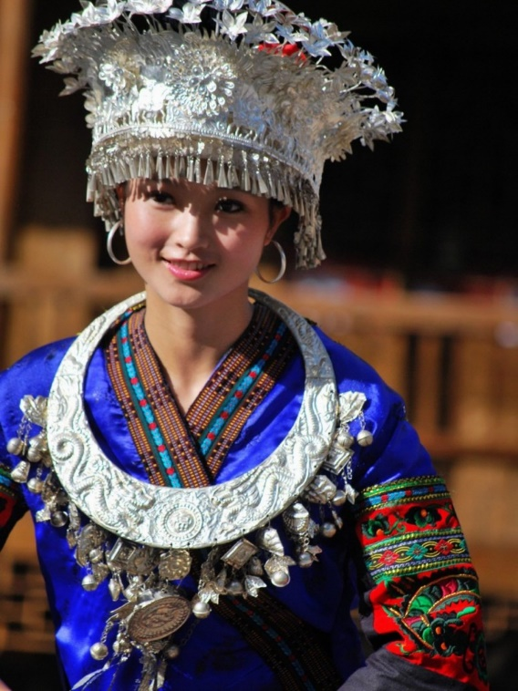
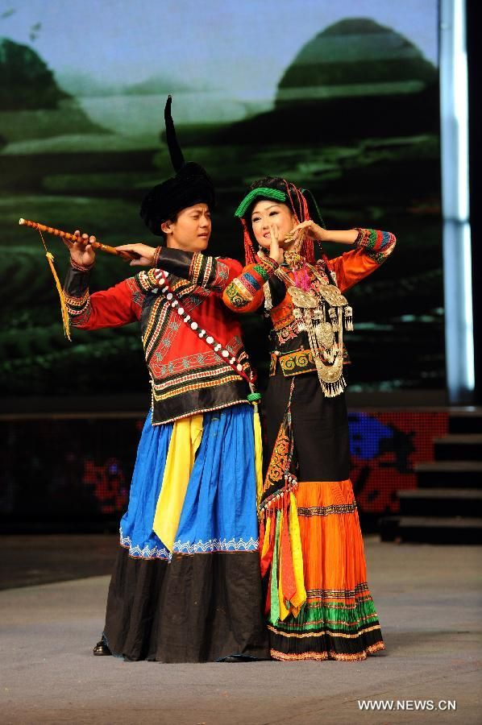
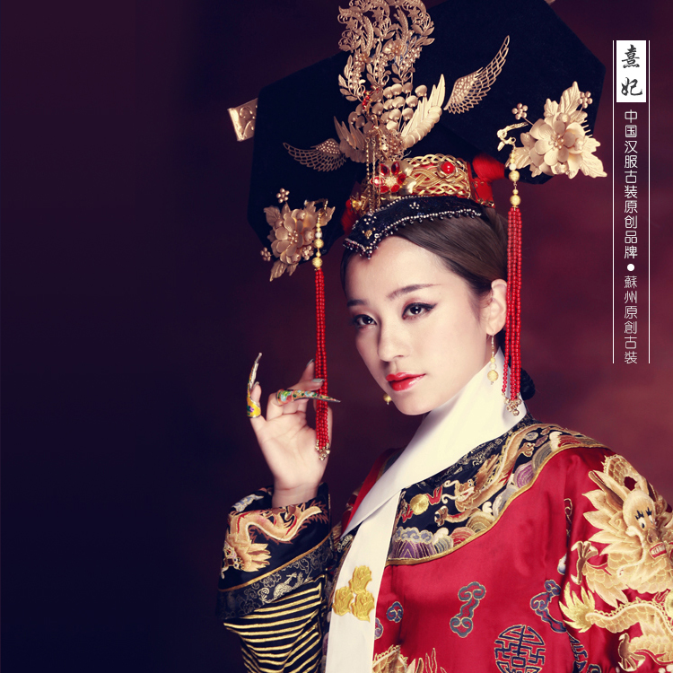
Clothing in China

Slide 21
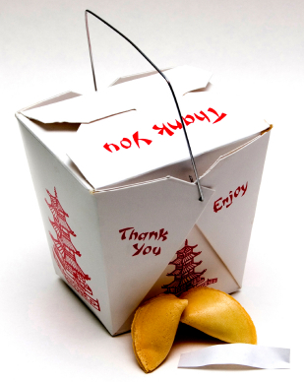
Food in china
Well known around the world.
It has grown in popularity and found its modifications along the way.
Fortune cookies?
Take out containers?

Slide 22
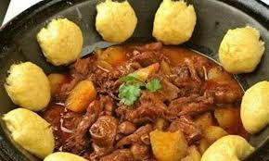
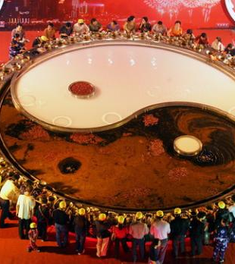
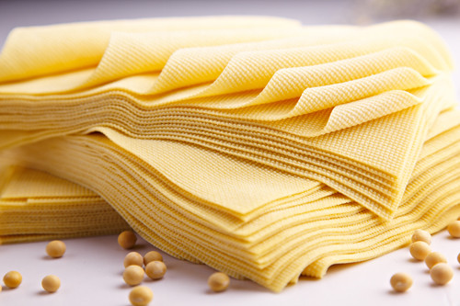
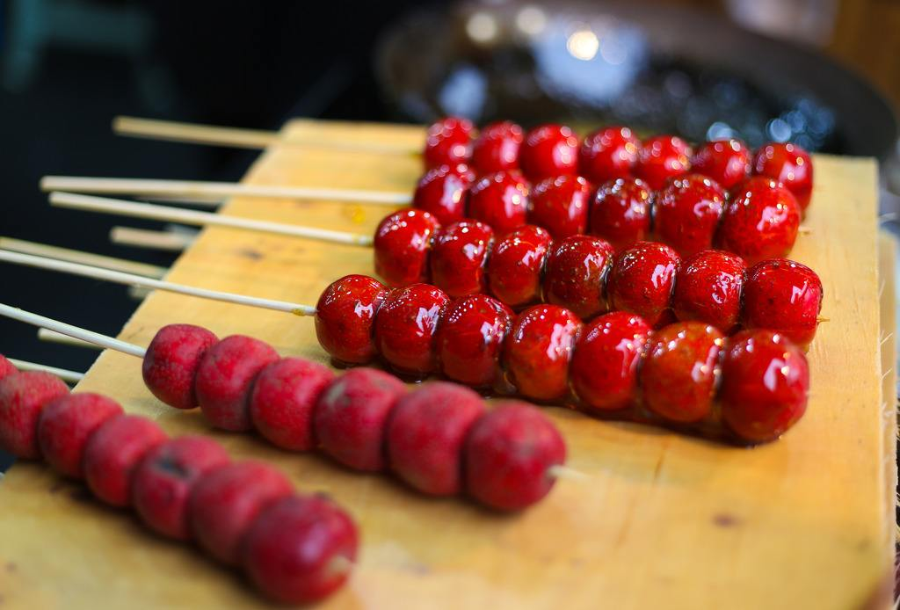
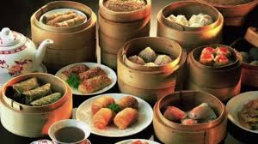
Food in China

Slide 23
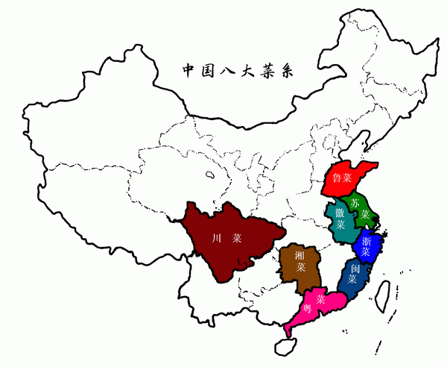
Traditional Chinese food
8 major styles of Traditional Chinese Food that can be attributed to the various territories in the country from which they originate.
Hunan/sichuan- spicy
Guangdong/Fujian-sweet
Shandong- salty
American Chinese food Modifications of Guangdong and Fujian Cuisine

Slide 24
Where to go for authentic Chinese food?
Shu Restaurant in Fairfield
Laosichuan in Milford
Xi’an Cuisine in New Haven
Hunan House in New Haven

Slide 25
Meat and Indian Bread. Mostly cooked in tandoor and curries are thick, moderate spicy and creamy.
Popular : Roti, Naan, Rajma, Daal Makhani, Chicken tikka, etc.
Punjab and North India
South Indian
Rice is the staple food.
Most dishes are coconut based.
Spicy and Hot, especially the
Chettinad cuisine. Hyderabad for
Biryani.
Popular : Boiled rise, Idlis, Dosa,
Sambar, etc.
This cuisine varies slightly with sweet touch in Gujarat to spicy in Maharashtra. It consists of all vegetarian platter to something mix with veggies, seafood and meat.
Popular : Dhokla, Vada Pav, Aamras, Chapati, etc.
Central India
FOOOOD

Slide 26
Food
Kabsa
Areeka
Saleeq
Notes:
Kabsa :
Areeka:
Saleeq:

Slide 27
Holidays
Eid Al-Fitr
“ Breaking the fast’ Religious holiday where it is celebrated by Muslims
The end of Ramadan ( the holy month )
Eid Al-Adha
‘ Feast of the sacrifice’
Holier of the two holidays
History
1/3 of the sacrifice
https://www.instagram.com/ssclub.ub/

Slide 28
Holidays
Lunar Calendar
Last day of Lunar year –Chinese New Year Eve (Yuandan)
1st of January-Chinese New Year (Chunjie)
15th of January-Lantern Festival (Yuanxiaojie)
5th of May-Dragon Boat Festival
Dragon-good
7th of July-Qixi Festival
15th of August-Mid-Autumn Festival
Solar calendar
Labor day ( May 1st )
National day (Oct. 1st)

Slide 29
FESTIVALS of INDIA
DIWALI, CHRISTMAS
BIHU
ONAM , PONGAL
EID , HOLI

Slide 30
A Religious Paradise

Slide 31
Four Levels of Culture
"Cultural knowledge"
know about some cultural characteristics, history, values, beliefs, and behaviors of another ethnic or cultural group.
1
"Cultural awareness“
next stage of understanding other groups -- being open to the idea of changing cultural attitudes.
2
"Cultural sensitivity"
knowing that differences exist between cultures, but not assigning values to the differences (better or worse, right or wrong).
3
"Cultural competence"
brings together the previous stages -- and adds operational effectiveness.
4
Notes:
"Cultural sensitivity" is knowing that differences exist between cultures, but not assigning values to the differences (better or worse, right or wrong). Clashes on this point can easily occur, especially if a custom or belief in question goes against the idea of multiculturalism. Internal conflict (intrapersonal, interpersonal, and organizational) is likely to occur at times over this issue. Conflict won't always be easy to manage, but it can be made easier if everyone is mindful of the organizational goals.

Slide 33
Cross-culture checklist
Eye contact
Touch/personal space
Humor
Motivation
Small talk
Saving face
Show emotions: anger/affection

Slide 34
International Centers for Students and Scholars
Coffee Hours

Slide 35
Comparison discussion
What numbers are considered lucky, and what are bad luck?
What about eye contact?

Slide 36
Questions?

Slide 37
Thank you!
International Center for Students and Scholars (2019)

