Slide 1
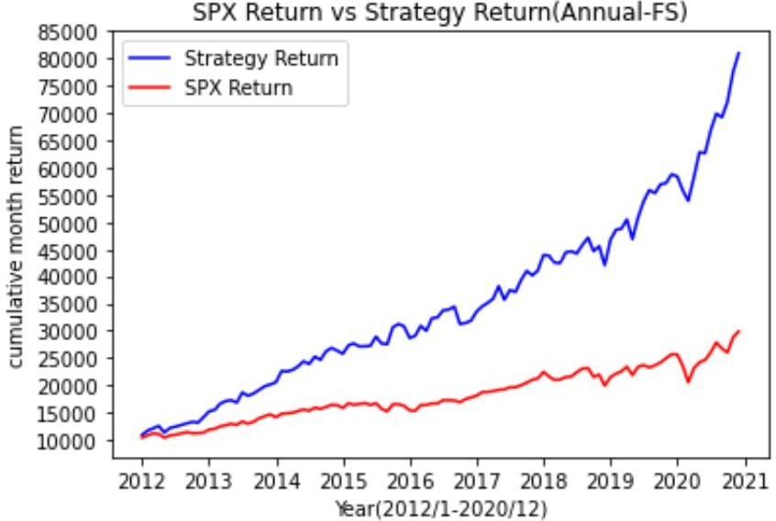
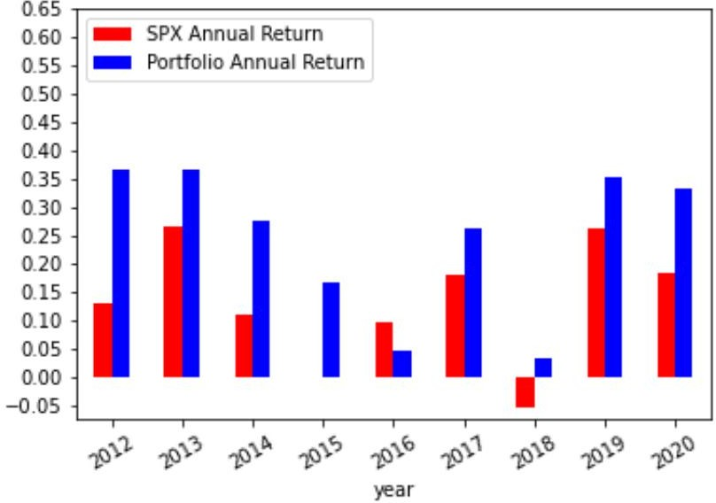
Portfolio Performance (2012-2020)
80% Momentum score & Fscore > 6
CAGR(Strategy): | 0. 26
SharpRatio(Strategy): | 1.57
Max-Drawdown(Strategy): | 0. 11
Volatility(Strategy): | 0.15
Portfolio Link:
https://docs.google.com/spreadsheets/d/1aO_91jp6CCWlfiBTKGe5ASzKmSHf4v67mxBCrtoEXGs/ edit?usp=sharing
CAGR(SPY):
SharpRatio(SPY):
Max-Drawdown(SPY): Volatility(Strategy):
0. 13
0. 78
0. 2
0.13

Slide 2
Portfolio Performance (2006-2020)
CAGR(Strategy): SharpRatio(Strategy):
Max-Drawdown(Strategy): Volatility(Strategy):
0. 18
0.89
0. 39
0.17
CAGR(SPY):
SharpRatio(SPY):
Max-Drawdown(SPY): Volatility(Strategy):
0. 07
0. 34
0. 52
0.15

Slide 3
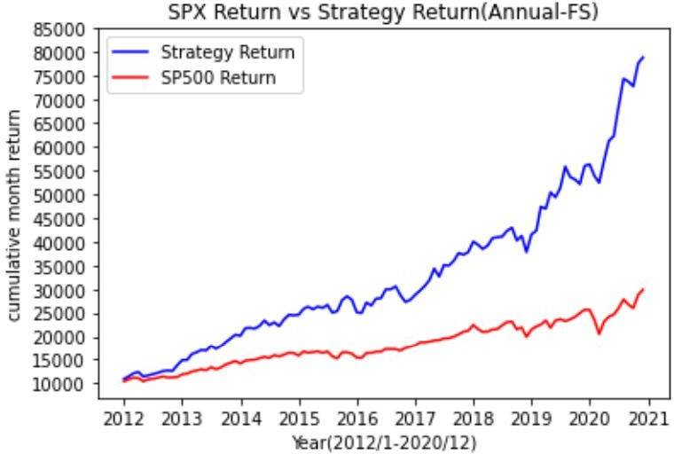
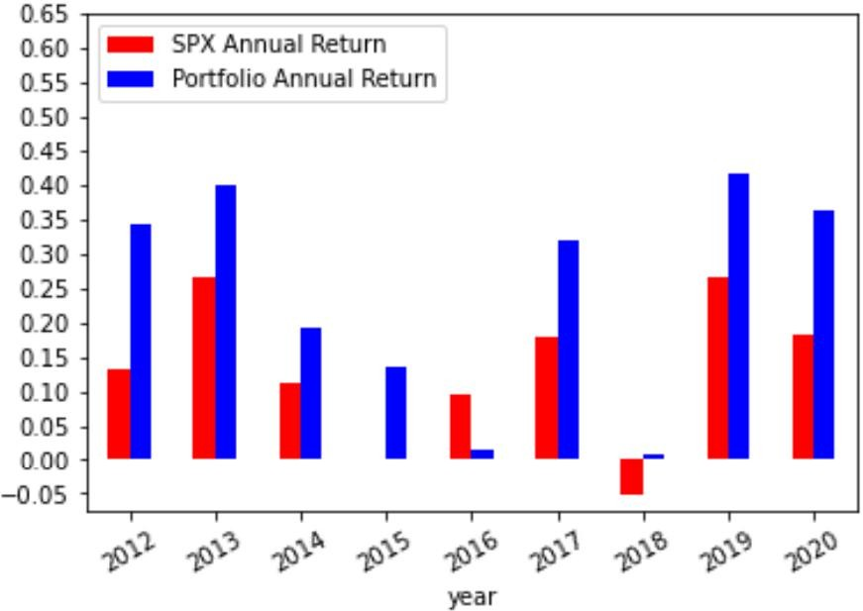
Portfolio Performance (2012-2020)
Momentum score >0 & Fscore >=6 (2012-2020)

