Slide 1
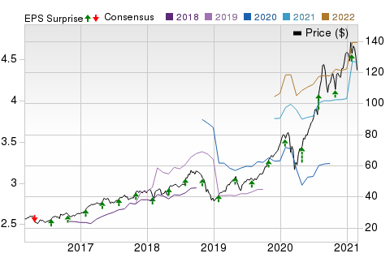
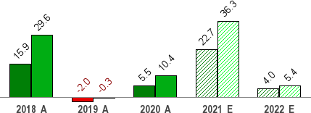
Our Research
Your Sucess
Feb 28, 2021
Apple Inc. (AAPL)
$121.26 (As of 02/26/21)
Price Target (6-12 Months): $145.00
Long Term: 6-12 Months SEABRIDGE Recommendation: Outperform
(Since: 01/29/21)
Prior Recommendation: Neutral
Short Term: 1-3 Months SEABRIDGE Rank: (1-5)
SEABRIDGE Style Scores:
2-Buy
VGM: B
Momentum: D
Value: D Growth: A
Summary
Price, Consensus & Surprise
Apple’s first-quarter fiscal 2021 results reflected continued momentum in the Services segment, driven by a robust performance of App Store, Cloud Services, Music, advertising, AppleCare and payment services. Moreover, iPad, Mac and Wearables contributed strongly to the quarterly results. Further, iPhone sales increased due to strong demand for iPhone 12 devices. China and Japan iPhone sales increased significantly. Apple did not provide any guidance due to uncertainties triggered by the pandemic. Apple’s near-term prospects are bright, driven by new iPhones that support 5G, revamped iPad and Mac line-up of devices, health-focused Apple Watch and robust growth in the Services business. However, increasing scrutiny and legal woes over App Store is a headwind. Shares have underperformed the S&P 500 year to date.
Data Overview
52 Week High-Low | $145.09 - $53.15
20 Day Average Volume (sh) | 92,349,312
Market Cap | $2,035.7 B
YTD Price Change | -8.6%
Beta | 1.27
Dividend / Div Yld | $0.82 / 0.7%
Industry | Computer - Mini computers
SEABRIDGE Industry Rank | Top 1% (3 out of 253)
Last EPS Surprise | 19.2%
Last Sales Surprise | 8.7%
EPS F1 Est- 4 week change | 10.2%
Expected Report Date | 04/29/2021
Earnings ESP | 0.0%
P/E TTM | 16.1
P/E F1 | 27.1
PEG F1 | 2.6
P/S TTM | 6.9
Salse and EPS Growth Rates (Y/Y %)
Sales Estimates (millions of $)
 | Q1 | Q2 | Q3 | Q4 | Annual*
2022 | 112,503 E | 79,707 E | 73,688 E | 83,882 E | 350,278 E
2021 | 111,439 A | 77,548 E | 68,749 E | 79,169 E | 336,812 E
2020 | 91,819 A | 58,313 A | 59,685 A | 64,698 A | 274,515 A
EPS | Estimates
 | Q1 | Q2 | Q3 | Q4 | Annual*
2022 | $1.67 E | $1.05 E | $0.94 E | $1.12 E | $4.71 E
2021 | $1.68 A | $0.99 E | $0.82 E | $1.00 E | $4.47 E
2020 | $1.25 A | $0.64 A | $0.65 A | $0.73 A | $3.28 A
*Quarterly figures may not add up to annual.
The data in the charts and tables, including theSEABRIDGE FINTECH Consensus EPS and sales estimates, is as of 02/26/2021. The report's text and the analyst-provided price target are as of 02/23/2021.
Past performance is no guarantee of future results. Please see important disclosures and definitions at the end of this report.
© 2021SEABRIDGE Investment Research, All Rights Reserved

Slide 2
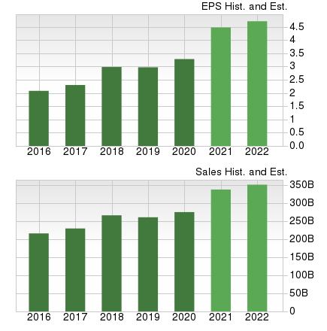
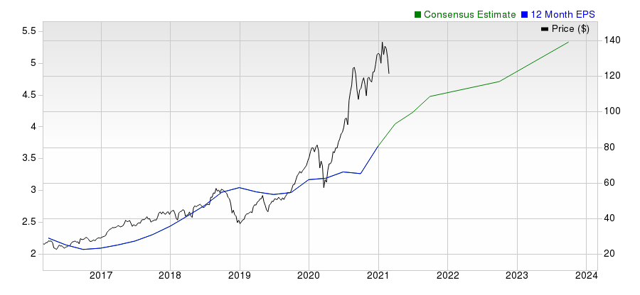
Overview
Apple’s business primarily runs around its flagship iPhone. However, the Services portfolio that includes revenues from cloud services, App store, Apple Music, AppleCare, Apple Pay, and licensing and other services now became the cash cow.
Moreover, non-iPhone devices like Apple Watch and AirPod gained significant traction. In fact, Apple dominates the Wearables and Hearables markets due to the growing adoption of Watch and AirPods. Solid uptake of Apple Watch also helped Apple strengthen its presence in the personal health monitoring space.
Headquartered in Cupertino, CA, Apple also designs, manufactures and sells iPad, MacBook and HomePod. These devices are powered by software applications including iOS, macOS, watchOS and tvOS operating systems.
Apple’s other services include subscription-based Apple News+, Apple Card, Apple Arcade, new Apple TV app, Apple TV channels and Apple TV+, a new subscription service.
In fiscal 2020, Apple generated $274.52 billion in total revenues. The company’s flagship device iPhone accounted for 50.2% of total revenues. Services, Mac, iPad and Other products category contributed 19.6%, 11.2%, 8.6% and 10.4%, respectively.
Apple primarily reports revenues on a geographic basis, namely the Americas (North & South America), Europe (European countries, India, Middle East and Africa), Greater China (China, Hong Kong & Taiwan), Japan and Rest of Asia Pacific (Australia & other Asian Countries).
In fiscal 2020, Americas, Europe, Greater China, Japan and Rest of Asia-Pacific accounted for 45.4%, 25%, 14.7%, 7.8% and 7.1% of total revenues, respectively.
Apple faces stiff competition from the likes of Samsung, Xiaomi, Oppo, Vivo, Google, Huawei and Motorola in the smartphone market. Lenovo, HP, Dell, Acer and Asus are its primary competitors in the PC market. Other notable competitors are Google & Amazon (smart speakers) and Fitbit & Xiaomi (wearables).
www.seabridgefintech.com/

Slide 3
Reasons To Buy:
Apple’s Services and Wearables businesses are expected to drive top-line growth in fiscal 2021 and beyond. Although Apple’s business primarily runs around its flagship iPhone, the Services portfolio has emerged as the company’s new cash cow. Apple’s endeavors to open up its ecosystem, through partnerships with the likes of Samsung and Amazon, are positive for the Services segment. The subscription-based video streaming, news and gaming services are expected to benefit from Apple’s strong installed base. Robust App Store sales coupled with solid adoption of Apple Pay and Apple Music helped Apple double its 2016 Services revenues six months ahead of its targeted 2020-end. Moreover, its wearables and hearables business is expected to be driven by solid demand for Apple Watch and Airpods.
Apple is benefiting from momentum in the Services business, strong adoption of Apple Pay and growing Apple Music subscriber base.
Apple currently has more than 620 million paid subscribers across its Services portfolio. The App Store continues to draw the attention of prominent developers from around the world, helping the company offer appealing new apps that drive App Store traffic. Further, growing number of AI-infused apps will attract more subscribers on App Store. Notably, more than 30,000 third-party subscription apps are available on App Store and the largest of them accounts for only 0.25% of Apple’s total Services revenues.
Apple Pay, designed on the basis of a contactless payment (NFC) technology, has been expanded to several markets. Apple Pay allowed entry to more than 150 stadiums, ballparks, arenas and entertainment venues around the world with contactless tickets. Moreover, users could ride public transport in Shanghai, Beijing, Tokyo, Moscow, London and New York. Users can also access dorms and services of additional universities across the United States through Apple Watch and iPhone. The growing adoption of contactless payment primarily due to coronavirus pandemic bodes well for Apple Pay.
Further, Apple Music has more than 60 million paid subscribers. The service offers more than 60 million songs, with world class music experts and taste makers curating thousands of playlists and daily selections in 115 countries. Apple Music’s availability on Amazon Echo devices is expected to expand the iPhone maker’s footprint against Spotify, which is currently the dominant player in the paid, premium music streaming market. The partnership with Verizon is also noteworthy in this regard. Moreover, the company’s partnership with National Basketball Association for an Apple Music playlist that features independent artists from an emerging label, UnitedMasters, is expected to draw new subscribers who are fans of NBA games.
Apple is encouraging developers to use artificial intelligence (AI) and machine learning in their apps. The company’s Core ML 2 API helps developers recognize faces or animals in photos, and parse the meaning of text. Further, the company is offering Create ML for simple and efficient machine learning training on the Mac, which is built on top of Swift programming language. Notably, Apple has hired former Google head of search and AI, John Giannandrea to lead its restructured AI division that includes the machine learning division, Siri team and the Core ML API team. In addition to all these, acquisition of start-ups like Silk Labs enhances the company’s expertise in the domain.
Apple’s focus on autonomous vehicles and augmented reality/virtual reality (AR/VR) technologies presents growth opportunity in the long haul. These are fast emerging as lucrative business opportunities. To ramp up its efforts, Apple has acquired several smaller firms with expertise in AR hardware, 3D gaming and VR software. These include SensoMotoric, Flyby Media, Emotient, TupleJump, Turi, Metaio, PrimeSense and Lattice Data Inc. In addition, Apple’s ARKit is helping third-party developers to work on creating AR experiences for its iOS platform. Furthermore, Apple, with its new offerings, would also be able to leverage the Internet of Things (IoT) market, which is expected to grow exponentially, given the rising demand for connected/automated devices, appliances and automobiles.
Apple has a strong balance sheet and generates significant cash flow. As of Dec 26, 2020, cash & marketable securities were $195.57 billion compared with $191.83 billion as of Sep 26, 2020. Term debt, as of Dec 26, 2020, was $107.04 billion, up from $101.56 billion as of Sep 26, 2020. Apple returned $30 billion in the reported quarter through dividend payouts ($3.6 billion) and share repurchases ($24 billion). These factors make Apple an attractive stock for investors.
www.seabridgefintech.com/

Slide 4
Risks
Apple’s fortunes are tied to its most important offering, iPhone. The device plays an important role in expanding the iOS ecosystem. However, Apple’s excessive dependence on iPhone is a risk to overall growth. Although iPhone sales have been benefiting from higher average selling price (ASP), premium pricing has been blamed for Apple’s declining market share in countries like China and India. Moreover, the smartphone segment is chock-a-block with attractive devices from Samsung, Huawei, Xiaomi, Oppo, and Vivo that are intensifying competition for the company. Moreover, Apple is yet to launch a 5G-supported iPhone, which is a concern.
China is an important market for Apple, given the growing number of middle-class customers. However, the waning macroeconomic environment in China and the intensifying competition have dented shipment growth. Moreover, the supply-chain disruption caused by the coronavirus outbreak in China is expected to hurt iPhone’s demand and supply globally, at least in the near term.
Competition has negatively impacted iPad’s growth, with Amazon, HTC, Microsoft, Hewlett-Packard and others flooding the tablet market. iPad demand has severely declined due to increasing availability of large-screen smartphones, in addition to stiff competition from Google Chromebooks and Microsoft Surface. Moreover, Apple faces significant competition in the desktop and portable computer segment from the market leader Lenovo and the likes of Hewlett-Packard, Dell, Acer and Asus. MacBook has failed to become a key product, due to Apple’s shortage of innovation in this product line as compared to iPhone and iPad.
Apple is facing increasing regulatory hassles in Europe. The European Commission is opening two antitrust investigations into Apple’s App Store and Apple Pay practices over concerns that the company’s way of doing business hurts consumers by limiting choice and innovation and keeping prices high. Notably, music-streaming service Spotify has filed a formal complaint against Apple, alleging unfair practice by the iPhone maker to lower competition. The complaint relates to the 30% revenue cut that the company takes from some app providers. Further, Fortnite developer Epic Games filed a lawsuit against Apple after the hit game was removed from App Store. Apple stated that the game violated its software-distribution platform guidelines and has countersued Epic Games. Moreover, the Supreme Court has allowed the consumers’ antitrust lawsuit against Apple to continue in a lower court. The lawsuit alleges iPhone apps to be expensive. The company is also facing lawsuits in relation to health-monitoring features of Apple Watch.
Moreover, Apple is slapped with a record fine of €1.1 billion by French anti-trust regulators for engaging in anti-competitive practices. The regulators alleged that Apple favored Tech Data and Ingram Micro to align prices as well as limit wholesale competition for Apple products in France. The company is also ordered to pay a $500-million settlement for intentionally inhibiting/restricting the performance of older iPhone models to preserve batteries. Further, the U.S. Supreme Court repealed an appeal by Apple in a decade-long dispute wherein Nevada-based VirnetX is fighting to collect royalties from the company for secure communications technology used in the iPhone, iPad and Mac computers.
www.seabridgefintech.com/

Slide 5
Last Earnings Report
Apple's Q1 Earnings Beat, iPhone & Services Aid Top Line
Quarter Ending
12/2020
Apple reported first-quarter fiscal 2021 earnings of $1.68 per share that beat the SEABRIDGE Consensus Estimate by 19.2% and jumped 34.4% year over year.
Report Date Sales Surprise EPS Surprise Quarterly EPS
Annual EPS (TTM)
Jan 27, 2021
8.71%
19.15%
1.68
3.69
Net sales increased 21.4% year over year to $111.4 billion, which surpassed the SEABRIDGEs Consensus Estimate by 8.7%.
Services, along with iPad, Wearables and Mac, continued their momentum in the quarter under review. Services (14.1% of sales) revenues grew 24% from the year-ago quarter to $15.76 billion.
Product sales (85.9% of sales) increased 21% year over year to $95.68 billion.
Strong China & Japan Aid Top-Line Growth
Apple achieved double-digit growth and new all-time records in each of its five geographic segments. The company’s installed base of active devices passed 1.65 billion in the reported quarter.
Americas sales increased 11.9% year over year to $46.31 billion and accounted for 41.6% of total sales.
Europe generated $27.31 billion in sales, up 17.3% on a year-over-year basis. The region accounted for 24.5% of total sales. Greater China sales surged 57% from the year-ago quarter to $21.31 billion, accounting for 19.1% of total sales.
Japan sales soared 33.1% year over year to $8.29 billion, accounting for 7.4% of total sales.
Rest of the Asia Pacific generated sales of $8.23 billion, up 11.5% year over year. The region accounted for 7.4% of total sales.
iPhone Sales Increase Y/Y
iPhone sales increased 17.2% from the year-ago quarter to $65.59 billion and accounted for 58.9% of total sales. The robust year-over-year growth was driven by strong demand for the iPhone 12 family.
Markedly, iPhone’s active installed base is now more than 1 billion.
Apple quoted a recent survey report from 451 Research which stated that customer satisfaction was 98% for the iPhone 12 family in the reported quarter.
Services Momentum Continues
Services maintained momentum in the reported quarter. Apple set quarterly record for the App Store, Cloud Services, Music, advertising, AppleCare and payment Services.
Apple TV+, Apple Arcade, Apple News+, Apple Card, Apple Fitness+ and Apple One bundle also contributed to overall growth. These new services continue to add users, content and features.
Apple now has more than 620 million paid subscribers across its Services portfolio, up 35 million sequentially and 140 million year over year.
iPad & Mac Jump on Strong Demand
iPad sales of $8.44 billion jumped 41.1% year over year and accounted for 7.6% of total sales. Sales grew strong double digits in every geographic segment, including an all-time record in Japan.
Mac sales of $8.68 billion increased 21.2% from the year-ago quarter and accounted for 7.8% of total sales. The year-over-year growth was driven by strong adoption of the new MacBook Air, MacBook Pro and Mac Mini powered by Apple’s brand-new M1 chip.
Apple quoted a recent survey report from 451 Research which stated that overall consumer satisfaction was 94% for iPad and 93% for Mac in the quarter under review.
Wearables’ Robust Performance
Wearables, Home and Accessories sales increased 29.6% year over year to $12.97 billion and accounted for 11.6% of total sales.
Moreover, Apple Watch’s adoption rate grew rapidly. Notably, more than 75% of customers who purchased Apple Watch during the reported quarter were first-time customers.
Operating Details
Gross margin expanded 140 bps on a year-over-year basis to 39.8%. Moreover, gross margin increased 160 bps sequentially due to higher sales
www.seabridgefintech.com

Slide 6
and a strong revenue mix.
Products’ gross margin expanded 530 bps sequentially to 39.8%, driven by leverage and mix. Services’ gross margin was 68.4%, up 150 bps sequentially.
Operating expenses rose 11.9% year over year to $10.79 billion due to higher research & development (R&D), and selling, general & administrative (SG&A) expenses which increased 16% and 8.4%, respectively.
Operating margin expanded 220 bps on a year-over-year basis to 30.1%.
Balance Sheet
As of Dec 26, 2020, cash & marketable securities were $195.57 billion compared with $191.83 billion as of Sep 26, 2020. Term debt, as of Dec 26, 2020, was $107.04 billion, up from $101.56 billion as of Sep 26, 2020.
Apple returned $30 billion in the reported quarter through dividend payouts ($3.6 billion) and share repurchases ($24 billion).
Guidance
Apple didn’t provide revenue guidance, given the uncertainty around the impact of the coronavirus pandemic. However, management expects revenues to grow year over year.
Moreover, Apple expects Wearables, Home and Accessories’ year-over-year growth to decline in the first quarter. Further, Services are expected to face tough year-over-year comparison.
Gross margin is expected to be much similar to what was reported in the December quarter. Operating expenses are expected between $10.7 billion and $10.9 billion.
www.seabridgefintech.com

Slide 7
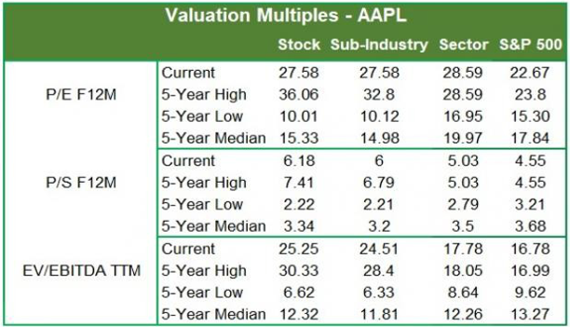
Recent News
On Jan 6, Apple released the 2020 retrospective of its Services business. Markedly, the company witnessed strong consumer spending on its App Store during the holiday season. The iPhone-maker announced that its App Store customer spending on digital goods and services totaled
$1.8 billion between Christmas Eve and New Year’s Eve.
Per a Reuters report on Dec 21, Apple is rumored to boost its driverless car initiative with plans to produce self-driving car technology and introduce the consumer vehicle that could include its own breakthrough battery technology by 2024.
Per a Nikkei Asia report on Dec 15, Apple is planning to increase production of iPhones in the first half of 2021 on strong demand for its 5G- enabled iPhone 12 as well as older iPhone 11 and iPhone SE. The Cupertino-based company expects to ship 95-96 million iPhones, indicating an increase of roughly 30% year over year.
On Dec 8, Apple launched its much anticipated new over-the-ear, wireless Airpods Max headphones, which retail at $549, in a bid to gain market share ahead of the holiday season. Additionally, Apple Fitness+ subscription services built for Apple Watch will be rolled out from Dec 14.
Per a Bloomberg report on Dec 7, Apple Music is now available on smart speakers from Google. Users of Google Nest Audio and Nest Mini, as well as of other providers like Lenovo, which use Google Assistant, can now listen to songs from Apple Music.
Per a Reuters report on Nov 20, Apple asked a federal judge overseeing the Alphabet-owned Google antitrust case to hide sensitive information from Google. Access to Apple's data could put the iPhone maker at a disadvantage when forging future deals with Google.
On Nov 18, Apple announced that it will reduce its App Store commission fees from 30% to 15% on paid apps and in-app purchases for small developers who earn less than $1 million in annual sales from their apps and those who are new to the store effective Jan 1, 2021. As part of Apple’s new App Store Small Business Program, the new commission structure is aimed at supporting small and individual developers as businesses adapt to a virtual world during the coronavirus pandemic.
On Nov 11, Apple in its “One more thing” product launch event, announced its first in-house chipsets for its Mac devices, the M1. Moreover, Apple launched its latest Mac offerings right ahead of the holiday season including a new MacBook Air laptop, a new 13-inch MacBook Pro laptop and Mac Mini desktop computer, all powered by the M1 chip.
On Oct 13, Apple introduced its first 5G-enabled iPhone 12 series at the “Hi Speed” virtual event. The iPhone 12 series comprises four new models - the iPhone 12, 12 mini, 12 Pro and 12 Pro Max. The company also introduced HomePod mini, an addition to its HomePod range of smart speakers.
Valuation
Apple shares are down 5% in the year-to-date period but up 69% over the trailing 12-month period. Stocks in the SEABRIDGE sub-industry are down 1.7%, while the same in the SEABRIDGE Computer & Technology sector are up 10% in the year-to-date period. Over the past year, the SEABRIDGE sub- industry and the sector are up 73.8% and 49.8%, respectively.
The S&P 500 index is up 4.5% in the year-to-date period and 23.3% in the past year.
The stock is currently trading at 27.58X forward 12-month earnings, which compares to 27.58X for the SEABRIDGE sub- industry, 28.59X for the SEABRIDGE sector and 22.67X for the S&P 500 index.
Over the past five years, the stock has traded as high as 36.06X and as low as 10.01X, with a 5-year median of 15.33X. Our Outperform recommendation indicates that the stock will perform better than the market. Our $145 price target reflects 31.72X forward 12-month earnings.
The table below shows summary valuation data for AAPL
As of 02/22/2021 Source: SEABRIDGE INVESTMENT RESEARCH
www.seabridgefintech.com

Slide 8
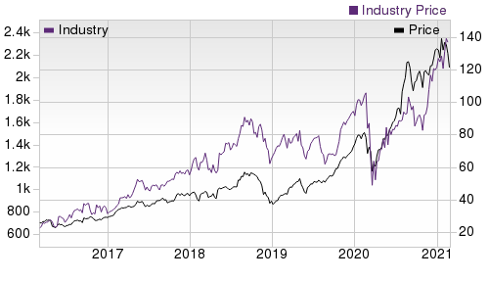
Industry Analysis SEABRIDGE Industry Rank: Top 1% (3 out of 253)
Top Peers
Company (Ticker) | Rec | Rank
Lenovo Group Ltd. (LNVGY) | Outperform | 1
Amazon.com, Inc. (AMZN) | Neutral | 3
Dell Technologies In…(DELL) | Neutral | 3
Alphabet Inc. (GOOGL) | Neutral | 3
Garmin Ltd. (GRMN) | Neutral | 3
HP Inc. (HPQ) | Neutral | 2
Microsoft Corporatio…(MSFT) | Neutral | 2
Spotify Technology S…(SPOT) | Neutral | 3
Industry Comparison Industry: Computer - Mini Computers
AAPL X Industry
Industry Peers
S&P 500
HPQ
LNVGY
MSFT
SEABRIDGE Recommendation (Long Term) Outperform
-
-
Neutral
Outperform
Neutral
SEABRIDGE Rank (Short Term)
2
-
-
2
1
2
VGM Score
C
-
-
B
A
D
Market Cap
2,035.72 B
25.67 B
27.20 B
36.11 B
15.23 B
1,752.66 B
# of Analysts
12
4
13
6
2
16
Dividend Yield
0.68%
0.93%
1.48%
2.68%
1.19%
0.96%
Value Score
F
-
-
A
A
D
Cash/Price
0.04
0.09
0.06
0.14
0.23
0.07
EV/EBITDA
26.34
8.20
14.95
8.66
7.74
24.49
PEG Ratio
2.64
2.18
2.32
1.99
0.47
2.65
Price/Book (P/B)
30.74
10.13
3.80
NA
3.89
13.46
Price/Cash Flow (P/CF)
30.11
20.00
15.39
9.89
9.31
30.81
P/E (F1)
27.13
19.65
20.41
10.81
12.19
31.66
Price/Sales (P/S)
6.92
3.78
3.10
0.63
0.27
11.43
Earnings Yield
3.69%
5.95%
4.82%
9.25%
8.22%
3.16%
Debt/Equity
1.50
0.53
0.68
-2.49
1.00
0.42
Cash Flow ($/share)
4.03
2.82
6.62
2.93
2.72
7.54
Growth Score
A
-
-
C
A
C
Hist. EPS Growth (3-5 yrs)
12.55%
12.55%
9.34%
2.40%
14.94%
21.45%
Proj. EPS Growth (F1/F0)
36.41%
67.89%
14.09%
17.54%
90.37%
27.42%
Curr. Cash Flow Growth
0.98%
-1.08%
0.52%
-3.13%
17.18%
17.66%
Hist. Cash Flow Growth (3-5 yrs)
1.15%
-8.27%
7.62%
-17.70%
4.06%
10.19%
Current Ratio
1.16
1.03
1.39
0.79
0.90
2.58
Debt/Capital
59.99%
50.11%
41.42%
NA
50.11%
29.74%
Net Margin
21.74%
3.67%
10.59%
5.61%
1.73%
33.47%
Return on Equity
90.59%
5.85%
14.65%
-209.76%
23.08%
42.19%
Sales/Assets
0.89
1.25
0.51
1.68
1.60
0.51
Proj. Sales Growth (F1/F0)
22.69%
10.70%
6.75%
3.17%
18.24%
14.33%
Momentum Score
D
-
-
C
F
D
Daily Price Chg
0.22%
0.07%
-0.84%
2.77%
-2.74%
1.48%
1 Week Price Chg
-4.06%
-2.74%
-0.16%
-1.42%
6.88%
-1.64%
4 Week Price Chg
-11.55%
-1.31%
2.75%
16.49%
3.04%
-2.74%
12 Week Price Chg
-1.37%
48.67%
5.58%
24.66%
72.68%
8.47%
52 Week Price Chg
77.33%
89.94%
20.43%
32.40%
102.54%
46.91%
20 Day Average Volume
92,349,312
6,943,303
2,018,241
8,129,683
77,616
24,783,290
(F1) EPS Est 1 week change
0.00%
0.00%
0.00%
0.25%
0.00%
0.00%
(F1) EPS Est 4 week change
10.18%
2.66%
0.45%
0.25%
5.06%
8.18%
(F1) EPS Est 12 week change
11.48%
13.06%
1.88%
1.07%
14.64%
8.91%
(Q1) EPS Est Mthly Chg
5.22%
0.84%
0.21%
1.69%
-7.84%
11.30%
www.seabridgefintech.com

Slide 9
SEABRIDGE Stock Rating System
We offer two rating systems that take into account investors' holding horizons:SEABRIDGE Rank and SEABRIDGE Recommendation. Each provides valuable insights into the future profitability of the stock and can be used separately or in combination with each other depending on your investment style.
SEABRIDGE Recommendation
The SEABRIDGE Recommendation aims to predict performance over the next 6 to 12 months. The foundation for the quantitatively determined SEABRIDGE Recommendation is trends in the company's estimate revisions and earnings outlook. The SEABRIDGE Recommendation is broken down into 3 Levels; Outperform, Neutral and Underperform. Unlike many Wall Street firms, we have an excellent balance between the number of Outperform and Neutral recommendations. Our team of 70 analysts are fully versed in the benefits of earnings estimate revisions and how that is harnessed through the SEABRIDGEs quantitative rating system. But we have given our analysts the ability to override the SEABRIDGE Recommendation for the 1200 stocks that they follow. The reason for the analyst over-rides is that there are often factors such as valuation, industry conditions and management effectiveness that a trained investment professional can spot better than a quantitative model.
SEABRIDGE Rank The SEABRIDGE Rank is our short-term rating system that is most effective over the one- to three-month holding horizon. The underlying driver for the quantitatively-determined SEABRIDGE Rank is the same as the SEABRIDGEs Recommendation, and reflects trends in earnings estimate revisions.
SEABRIDGE Style Scores
The SEABRIDGE Style Score is as a complementary indicator to the SEABRIDGE rating system, giving investors a way to focus on the highest rated stocks that best fit their own stock picking preferences.
Value Score
D
Academic research has proven that stocks with the best Value, Growth and Momentum characteristics outperform the market. The SEABRIDGE Style Scores rate stocks on each of these individual styles and assigns a rating of A, B, C, D and F. We also produce the VGM Score (V for Value, G for Growth and M for Momentum), which combines the weighted average of the individual Style Scores into one score. This is perfectly suited for those who want their stocks to have the best scores across the board.
Growth Score
A
Momentum Score
D
VGM Score
B
As an investor, you want to buy stocks with the highest probability of success. That means buying stocks with a SEABRIDGE Recommendation of Outperform, which also has a Style Score of an A or a B.
Disclosures
This report contains independent commentary to be used for informational purposes only. The analysts contributing to this report do not hold any shares of this stock. The analysts contributing to this report do not serve on the board of the company that issued this stock. The EPS and revenue forecasts are the SEABRDIGE Consensus estimates, unless indicated otherwise on the report's first page. Additionally, the analysts contributing to this report certify that the views expressed herein accurately reflect the analysts' personal views as to the subject securities and issuers. ZIR certifies that no part of the analysts' compensation was, is, or will be, directly or indirectly, related to the specific recommendation or views expressed by the analyst in the report.
Additional information on the securities mentioned in this report is available upon request. This report is based on data obtained from sources we believe to be reliable, but is not guaranteed as to accuracy and does not purport to be complete. Any opinions expressed herein are subject to change.
ZIR is not an investment advisor and the report should not be construed as advice designed to meet the particular investment needs of any investor. Prior to making any investment decision, you are advised to consult with your broker, investment advisor, or other appropriate tax or financial professional to determine the suitability of any investment. This report and others like it are published regularly and not in response to episodic market activity or events affecting the securities industry.
This report is not to be construed as an offer or the solicitation of an offer to buy or sell the securities herein mentioned. ZIR or its officers, employees or customers may have a position long or short in the securities mentioned and buy or sell the securities from time to time. ZIR is not a broker-dealer. ZIR may enter into arms-length agreements with broker-dealers to provide this research to their clients.SEABRDIGE and its staff are not involved in investment banking activities for the stock issuer covered in this report.
ZIR uses the following rating system for the securities it covers. Outperform- ZIR expects that the subject company will outperform the broader
U.S. equities markets over the next six to twelve months. Neutral- ZIR expects that the company will perform in line with the broader U.S. equities markets over the next six to twelve months. Underperform- ZIR expects the company will underperform the broader U.S. equities markets over the next six to twelve months.
No part of this report can be reprinted, republished or transmitted electronically without the prior written authorization of ZIR.
www.seabridgefintech.com

