Slide 1

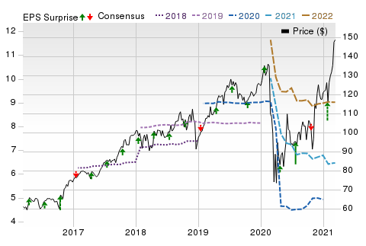
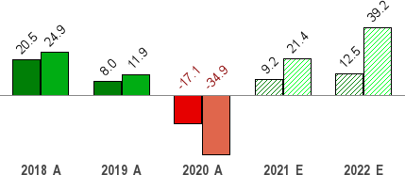
Mar 20, 2021
American Express (AXP)
$140.71 (As of 03/19/21)
Price Target (6-12 Months): $155.00
Long Term: 6-12 Months
Zacks Recommendation:
(Since: 05/27/20)
Prior Recommendation: Underperform
Neutral
Short Term: 1-3 Months Zacks Rank: (1-5)
Zacks Style Scores:
Value: B Growth: C
3-Hold
VGM: B
Momentum: A
Summary
Price, Consensus & Surprise
Shares of American Express have outperformed the industry in the past six months. Its strategic initiatives bode well to recover from the bleak market. The company regulated its expense base while selectively investing in the areas crucial for long-term strategies. Its cost control efforts are likely to aid margins. Decline in card member services due to less usage of travel-related benefits following COVID-imposed travel restrictions also aided the bottom line. Given that billed business and travel are likely to stay at low levels, the decline is likely to persist. Maintenance of sufficient capital will boost business. However, the company is witnessing tepid spending volumes. The company's drained profitability and stressed revenues might persist due to the uncertain environment. Its weaker debt servicing capacity continue to bother us.
Data Overview
52 Week High-Low
20 Day Average Volume (sh)
Market Cap
Sales and EPS Growth Rates (Y/Y %)
Sales EPS
$151.46 - $68.12
3,755,105
$113.4 B
YTD Price Change
16.4%
Beta
1.30
Dividend / Div Yld
Industry
$1.72 / 1.2%
Financial - Miscellaneous Services
Zacks Industry Rank Last EPS Surprise | Top 43% (108 out of 253) 39.7%
Last Sales Surprise | -0.5%
EPS F1 Est- 4 week change | 0.4%
Expected Report Date | 04/23/2021
Earnings ESP | 4.1%
P/E TTM | 26.4
P/E F1 | 21.7
PEG F1 | 2.0
P/S TTM | 3.1
Sales Estimates (millions of $)
 | Q1 | Q2 | Q3 | Q4 | Annual*
2022 | 10,420 E | 10,836 E | 11,054 E | 11,651 E | 44,327 E
2021 | 9,261 E | 9,476 E | 9,972 E | 10,621 E | 39,410 E
2020 | 10,310 A | 7,675 A | 8,751 A | 9,351 A | 36,087 A
EPS | Estimates Q1 | Q2 | Q3 | Q4 | Annual*
2022 | $2.07 E | $2.26 E | $2.41 E | $2.33 E | $9.02 E
2021 | $1.55 E | $1.61 E | $1.67 E | $1.58 E | $6.48 E
2020 | $1.98 A | $0.29 A | $1.30 A | $1.76 A | $5.34 A
*Quarterly figures may not add up to annual.
The data in the charts and tables, including the Zacks Consensus EPS and sales estimates, is as of 03/19/2021. The report's text and the analyst-provided price target are as of 03/08/2021.
Past performance is no guarantee of future results. Please see important disclosures and definitions at the end of this report.
© 2021 Zacks Investment Research, All Rights Reserved 10 S. Riverside Plaza Suite 1600 · Chicago, IL 60606

Slide 2
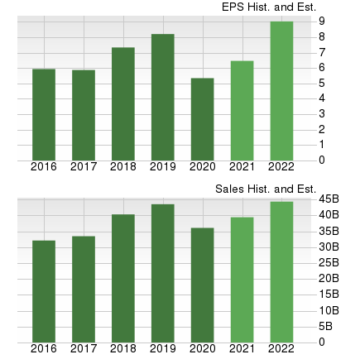
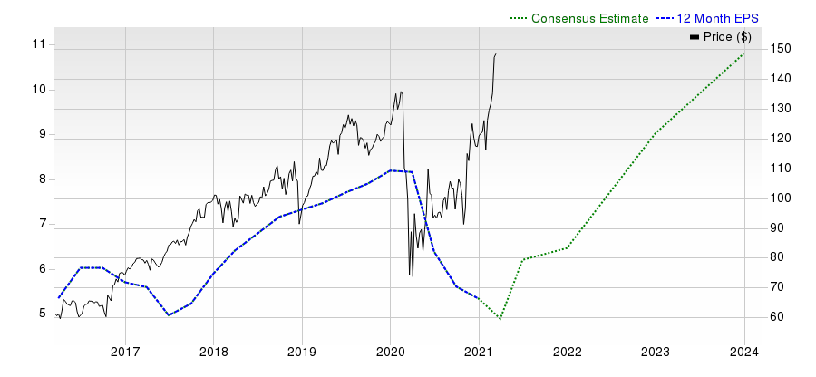
Overview
Founded in 1850, NY-based American Express Company is a diversified financial services company, offering charge and credit payment card products, and travel-related services worldwide. American Express and its main subsidiary – American Express Travel Related Services Company, Inc. (“TRS”) – are bank holding companies under the Bank Holding Company Act of 1956. The company offers business travel- related services through its non-consolidated joint venture, American Express Global Business Travel (the GBT JV).
The company’s range of products and services include charge card, credit card and other payment and financing products; Merchant acquisition and processing, servicing and settlement, and point-of-sale marketing and information products and services for merchants; Network services; other fee services, including fraud prevention services and the design and operation of customer loyalty programs; Expense management products and services and Travel-related services.
The company’s reporting segments are as follows:
Global Consumer Services Group (GCSG), (58% of 2020 total net revenues) including proprietary consumer cards globally, consumer services including travel services and non-card financing products, certain international joint ventures and the company’s partnership agreements in China;
Global Commercial Services (GCS), (29%) offers a wide range of
card and payment programs, expense management tools, consulting services, business financing and cross-border payments solutions to small businesses, mid-size companies and large corporations around the world.
Global Merchant and Network Services (GMNS), (13%) operate a global payments network that processes and settles card transactions, acquires merchants and provides fraud-prevention tools, marketing solutions, data analytics and other programs and services to merchants that leverage the capabilities of the company’s integrated network.
www.zacks.com

Slide 3
Reasons To Buy:
Share Price Movement: American Express’ shares have outperformed its industry in a year. Moreover, its progress on fundamentals is likely to continue benefiting the stock’s steady performance in the quarters ahead.
Decrease in marketing expense, cost of rewards and card member services, favorable debt ratings, and solid capital position are some of the positives.
Decrease in Operating Expenses: The company’s total expenses were down 14% in 2020 as the company regulated its expense base while selectively investing in the areas crucial for long-term strategies. In 2021, the company expects its operating expenses to be $11.5 billion, indicating a fall from the reported 2019 levels as it steadily controls its operating expenses. This decline in expenses will aid margins.
Decrease in Card Member Services and Card Member Rewards: The company has been experiencing a rise in Reward expenses and card member services for the past many years. These two categories constitute nearly 40% of the company total expenses. However, these expenses declined in 2020. While card member rewards fell 23% due to decrease in billed business, card
member services were down 45% due to decrease in usage of travel-related benefits following the COVID-19-related travel decline. This decline in card member rewards and card member services is expected to continue for some time now, given that billed business and travel are likely to stay at low levels. A decline in the expense category will in turn, aid the bottom line.
Favorable Debt Ratings: The company’s unsecured debt carries investment grade ratings with a stable outlook from Moody’s and S&P. Its investment grade rating along with a stable outlook places it in a favorable position to secure funding at reasonable costs and keep intact its borrowing capacity.
www.zacks.com

Slide 4
Reasons To Sell:
Revenue Growth to Remain Stressed: The company’s revenues have been increasing since 2016, led by a number of growth initiatives, such as launching products, enhancing the existing features, modifying price, reaching agreements and forging alliances among others. However, the COVID-19- led fall in business volumes, which hurt the company’s cross border as well as domestic business weighed on the company’s full year revenues. In 2020 the company’s non-interest revenues were down 20% year over year. We expect revenues to remain stressed for at least the first half of 2021 as discount revenues, the biggest revenue driver and dependent on billed business, are expected to remain supressed. The company’s billed business is dependent on travel and entertainment expenditure, and non-T&E spend. Since the T&E spend is still at low levels, it will drag down overall revenues.
Pressure on revenue growth, decline in profitability, suspension of share buyback, high debt level and reduced interest payment capability are some of the headwinds facing the company.
Decline in Net Interest Income: Net interest income fell 7% in 2020 due to lower loans. This revenue driver is likely to stay at subdued levels at least through the first half of 2021 as demand for loans remains supressed.
Increase in Provision: Provisions for credit losses increased 32% in 2020, due to a significant reserve build that reflected the deterioration of the estimated global macroeconomic outlook as a result of the COVID-19 impact. This reserve is expected to remain high at least through the first half of 2020 and is likely to drain margins.
Decline in Profitability: The company’s return on equity at the end of the fourth quarter was 14.2% down 1540 basis points year over year. Given a difficult operating environment, we expect profitability to remain under pressure in the coming quarters.
High Debt and Low Interest Coverage: The company’s debt to equity level of 187% has declined from 204% in the previous quarter, but remains at a high level than the industry’s average of 142%. Moreover, its interest earned ratio of 0.6x implies that earnings are insufficient to service interest costs. The company’s long-term debt and liabilities of $79 billion are higher than its cash and cash equivalents of $33 billion. The company’s higher-than-average debt position and weaker debt servicing capacity raises financial risk.
www.zacks.com

Slide 5
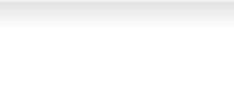
Last Earnings Report
AmEx's Q4 Earnings Surpass Estimates, Decline Y/Y | Quarter Ending | 12/2020
American Express Company reported fourth-quarter 2020 earnings of $1.76 per share, beating | Report Date | Jan 26, 2021
the Zacks Consensus Estimate of $1.26 by 39.7% on the back of lower expenses. However, the | Sales Surprise | -0.51%
bottom line fell 13.3% year over year due to muted revenues. | EPS Surprise | 39.68%
Earnings took a hit from weak spending volumes as a result of the adverse COVID-19 impact.
Quarterly EPS
1.76
Annual EPS (TTM)
5.33
Total revenues of $9.4 billion missed the Zacks Consensus Estimate, marginally by 0.5% and also declined 18% year over year. The top line was affected by a drop in Card Member spending and lower average discount rate.
Meanwhile, total expenses of $7.6 billion decreased 9% year over year owing to lower customer engagement costs on the back of limited Card Member spending as well as controlled usage of travel-related Card Member benefits.
Total provision led to a $111-million benefit in the reported quarter compared with $1 billion reported in the year-ago period on the back of reserve releases and a solid credit performance.
Return on equity of 14.2% declined 1540 basis points year over year.
Segmental Performances
American Express’ Global Consumer Services segment reported net income of $1.1 billion, up 12.1% year over year. Total revenues, net of interest expenses of $5.5 billion, decreased 14% year over year, reflecting a fall in Card Member spending and net interest income.
Global Commercial Services posted net income of $538 million, down 2.2% year over year. Total revenues, net of interest expenses, were $2.7 billion, which in turn, decreased 20% year over year, mirroring a decline in Card Member spending.
Global Merchant and Network Services’ net income plunged 56.1% year over year to $208 million in the reported quarter. Total revenues, net of interest expenses, were down 21% year over year to $1.2 billion, mainly due to reduced Card Member spending and the average discount rate.
Strong Financial Position (as of Dec 31, 2020)
Cash and cash equivalents were $33 billion, up 38% year over year. Total long-term debt of $43 billion was down 26% year over year.
2020 Update
Full-year adjusted earnings of $3.77 per share were down 53% year over year.
Total revenues, net of interest expense for the full year, were $36.1 billion, down 17% year over year. Consolidated expenses for 2020 stood at $27.1 billion, down 14% year over year.
www.zacks.com

Slide 6
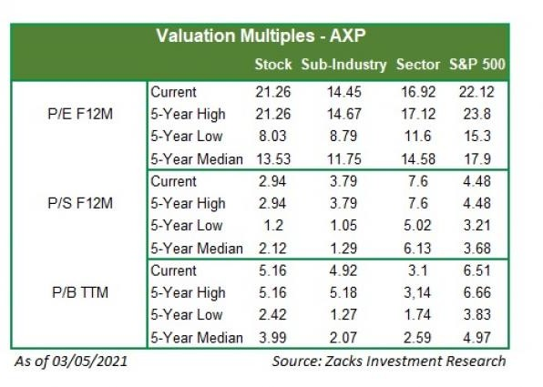
Recent News
American Express Introduces Offers to Help Consumers Amid Pandemic — Jan 5, 2021
American Express has unveiled new offers for U.S. Consumer, Small Business and Cobrand Card Members, and small merchants. The offers intend to address the current needs of consumers amid the pandemic, with an intensified focus on online shopping, small business needs, local travel and much more.
American Express Approves Quarterly Dividend — Dec 10, 2020
The board of directors at American Express has declared a quarterly dividend of 43 cents per share. The dividend will be paid on Feb 10, 2021 to shareholders of record as of Jan 8.
Valuation
American Express shares are up 21.9% and 49.9%, in the year-to-date period and over the trailing 12-month period, respectively. Stocks in the Zacks sub-industry are up 8.4% and the Zacks Finance sector are up 9% in the year-to-date period, respectively. Over the past year, the Zacks sub-industry are up 10.2% but the sector is up 33.8%.
The S&P 500 index is up 2.9% in the year-to-date period and 42.6% in the past year.
The stock is currently trading at 21.26x forward 12-month earnings, which compares to 14.45x for the Zacks sub-industry, 16.92x for the Zacks sector and 22.12x for the S&P 500 index.
Over the past five years, the stock has traded as high as 21.26x and as low as 8.03x, with a 5-year median of 13.53x. Our Neutral recommendation indicates that the stock will perform in-line with the market. Our $155 price target reflects 22.37x forward earnings.
The table below shows summary valuation data for AXP
www.zacks.com

Slide 7
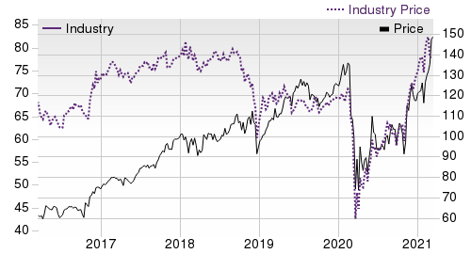
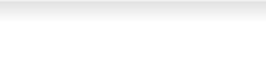
Industry Analysis Zacks Industry Rank: Top 43% (108 out of 253)
Top Peers
Company (Ticker) | Rec | Rank
Jefferies Financial …(JEF) | Outperform | 1
Synchrony Financial (SYF) | Outperform | 1
Equitable Holdings, …(EQH) | Neutral | 3
Globe Life Inc. (GL) | Neutral | 3
Orix Corp Ads (IX) | Neutral | 3
Mastercard Incorpora…(MA) | Neutral | 3
Moodys Corporation (MCO) | Neutral | 3
Visa Inc. (V) | Neutral | 3
Industry Comparison Industry: Financial - Miscellaneous Services
AXP X Industry
Industry Peers
S&P 500
IX
SNEX
SYF
Zacks Recommendation (Long Term) Neutral
-
-
Neutral
Underperform
Outperform
Zacks Rank (Short Term)
3
-
-
3
5
1
VGM Score
B
-
-
C
A
B
Market Cap
113.35 B
493.98 M
28.48 B
22.12 B
1.28 B
23.92 B
# of Analysts
11
2
13
3
1
6
Dividend Yield
1.22%
0.00%
1.38%
1.80%
0.00%
2.15%
Value Score
B
-
-
A
B
A
Cash/Price
0.28
0.28
0.06
1.69
5.01
0.46
EV/EBITDA
17.64
7.20
15.90
3.79
-10.81
10.51
PEG Ratio
2.04
1.08
2.36
3.47
NA
0.94
Price/Book (P/B)
4.93
1.88
3.90
0.77
1.60
2.00
Price/Cash Flow (P/CF)
19.05
9.39
15.91
4.13
9.44
12.46
P/E (F1)
21.71
13.99
21.22
11.26
11.08
8.45
Price/Sales (P/S)
3.14
2.54
3.30
1.04
0.02
1.48
Earnings Yield
4.61%
6.73%
4.61%
8.88%
9.02%
11.84%
Debt/Equity
1.87
0.46
0.67
1.44
2.66
1.32
Cash Flow ($/share)
7.39
0.98
6.78
21.88
6.92
3.29
Growth Score
C
-
-
D
A
D
Hist. EPS Growth (3-5 yrs)
5.25%
6.22%
9.32%
88.15%
26.51%
6.22%
Proj. EPS Growth (F1/F0)
21.30%
18.69%
14.54%
-26.23%
35.94%
113.51%
Curr. Cash Flow Growth
-26.78%
2.37%
0.72%
-0.09%
23.37%
-41.08%
Hist. Cash Flow Growth (3-5 yrs)
-1.89%
11.20%
7.32%
5.66%
14.75%
-4.28%
Current Ratio
1.50
1.44
1.39
1.75
1.86
1.23
Debt/Capital
65.14%
37.02%
41.42%
59.09%
72.66%
55.40%
Net Margin
8.62%
10.07%
10.59%
8.85%
0.33%
8.44%
Return on Equity
20.16%
8.85%
14.75%
6.61%
12.53%
13.62%
Sales/Assets
0.19
0.17
0.51
0.17
4.11
0.17
Proj. Sales Growth (F1/F0)
9.21%
0.00%
7.02%
-3.35%
39.41%
-4.17%
Momentum Score
A
-
-
F
B
A
Daily Price Chg
-1.31%
0.00%
-0.12%
0.43%
0.31%
-0.70%
1 Week Price Chg
0.82%
4.41%
2.96%
0.32%
5.40%
6.48%
4 Week Price Chg
9.51%
0.73%
3.72%
6.54%
8.30%
11.79%
12 Week Price Chg
19.91%
17.41%
8.75%
22.26%
15.04%
20.64%
52 Week Price Chg
82.57%
88.66%
72.55%
66.44%
100.55%
180.62%
20 Day Average Volume
3,755,105
187,384
2,394,762
24,187
67,064
6,791,100
(F1) EPS Est 1 week change
0.25%
0.00%
0.00%
0.00%
0.00%
-0.48%
(F1) EPS Est 4 week change
0.35%
0.00%
0.00%
-1.31%
0.00%
7.14%
(F1) EPS Est 12 week change
-4.13%
2.10%
2.10%
2.51%
-20.16%
42.12%
(Q1) EPS Est Mthly Chg
1.68%
0.00%
0.00%
0.00%
0.00%
-2.32%
www.zacks.com

Slide 8
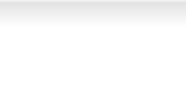
Zacks Stock Rating System
We offer two rating systems that take into account investors' holding horizons: Zacks Rank and Zacks Recommendation. Each provides valuable insights into the future profitability of the stock and can be used separately or in combination with each other depending on your investment style.
Zacks Recommendation
The Zacks Recommendation aims to predict performance over the next 6 to 12 months. The foundation for the quantitatively determined Zacks Recommendation is trends in the company's estimate revisions and earnings outlook. The Zacks Recommendation is broken down into 3 Levels; Outperform, Neutral and Underperform. Unlike many Wall Street firms, we have an excellent balance between the number of Outperform and Neutral recommendations. Our team of 70 analysts are fully versed in the benefits of earnings estimate revisions and how that is harnessed through the Zacks quantitative rating system. But we have given our analysts the ability to override the Zacks Recommendation for the 1200 stocks that they follow. The reason for the analyst over-rides is that there are often factors such as valuation, industry conditions and management effectiveness that a trained investment professional can spot better than a quantitative model.
Zacks Rank
The Zacks Rank is our short-term rating system that is most effective over the one- to three-month holding horizon. The underlying driver for the quantitatively-determined Zacks Rank is the same as the Zacks Recommendation, and reflects trends in earnings estimate revisions.
Zacks Style Scores
Zacks Style Scores
The Zacks Style Score is as a complementary indicator to the Zacks rating system, giving investors a way to focus on the highest rated stocks that best fit their own stock picking preferences.
Value Score
B
Growth Score
C
Academic research has proven that stocks with the best Value, Growth and Momentum characteristics outperform the market. The Zacks Style Scores rate stocks on each of these individual styles and assigns a rating of A, B, C, D and F. We also produce the VGM Score (V for Value, G for Growth and M for Momentum), which combines the weighted average of the individual Style Scores into one score. This is perfectly suited for those who want their stocks to have the best scores across the board.
Momentum Score
A
VGM Score
B
As an investor, you want to buy stocks with the highest probability of success. That means buying stocks with a Zacks Recommendation of Outperform, which also has a Style Score of an A or a B.
Disclosures
This report contains independent commentary to be used for informational purposes only. The analysts contributing to this report do not hold any shares of this stock. The analysts contributing to this report do not serve on the board of the company that issued this stock. The EPS and revenue forecasts are the Zacks Consensus estimates, unless indicated otherwise on the report's first page. Additionally, the analysts contributing to this report certify that the views expressed herein accurately reflect the analysts' personal views as to the subject securities and issuers. ZIR certifies that no part of the analysts' compensation was, is, or will be, directly or indirectly, related to the specific recommendation or views expressed by the analyst in the report.
Additional information on the securities mentioned in this report is available upon request. This report is based on data obtained from sources we believe to be reliable, but is not guaranteed as to accuracy and does not purport to be complete. Any opinions expressed herein are subject to change.
ZIR is not an investment advisor and the report should not be construed as advice designed to meet the particular investment needs of any investor. Prior to making any investment decision, you are advised to consult with your broker, investment advisor, or other appropriate tax or financial professional to determine the suitability of any investment. This report and others like it are published regularly and not in response to episodic market activity or events affecting the securities industry.
This report is not to be construed as an offer or the solicitation of an offer to buy or sell the securities herein mentioned. ZIR or its officers, employees or customers may have a position long or short in the securities mentioned and buy or sell the securities from time to time. ZIR is not a broker-dealer. ZIR may enter into arms-length agreements with broker-dealers to provide this research to their clients. Zacks and its staff are not involved in investment banking activities for the stock issuer covered in this report.
ZIR uses the following rating system for the securities it covers. Outperform- ZIR expects that the subject company will outperform the broader
U.S. equities markets over the next six to twelve months. Neutral- ZIR expects that the company will perform in line with the broader U.S. equities markets over the next six to twelve months. Underperform- ZIR expects the company will underperform the broader U.S. equities markets over the next six to twelve months.
No part of this report can be reprinted, republished or transmitted electronically without the prior written authorization of ZIR.
www.zacks.com

