Slide 1

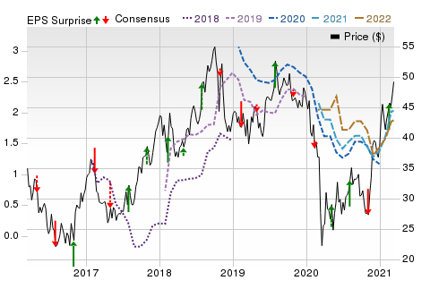
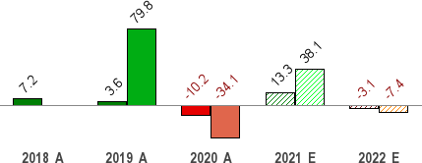
Mar 20, 2021
CF Industries (CF)
$48.17 (As of 03/19/21)
Price Target (6-12 Months): $52.00
Long Term: 6-12 Months
Zacks Recommendation:
(Since: 02/16/21)
Prior Recommendation: Outperform
Neutral
Short Term: 1-3 Months Zacks Rank: (1-5)
Zacks Style Scores:
Value: B Growth: C
3-Hold
VGM: B
Momentum: A
Summary
Price, Consensus & Surprise
CF Industries’ earnings and sales for the fourth quarter beat the respective Zacks Consensus Estimate. The company is well placed to benefit from higher nitrogen demand in major markets in 2021. Demand for nitrogen is expected to be strong in North America, driven by healthy corn acres in the United States. Moreover, lower domestic urea production is likely to drive demand in Brazil. The company will also gain from a recovery in nitrogen prices on the back of lower supply availability. It is also committed to reduce debt and boost shareholders’ value leveraging strong cash flows. However, the company faces headwinds from lower expected sales volumes and ammonia production due to maintenance turnaround activities. Higher natural gas costs are also expected to weigh on margins. It has also underperformed the industry over a year.
Sales and EPS Growth Rates (Y/Y %)
Sales EPS
Data Overview
52 Week High-Low | $51.24 - $21.43
20 Day Average Volume (sh) | 2,410,445
Market Cap | $10.3 B
YTD Price Change | 24.4%
Beta | 1.19
Dividend / Div Yld | $1.20 / 2.5%
Industry | Fertilizers
Zacks Industry Rank | Top 10% (26 out of 253)
Last EPS Surprise | 400.0%
Last Sales Surprise | 12.0%
EPS F1 Est- 4 week change | 15.2%
Expected Report Date | 05/05/2021
Earnings ESP | 0.0%
P/E TTM | 32.8
P/E F1 | 23.7
PEG F1 | 4.0
P/S TTM | 2.5
Sales Estimates (millions of $)
 | Q1 | Q2 | Q3 | Q4 | Annual*
2022 | 1,086 E | 1,290 E | 1,060 E | 1,259 E | 4,527 E
2021 | 1,084 E | 1,392 E | 1,076 E | 1,248 E | 4,671 E
2020 | 971 A | 1,204 A | 847 A | 1,102 A | 4,124 A
EPS | Estimates
 | Q1 | Q2 | Q3 | Q4 | Annual*
2022 | $0.38 E | $0.63 E | $0.36 E | $0.59 E | $1.88 E
2021 | $0.49 E | $0.96 E | $0.25 E | $0.42 E | $2.03 E
2020 | $0.31 A | $0.89 A | -$0.13 A | $0.40 A | $1.47 A
*Quarterly figures may not add up to annual.
The data in the charts and tables, including the Zacks Consensus EPS and sales estimates, is as of 03/19/2021. The report's text and the analyst-provided price target are as of 03/09/2021.
Past performance is no guarantee of future results. Please see important disclosures and definitions at the end of this report.
© 2021 Zacks Investment Research, All Rights Reserved 10 S. Riverside Plaza Suite 1600 · Chicago, IL 60606

Slide 2
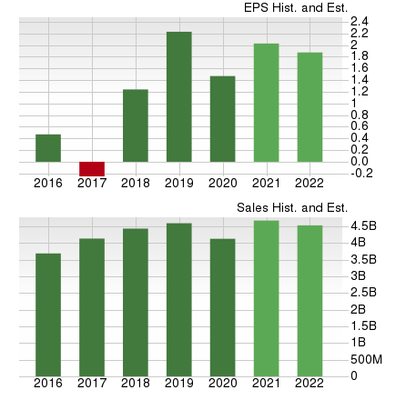
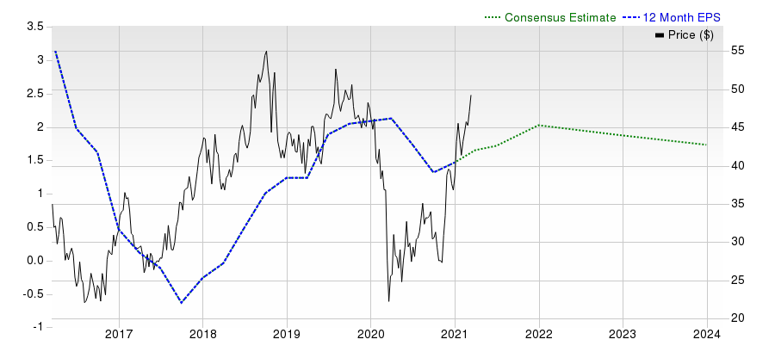
Overview
CF Industries Holdings, Inc., headquartered in Deerfield, IL, is one of the largest manufacturers and distributors of nitrogenous fertilizer and other nitrogen products globally. The company’s principal nitrogenous fertilizer products are ammonia, granular urea, urea ammonium nitrate solution (UAN) and ammonium nitrate (AN).
CF Industries is a leading nitrogen fertilizer producer in North America. The company operates two of the largest fertilizer complexes in North America, one in Donaldsonville, Louisiana, United States and the other in Medicine Hat, Alberta, Canada.
Roughly 25%, 30%, 26% and 11% of its total sales in 2020 came from its Ammonia, Granular Urea and UAN and AN segments, respectively, while the “Other” segment accounted for the balance. The company completed the divestment of its phosphate unit to The Mosaic Company in March 2014.
In April 2010, CF Industries acquired rival Terra Industries for $4.7 billion. With the acquisition, the company has become the global leader in the nitrogen fertilizer industry and has expanded geographically.
CF Industries, in October 2013, signed a definitive agreement to sell its phosphate mining and manufacturing business to fertilizer producer Mosaic for $1.4 billion in cash (including $200 million to fund CF Industries’ asset retirement obligation escrow). The transaction was closed in March 2014.
Under the deal, CF Industries disposed the Hardee County phosphate rock mine, the Plant City phosphate complex, an ammonia terminal, phosphate warehouse and dock at the Port of Tampa and the site of the former Bartow phosphate complex to Mosaic.
CF Industries and Mosaic also entered into a long-term ammonia supply agreement, under which, the former agreed to supply ammonia to Mosaic from its Donaldsonville, LA, nitrogen complex and its 50% owned Point Lisas Nitrogen Ltd. (PLNL) facility in the Republic of Trinidad and Tobago.
In 2016, the company completed its capacity expansion projects at Donaldsonville and Port Neal. The projects involved the building of new urea, ammonia and UAN facilities at Donaldsonville complex along with new urea and ammonia facilities at the Port Neal complex. The facilities have boosted the company’s overall production capacity by roughly 25%.
www.zacks.com

Slide 3
Reasons To Buy:
CF Industries should benefit from higher expected global demand for nitrogen fertilizers. The company expects demand for nitrogen to remain strong this year. Strong crop commodity prices are contributing to higher demand globally. Industrial demand has also recovered from the pandemic-related disruptions in April and May. In 2021, demand for nitrogen is expected to be driven by higher corn acres in the United States. The company projects around 90-92 million planted corn acres in the United States in 2021. Demand in Canada is also expected to be fueled by increased canola plantings. CF Industries also sees continued strong demand for urea imports from Brazil and India. Lack of active domestic urea production and improved farm economics are likely to increase demand in Brazil this year. Urea tender volumes are also expected remain healthy in India in 2021.
CF Industries is well placed to benefit from higher nitrogen demand in major markets. It should also gain from a recovery in nitrogen prices. The company is also committed to cut debt and boost shareholders’ value.
While CF Industries bore the brunt of lower nitrogen prices in 2020, it is expected to benefit from a recovery in prices this year. Nitrogen prices, in 2020, were affected by greater global
supply availability due to increased global operating rates. Moreover, lower global energy prices put pressure on prices last year. However, the company expects a recovery in nitrogen pricing in 2021 on the back of lower supply resulting from reduced operating rates across Europe and Asia. Prices are also expected to gain support from higher commodity crop futures prices. As such, higher nitrogen prices are expected to support the company’s bottom line.
The company remains committed to boost shareholders’ value by leveraging strong cash flows. CF Industries generated operating cash flows of roughly $1.2 billion and free cash flow of $748 million in 2020. The company also paid dividend worth $258 million in 2020. Moreover, the company is currently executing a $1 billion share repurchase program that is authorized through 2021. It repurchased 2.6 million shares worth $100 million in 2020. It has bought back around 10.2 million shares for $437 million since the announcement of the current share repurchase authorization in February 2019.
CF Industries is taking actions to de-leverage its balance sheet. Its long-term debt of $3,712 million at the end of the fourth quarter of 2020 fell from $3,960 million at the end of the third quarter. Also, its cash and cash equivalents jumped around 138% year over year to $683 million at the end of 2020. The company has also decided to repay the $250 million of Senior Secured Notes due December 2021, which will lower its interest expenses. Further, its time-interest-earned ratio of 3.6 at the end of the fourth quarter rose from 3.3 in the prior quarter. As such, the company appears to have lower default risk.
www.zacks.com

Slide 4
Reasons To Sell:
CF Industries has underperformed the industry it belongs to over a year. The company’s shares are up 61.3% compared with the 79% rise of the industry. The company saw higher sales volumes in 2020 on increased supply availability from higher starting inventories and higher production. However, volumes are expected to decline in 2021 on a year-over-year basis due to reduced year-end inventory and lower expected production. The company expects sales volumes to decline to 19-19.5 million tons in 2021 from 20.3 million tons in 2020. This may impact the company’s top line.
The company faces headwinds from lower expected sales volumes and ammonia production. Higher natural gas costs are also expected to weigh on margins.
Higher expected natural gas cost in 2021 is a concern for the company. CF Industries benefited from lower year over year natural gas costs for full-year 2020. However, it witnessed
higher costs in the fourth quarter. Natural gas cost was $2.60 per million British thermal units (MMBtu) in the quarter, up from $2.36 per MMBtu in the year-ago quarter. The company expects natural gas costs to increase year over year in 2021. As such, higher natural gas costs may increase its cost of sales and hurt margins.
The company faces headwind from maintenance turnarounds in 2021, which is expected to hurt its production. CF Industries expects its gross ammonia production to be around 9.5-10 million tons in 2021 compared with a record 10.4 million tons it produced in 2020. Production is expected to be impacted by planned maintenance and turnaround activities and gas-driven curtailments. In addition to normal turnarounds this year, the company will also execute those that were deferred from 2020.
www.zacks.com

Slide 5
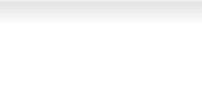
Last Earnings Report
CF Industries' Earnings & Sales Surpass Estimates in Q4 | Quarter Ending | 12/2020
CF Industries reported a profit of $87 million or 40 cents per share in the fourth quarter of 2020 | Report Date | Feb 17, 2021
compared with profits of $55 million or 25 cents in the year-ago quarter. Also, earnings per share | Sales Surprise | 11.97%
surpassed the Zacks Consensus Estimate of 8 cents. | EPS Surprise | 400.00%
Net sales increased 5% year over year to $1,102 million in the quarter. The figure also beat the Zacks Consensus Estimate of $984.2 million.
Quarterly EPS
0.40
Annual EPS (TTM) 1.47
Per the company, average selling prices in the reported quarter were lower on a year-over-year
basis across most segments due to higher global supply availability. But, sales volume in the fourth quarter was higher than the prior-year quarter’s levels owing to greater supply availability.
Segment Review
Net sales in the Ammonia segment increased 12% year over year to $298 million in the reported quarter. In full year 2020, sales volume increased from prior-year’s levels owing to increased supply availability resulting from higher production and beginning inventories in the year. Average selling prices in 2020 declined due to increased global supply availability.
Sales in the Granular Urea segment increased 39.3% year over year to $333 million. Average selling prices for urea declined for the full year due to increased global supply availability, while sales volume increased due to greater supply availability.
Sales in the UAN segment fell 19% year over year to $272 million. Sales volume in 2020 was in-line with prior-year levels, while average selling prices declined due to higher global supply availability.
Sales in the AN segment declined 4.3% year over year to $112 million. In 2020, sales volumes rose year over year but average selling prices declined due to increased global supply availability.
FY20 Results
Earnings (as reported) for full-year 2020 were $1.47 per share compared with earnings of $2.23 per share a year ago. Net sales fell 10.9% year over year to around $4.1 billion.
Financials
CF Industries’ cash and cash equivalents increased 138% year over year to $683 million at the end of 2020. Long-term debt was $3,712 million at the end of the year, down 6.2% year over year.
Cash flow from operations amounted to $290 million in the reported quarter, down 4% year over year.
Outlook
CF Industries expects nitrogen pricing to be positive in 2021 owing to higher commodity crop futures prices as well as energy prices in Asia and Europe. It expects higher canola plantings in Canada to also support nitrogen demand. Moreover, CF Industries projects higher nitrogen demand in North America for industrial uses. Also, the company sees global nitrogen requirements to remain robust this year, which is likely to be driven by strong demand for urea imports from India and Brazil.
www.zacks.com

Slide 6
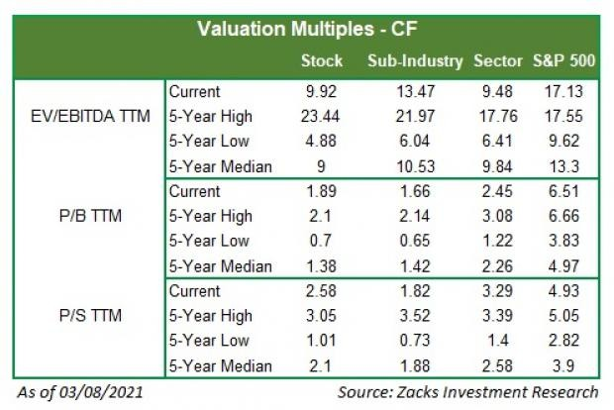
Recent News
CF Industries Declares Dividend
On Feb 4, 2021, CF Industries’ board declared a quarterly dividend payout of 30 cents per share on its common stock. The dividend will be paid on Feb 26, 2021 to shareholders of record as of Feb 16, 2021.
Valuation
CF Industries’ shares are up 61.3% over the trailing 12-month period. Over the past year, the Zacks Fertilizers industry and the Zacks Basic Materials sector are up 79% and 65.4%, respectively.
The S&P 500 index is up 35.8% in the past year.
The stock is currently trading at 9.92X trailing 12-month enterprise value-to EBITDA (EV/EBITDA) ratio, which compares to 13.47X for the Zacks sub-industry, 9.48X for the Zacks sector and 17.13X for the S&P 500 index.
Over the past five years, the stock has traded as high as 23.44X and as low as 4.88X, with a 5-year median of 9X.
Our Neutral recommendation indicates that the stock will perform in-line with the market. Our $52 price target reflects 1.98X tangible book value. The table below shows summary valuation data for CF:
www.zacks.com

Slide 7
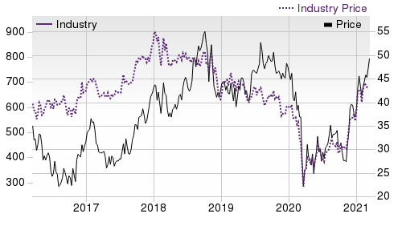
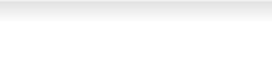
Industry Analysis Zacks Industry Rank: Top 10% (26 out of 253)
Top Peers
Company (Ticker) | Rec | Rank
BASF SE (BASFY) | Outperform | 2
Bunge Limited (BG) | Outperform | 1
The Mosaic Company (MOS) | Outperform | 1
Israel Chemicals Shs (ICL) | Neutral | 3
Intrepid Potash, Inc (IPI) | Neutral | 3
Nutrien Ltd. (NTR) | Neutral | 3
The Scotts MiracleGr…(SMG) | Neutral | 2
Sociedad Quimica y M…(SQM) | Neutral | 2
Industry Comparison Industry: Fertilizers
Industry Peers
CF
X Industry
S&P 500
IPI
MOS
SQM
Zacks Recommendation (Long Term)
Neutral
-
-
Neutral
Outperform
Neutral
Zacks Rank (Short Term)
3
-
-
3
1
2
VGM Score
B
-
-
C
C
F
Market Cap
10.32 B
10.32 B
28.48 B
483.37 M
12.63 B
14.35 B
# of Analysts
6
4
13
2
6
4
Dividend Yield
2.49%
0.27%
1.38%
0.00%
0.60%
0.53%
Value Score
B
-
-
C
B
F
Cash/Price
0.06
0.04
0.06
0.04
0.05
0.03
EV/EBITDA
8.70
12.06
15.90
35.01
12.63
40.31
PEG Ratio
3.95
2.60
2.36
NA
2.01
2.49
Price/Book (P/B)
1.84
1.45
3.90
1.17
1.29
6.64
Price/Cash Flow (P/CF)
8.53
10.20
15.91
28.64
10.20
61.08
P/E (F1)
23.73
23.75
21.22
120.13
14.10
47.63
Price/Sales (P/S)
2.50
1.56
3.30
2.45
1.45
7.90
Earnings Yield
4.21%
4.21%
4.61%
0.83%
7.08%
2.09%
Debt/Equity
0.66
0.43
0.67
0.04
0.42
0.88
Cash Flow ($/share)
5.65
3.25
6.78
1.26
3.27
0.89
Growth Score
C
-
-
D
C
F
Hist. EPS Growth (3-5 yrs)
13.65%
1.19%
9.32%
NA
-8.54%
-1.97%
Proj. EPS Growth (F1/F0)
37.98%
59.34%
14.54%
119.74%
177.85%
27.22%
Curr. Cash Flow Growth
-7.21%
-7.21%
0.72%
-65.34%
-22.63%
-15.50%
Hist. Cash Flow Growth (3-5 yrs)
-2.83%
-4.47%
7.32%
-23.80%
-7.59%
-6.11%
Current Ratio
1.51
1.57
1.39
2.02
1.12
5.40
Debt/Capital
39.85%
31.00%
41.42%
3.50%
29.46%
46.76%
Net Margin
7.69%
5.89%
10.59%
-13.79%
7.67%
9.05%
Return on Equity
5.75%
4.59%
14.75%
-5.16%
3.67%
9.91%
Sales/Assets
0.34
0.44
0.51
0.35
0.45
0.37
Proj. Sales Growth (F1/F0)
13.25%
13.25%
7.02%
19.21%
20.99%
20.77%
Momentum Score
A
-
-
A
D
B
Daily Price Chg
-0.37%
-0.19%
-0.12%
-0.39%
-0.51%
1.39%
1 Week Price Chg
4.54%
8.72%
2.96%
21.13%
10.41%
11.68%
4 Week Price Chg
9.80%
2.69%
3.72%
21.76%
20.47%
2.89%
12 Week Price Chg
30.86%
41.27%
8.75%
129.41%
51.68%
13.91%
52 Week Price Chg
109.62%
167.41%
72.55%
275.42%
305.23%
218.76%
20 Day Average Volume
2,410,445
60,689
2,394,762
231,354
6,853,907
1,334,590
(F1) EPS Est 1 week change
0.00%
0.00%
0.00%
0.00%
0.00%
2.97%
(F1) EPS Est 4 week change
15.25%
9.57%
0.00%
400.00%
54.02%
8.22%
(F1) EPS Est 12 week change
47.34%
20.75%
2.10%
198.90%
86.94%
7.61%
(Q1) EPS Est Mthly Chg
280.00%
2.27%
0.00%
-20.00%
174.12%
2.27%
www.zacks.com

Slide 8
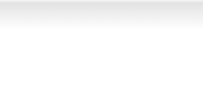
Zacks Stock Rating System
We offer two rating systems that take into account investors' holding horizons: Zacks Rank and Zacks Recommendation. Each provides valuable insights into the future profitability of the stock and can be used separately or in combination with each other depending on your investment style.
Zacks Recommendation
The Zacks Recommendation aims to predict performance over the next 6 to 12 months. The foundation for the quantitatively determined Zacks Recommendation is trends in the company's estimate revisions and earnings outlook. The Zacks Recommendation is broken down into 3 Levels; Outperform, Neutral and Underperform. Unlike many Wall Street firms, we have an excellent balance between the number of Outperform and Neutral recommendations. Our team of 70 analysts are fully versed in the benefits of earnings estimate revisions and how that is harnessed through the Zacks quantitative rating system. But we have given our analysts the ability to override the Zacks Recommendation for the 1200 stocks that they follow. The reason for the analyst over-rides is that there are often factors such as valuation, industry conditions and management effectiveness that a trained investment professional can spot better than a quantitative model.
Zacks Rank
The Zacks Rank is our short-term rating system that is most effective over the one- to three-month holding horizon. The underlying driver for the quantitatively-determined Zacks Rank is the same as the Zacks Recommendation, and reflects trends in earnings estimate revisions.
Zacks Style Scores
Zacks Style Scores
The Zacks Style Score is as a complementary indicator to the Zacks rating system, giving investors a way to focus on the highest rated stocks that best fit their own stock picking preferences.
Value Score
B
Growth Score
C
Academic research has proven that stocks with the best Value, Growth and Momentum characteristics outperform the market. The Zacks Style Scores rate stocks on each of these individual styles and assigns a rating of A, B, C, D and F. We also produce the VGM Score (V for Value, G for Growth and M for Momentum), which combines the weighted average of the individual Style Scores into one score. This is perfectly suited for those who want their stocks to have the best scores across the board.
Momentum Score
A
VGM Score
B
As an investor, you want to buy stocks with the highest probability of success. That means buying stocks with a Zacks Recommendation of Outperform, which also has a Style Score of an A or a B.
Disclosures
This report contains independent commentary to be used for informational purposes only. The analysts contributing to this report do not hold any shares of this stock. The analysts contributing to this report do not serve on the board of the company that issued this stock. The EPS and revenue forecasts are the Zacks Consensus estimates, unless indicated otherwise on the report's first page. Additionally, the analysts contributing to this report certify that the views expressed herein accurately reflect the analysts' personal views as to the subject securities and issuers. ZIR certifies that no part of the analysts' compensation was, is, or will be, directly or indirectly, related to the specific recommendation or views expressed by the analyst in the report.
Additional information on the securities mentioned in this report is available upon request. This report is based on data obtained from sources we believe to be reliable, but is not guaranteed as to accuracy and does not purport to be complete. Any opinions expressed herein are subject to change.
ZIR is not an investment advisor and the report should not be construed as advice designed to meet the particular investment needs of any investor. Prior to making any investment decision, you are advised to consult with your broker, investment advisor, or other appropriate tax or financial professional to determine the suitability of any investment. This report and others like it are published regularly and not in response to episodic market activity or events affecting the securities industry.
This report is not to be construed as an offer or the solicitation of an offer to buy or sell the securities herein mentioned. ZIR or its officers, employees or customers may have a position long or short in the securities mentioned and buy or sell the securities from time to time. ZIR is not a broker-dealer. ZIR may enter into arms-length agreements with broker-dealers to provide this research to their clients. Zacks and its staff are not involved in investment banking activities for the stock issuer covered in this report.
ZIR uses the following rating system for the securities it covers. Outperform- ZIR expects that the subject company will outperform the broader
U.S. equities markets over the next six to twelve months. Neutral- ZIR expects that the company will perform in line with the broader U.S. equities markets over the next six to twelve months. Underperform- ZIR expects the company will underperform the broader U.S. equities markets over the next six to twelve months.
No part of this report can be reprinted, republished or transmitted electronically without the prior written authorization of ZIR.
www.zacks.com

