Slide 1

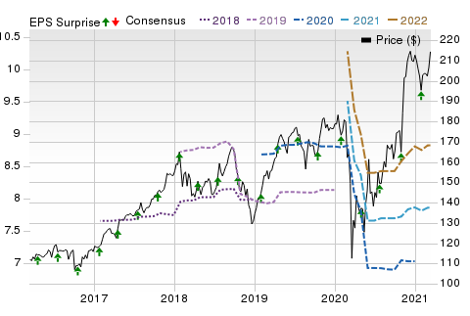
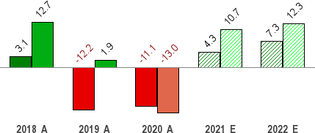
Mar 20, 2021
Honeywell (HON)
$212.91 (As of 03/19/21)
Price Target (6-12 Months): $217.00
Long Term: 6-12 Months
Zacks Recommendation:
(Since: 12/23/18)
Prior Recommendation: Underperform
Neutral
Short Term: 1-3 Months Zacks Rank: (1-5)
Zacks Style Scores:
Value: C Growth: C
3-Hold
VGM: C
Momentum: C
Summary
Price, Consensus & Surprise
Strength in defense and space businesses as well as solid demand for warehouse automation products are likely to boost Honeywell’s revenues in the quarters ahead. Also, solid demand for personal protective equipment, along with a strong backlog conversion rate, will act as tailwinds. Increased commercial and operational excellence initiatives are likely to improve its near-term profitability. Also, strong cash flows allow it to effectively deploy capital for making acquisitions and paying out dividends. However, in the past six months, the company’s shares have underperformed the industry. It believes that the coronavirus outbreak-led market downturn and weak commercial aerospace will adversely impact its near-term results. Given its extensive geographic presence, its business is subject to political, economic and geopolitical risks.
Sales and EPS Growth Rates (Y/Y %)
Sales EPS
Data Overview
52 Week High-Low | $219.00 - $101.08
20 Day Average Volume (sh) | 2,869,750
Market Cap | $149.5 B
YTD Price Change | 1.1%
Beta | 1.17
Dividend / Div Yld | $3.72 / 1.7%
Industry | Diversified Operations
Zacks Industry Rank | Top 40% (102 out of 253)
Last EPS Surprise | 3.5%
Last Sales Surprise | 6.5%
EPS F1 Est- 4 week change | 0.0%
Expected Report Date | 05/07/2021
Earnings ESP | 0.0%
P/E TTM | 30.0
P/E F1 | 27.1
PEG F1 | 2.9
P/S TTM | 4.5
Sales Estimates (millions of $)
 | Q1 | Q2 | Q3 | Q4 | Annual*
2022 | 8,612 E | 9,006 E | 9,075 E | 10,006 E | 36,502 E
2021 | 8,048 E | 8,255 E | 8,522 E | 9,344 E | 34,034 E
2020 | 8,463 A | 7,477 A | 7,797 A | 8,900 A | 32,637 A
EPS | Estimates
 | Q1 | Q2 | Q3 | Q4 | Annual*
2022 | $2.09 E | $2.04 E | $2.21 E | $2.60 E | $8.83 E
2021 | $1.79 E | $1.82 E | $1.97 E | $2.27 E | $7.86 E
2020 | $2.21 A | $1.26 A | $1.56 A | $2.07 A | $7.10 A
*Quarterly figures may not add up to annual.
The data in the charts and tables, including the Zacks Consensus EPS and sales estimates, is as of 03/19/2021. The report's text and the analyst-provided price target are as of 03/03/2021.
Past performance is no guarantee of future results. Please see important disclosures and definitions at the end of this report.
© 2021 Zacks Investment Research, All Rights Reserved 10 S. Riverside Plaza Suite 1600 · Chicago, IL 60606

Slide 2
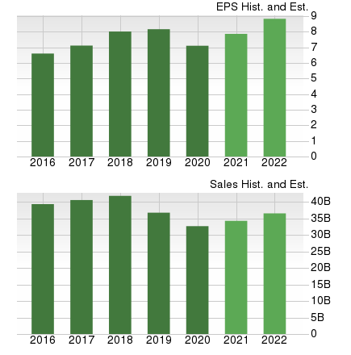
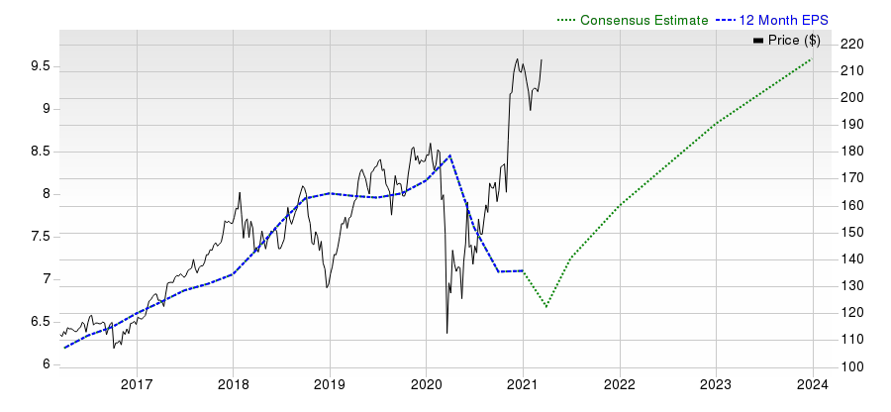
Overview
Honeywell International Inc. has solid footprints in the aerospace industry, with commercial aviation and defense being two major business sources. Opportunities within unmanned aerial systems (UAS) and urban air mobility (UAM) industries are encouraging too. Newly formed unit — Unmanned Aerial Systems — is working to leverage from these promising markets. Launch of SATCOM — by far smallest and lightest satellite communication system for unmanned aerial vehicles — is a step forward in the direction.
Based in Morris Township, NJ, Honeywell is a global diversified technology and manufacturing company, with a wide range of aerospace products and services. The company has operations in the United States, Europe, Canada, Asia and Latin America. Honeywell operates through four business segments as discussed hereunder:
Aerospace (33.4% revenues came from this segment in fourth- quarter 2020) is a leading global provider of integrated avionics, engines, systems and service solutions for aircraft manufacturers, airlines, business and general aviation, military, space and airport operations. In April 2018, the segment announced its decision to develop laser communication products for satellite communication in collaboration with market partners.
Performance Materials and Technologies segment (28.7%) offers leading technologies and high-performance materials, including
hydrocarbon processing technologies, catalysts, adsorbents, equipment and services. This segment includes its wholly owned subsidiary, Honeywell UOP, which is an international supplier and licensor of process technology, and consulting services to the petrochemical and petroleum refining industries.
Honeywell Building Technologies segment (16%) offers environmental & energy solutions, security and fire, and building solutions. Some of the notable products offered by the segment include sensors, switches, control systems and instruments for energy management as well as advanced software applications for building control and optimization.
Safety and Productivity Solutions (21.9%) includes sensing & productivity solutions and industrial safety, as well as the recently acquired Intelligrated business.
www.zacks.com

Slide 3
Reasons To Buy:
Honeywell’s strength across its defense and space business, supported by stable U.S. government defense budgets, is likely to act as a tailwind in the quarters ahead. In both third and fourth quarters of 2020, its defense and space business reported double digit organic sales growth on a year-over-year basis. Also, signs of recovery in business aviation aftermarket bode well for its aerospace segment. Moreover, it is set to benefit from solid product offerings and growing opportunities within UAS and UAM markets. Notably, it launched SATCOM — the smallest and lightest satellite communication system for unmanned aerial vehicles — in June 2020. For 2021, it anticipates Aerospace segment to be flat to up in low single digits. Going forward, strong demand for warehouse automation products and robust backlog level are likely to support its Intelligrated business. Notably, exiting 2020, its Intelligrated backlog remained in excess of $2.5 billion. In addition, solid demand for personal
Strength in Intelligrated, defense and safety products businesses, cost control and operational excellence initiatives, acquisitions and strong cash flow are likely to drive Honeywell's competency.
protective equipment and growth in productivity solutions and services will act as tailwinds for its Safety and Productivity Solutions segment. Also, in both the third quarter and the fourth quarter, it witnessed double digit year-over-year organic sales growth in Intelligrated and personal protective equipment businesses. For first-quarter 2021, the company expects similar growth in these businesses. It expects Safety and Productivity Solutions segment to grow in double digits in 2021. Honeywell’s focus on investing in product introductions, and growth opportunities across building solutions and safety products businesses through partnership with SAP will likely be beneficial for the Building Technologies segment. For 2021, it anticipates Building Technologies segment to grow in low single digits. For 2021, it anticipates revenues to lie in the range of $33.4-$34.4 billion, with organic revenues expected to be up 1-4% on a year-over-year basis.
Honeywell has been undertaking several cost-control measures to maintain a healthy capital structure amid the coronavirus crisis. Some of the actions are the reduction of discretionary expenses and repositioning actions. Notably, these steps enabled it to reduce costs by approximately $1,500 million year over year in 2020. The company believes that these measures, along with commercial and operational excellence initiatives, are likely to help it drive margin expansion across all four of its segments in the quarters ahead. In addition, its three transformation initiatives — the Connected Enterprise, Integrated Supply Chain and Honeywell Digital — will drive its profitability.
Strong cash flows allow the company to effectively deploy capital for making acquisitions, repurchasing shares and paying out dividend. Notably, for 2021, the company expects free cash flow to be between $5.1 billion and $5.5 billion. Also, in 2020, it paid out dividends worth
$2,592 million to shareholders, higher than $2,442 million paid out in the year-ago. Also, the company repurchased shares worth $3,714 million during the same time frame. It is worth noting that the quarterly dividend rate was hiked 3.3% in September 2020, marking its 11th increment since 2010. Such diligent capital deployment strategies boost shareholders' wealth.
Honeywell has been steadily strengthening business through acquisitions. For instance, the company’s agreement to acquire Sparta Systems (anticipated to close by the first quarter of 2021), will help in strengthening its position in digital transformation, industrial automation and enterprise performance management solutions space. In December 2020, Honeywell completed the acquisition of Sine Group, which will allow it to offer its Connected Buildings solutions with added security and safety features to its customers. Also, in October 2020, it acquired Ballard Unmanned Systems. The buyout will enhance growth scopes for Honeywell in the UAS market. Further, its acquisition of Rocky Research in the same month will enhance growth opportunities for its existing offerings in the energy storage, power and thermal management, and power generation arenas. This apart, in December 2019, the company acquired the Rebellion Photonics, which has been augmenting its portfolio of automation, process technologies and gas detection solutions. Also, Honeywell’s buyout of TruTrak Flight Systems (July 2019) has been expanding its capabilities in the aviation market.
www.zacks.com

Slide 4
Reasons To Sell:
In the fourth quarter, Honeywell’s revenues declined 7% on an organic basis on account of weakness across its end markets due to the coronavirus outbreak. Notably, the company expects headwinds across its commercial original equipment business due to lower air transport, slowdown in original equipment build rates and lower business jet demand to continue affecting its revenues in the near term. Also, persistent low global air transport flight hours, owing to the coronavirus outbreak-led issues, will affect its commercial aftermarket business in the quarters ahead. The company expects the Performance Materials and Technologies segment’s revenues to remain challenged in the first quarter of 2021, owing to the soft near-term outlook for oil and gas capital expenditure, persistent weakness in its UOP
The coronavirus outbreak- led market downturn, high- debt levels and unfavorable movements in foreign currencies weigh on Honeywell.
business and automation project delays in process solutions business. Moreover, persistent weakness in its IoT and gas sensing businesses remains a concern for its top-line performance in the near term. Over the past six months, Honeywell’s shares have gained 23.9% compared with the industry’s increase of 27%.
Honeywell’s long-term debt in the last five years (2016-2020) increased 6.1% (CAGR). At the end of 2020, the company’s long-term debt was $16,342 million, up 47.1% on a year-over-year basis. Notably, it had cash and cash equivalents of $14,275 million. Also, the company’s ability of repaying the financial obligations seems to have weakened in the quarter, with times interest earned declining from 18.1x in the third quarter of 2020 to 17.7x in the fourth quarter. High-debt levels can increase its financial obligations and prove detrimental to profitability in the quarters ahead.
Although Honeywell’s repositioning initiatives hold good for aligning its business to pandemic-related market conditions, it will negatively impact its short-term earnings. For instance, the company incurred repositioning and other charges of $89 million in the fourth quarter. Also, it incurred $291 million of capital expenditures in the quarter. Notably, the company expects to incur repositioning and other charges of $100-
$140 million in the first quarter for executing restructuring programs. High costs and expenses and capital expenditure incurred will negatively impact its short-term profitability. For first quarter of 2021, it anticipates adjusted earnings to be in the range of $1.68-$1.83 per share, down 14.8% year over year.
The company operates across diverse geographies, which exposes it to certain political, economic and geopolitical issues. Although foreign exchange had no impact on the company’s fourth-quarter sales, it adversely impacted sales in both the first and second quarters of 2020 by 1%. Fluctuations in foreign exchange rates might affect the company’s top line in the quarters ahead.
www.zacks.com

Slide 5

Last Earnings Report
Honeywell Q4 Earnings & Revenues Surpass Estimates
Quarter Ending
12/2020
Honeywell has reported better-than-expected fourth-quarter 2020 results, wherein both earnings and revenues surpassed estimates.
Report Date Sales Surprise EPS Surprise Quarterly EPS
Annual EPS (TTM)
Jan 29, 2021
6.49%
3.50%
2.07
7.10
Earnings & Revenues
Adjusted earnings were $2.07 per share, surpassing the Zacks Consensus Estimate of $2.00. Moreover, the bottom line was up 0.5% year over year.
In 2020, the company’s adjusted earnings came in at $7.10, down 13% year over year.
Honeywell’s fourth-quarter revenues were $8,900 million, surpassing the consensus estimate of $8,358 million. The top line fell 6% year over year on a reported basis and 7% on an organic basis, owing to weakness in end markets due to the coronavirus outbreak-led issues.
In 2020, the company’s revenues were $32,637 million, down 11% on a year-over-year basis.
Segmental Breakup
Aerospace’s quarterly revenues were $2,978 million, down 19% year over year. Honeywell Building Technologies’ revenues declined 3% to
$1,426 million. Performance Materials and Technologies’ revenues totaled $2,556 million, down 11%, while that for Safety and Productivity Solutions increased 28% to $1,940 million.
Costs/Margins
The company’s total cost of sales in the reported quarter was $5,976 million, down 5.6% year over year. Selling, general and administrative expenses declined 15.3% to $1,248 million. Interest expenses and other financial charges were $95 million compared with $91 million a year ago.
Operating income margin in the fourth quarter was 18.8%, up 100 basis points year over year.
Balance Sheet/Cash Flow
Exiting 2020, Honeywell had cash and cash equivalents of $14,275 million compared with $9,067 million as of Dec 31, 2019. Long-term debt was
$16,342 million, higher than $11,110 million recorded at the end of 2019.
In 2020, the company generated $6,208 million in cash from operating activities compared with $6,897 million a year ago. Capital expenditure was $906 million compared with $839 million incurred in 2019.
Adjusted free cash flow in the quarter was $2,491 million, up 8.7% year over year.
Outlook
Honeywell provided guidance for full-year 2021. For the year, the company anticipates earnings to be in the range of $7.60 to $8.00 per share, suggesting 9.9% year-over-year improvement at the mid-point. It anticipates revenues to be between $33.4 billion and $34.4 billion, with organic revenues expected to be up 1-4%.
For 2021, it also expects operating cash flow in the range of $5.7 billion to $6.1 billion, and free cash flow to be between $5.1 billion and $5.5 billion.
www.zacks.com

Slide 6
Recent News
On Feb 12, 2021, Honeywell’s board of directors approved the payment of a quarterly dividend of 93 cents per share. Notably, the dividend will be paid on Mar 12, 2021, to shareholders on record as of Feb 26, 2021.
On Jan 25, 2020, Honeywell introduced its Cabin Pressure Control and Monitoring System with applications in both commercial and military aircraft.
On Dec 22, 2020, Honeywell announced that it has decided to buy Sparta Systems from New Mountain Capital. The buyout, which is expected to be completed by the first quarter of 2021 subject to certain regulatory approvals, is valued at $1.3 billion in cash.
Hamilton, N.J.-based Sparta Systems is engaged in providing enterprise quality management software for the life sciences industry.
The acquisition will enable Honeywell to strengthen its position in digital transformation, industrial automation and enterprise performance management solutions space. Notably, Honeywell will leverage Sparta’s expertise in artificial intelligence enabled software as a service-based solutions and combine it with Honeywell Forge and Experion Process Knowledge System to further expand into the life sciences market.
On Dec 14, 2020, Honeywell announced that it has completed the acquisition of Sine Group. Based in Adelaide, Australia, Sine Group is a software as a service company engaged in offering visitor management, supply chain and workplace solutions, which are easily compatible with mobile devices. The financial terms of the transaction were kept under wraps.
On Dec 7, 2020, Honeywell introduced Honeywell Small and Medium Building Administrator — its building portfolio management system developed particularly for small and medium scale buildings.
On Dec 1, 2020, Honeywell introduced a catalyst for aircraft cabin air systems. Its new fourth-generation Combined Hydrocarbon Ozone Catalyst (CHOC4) improves in-cabin air quality, thus ensuring comfortable and safe travel experience for passengers.
On Nov 19, 2020, Honeywell announced a cybersecurity partnership with Nozomi Networks for delivering comprehensive, end-to-end cybersecurity for Operational Technology (OT) environments.
On Nov 17, 2020, Honeywell announced the launch of Electronic Air Cleaners (EACs) with UV Systems and a new line of indoor air quality (IAQ) sensors.
On Nov 16, 2020, Honeywell announced its investment in India-based Trinity Mobility Private Limited for managing a connected infrastructure to make cities safer, sustainable and more convenient for citizens.
On Oct 26, 2020, Honeywell announced the launch of Immersive Field Simulator, an advanced industrial training solution for plant operators and field technicians. The solution combines 3D immersive technology with advanced operator training simulation.
Oct Oct 20, 2020, Honeywell introduced the first tools from its new suite of Connected Life Safety Services.
On Oct 15, 2020, Honeywell announced that it acquired Southborough, MA-based fuel cell system manufacturer Ballard Unmanned Systems. The financial terms of the transaction have not been disclosed.
The products/solutions provided by Ballard Unmanned Systems will enhance growth scopes for Honeywell in the UAS market. Going forward, Honeywell wishes to expand its product offerings of fuel-cell systems and also work on opportunities in the aviation market with Ballard Power Systems.
On Oct 14, 2020, Honeywell announced that it has teamed up with Vertiv Holdings Co. to develop integrated solutions for improving sustainability and operational performance of data centers. The solutions are anticipated to be rolled out this year.
On Oct 12, 2020, Honeywell announced that it has clinched an “IDIQ” (Indefinite Delivery, Indefinite Quantity) deal from the U.S. Army. The five- year contract will require the company to provide repair and overhaul services for its advanced T55-GA-714A engines, deployed on CH-47 Chinook helicopters of the U.S. Army.
On Oct 8, 2020, Honeywell announced that it acquired Boulder City, NV-based technology firm Rocky Research. The financial terms of the transaction have not been disclosed.
The solutions provided by Rocky Research as well as its expertise in research and development will enhance growth scopes for Honeywell’s existing offerings in the energy storage, power and thermal management, and power generation arenas. In all, the buyout will assist Honeywell to deliver a complete range of products and services — including prototyping, demonstration, product delivery, support and others — to its customers.
Valuation
Honeywell shares are up 23.9% in the past six months while increased 20.7% over the trailing 12-month period. Stocks in both the Zacks sub- industry and the Zacks Conglomerates sector are up 27.4% in the trailing six-month period. Over the past year, both the Zacks sub-industry and sector are up 22.9%.
www.zacks.com

Slide 7
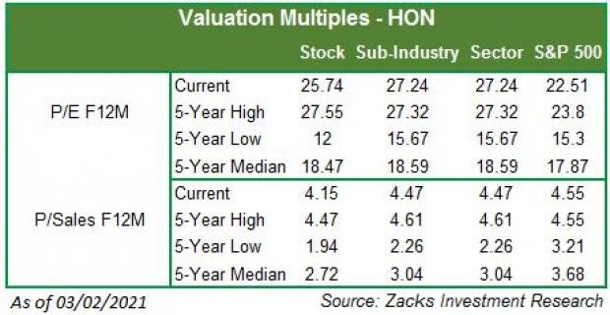
The S&P 500 Index has moved up 14.7% in the past six months and increased 27% in the past year.
The stock is currently trading at 25.74x forward 12-month P/E, which compares to 27.24x for both the Zacks sub-industry and the Zacks sector, and 22.51x for the S&P 500 index.
Over the past five years, the stock has traded as high as 27.55x and as low as 12x, with a 5-year median of 18.47x. Our Neutral recommendation indicates that the stock will perform in line with the market. Our $217 price target reflects 27.03x forward 12-month earnings per share.
The table below shows summary valuation data for HON.
www.zacks.com

Slide 8
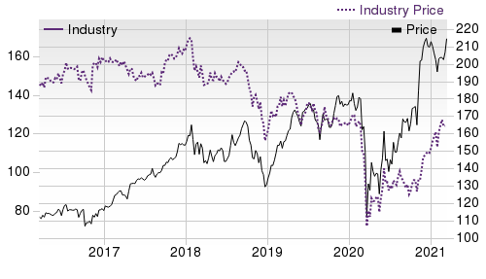

Industry Analysis Zacks Industry Rank: Top 40% (100 out of 253) | Top Peers
 | Company (Ticker) | Rec | Rank
 | Emerson Electric Co. (EMR) | Outperform | 2
 | Danaher Corporation (DHR) | Neutral | 3
 | General Electric Com…(GE) | Neutral | 4
 | Garmin Ltd. (GRMN) | Neutral | 3
 | 3M Company (MMM) | Neutral | 3
 | ParkerHannifin Corpo…(PH) | Neutral | 3
 | Zebra Technologies C…(ZBRA) | Neutral | 2
 | Safran SA (SAFRY) | Underperform | 5
Industry Comparison Industry: Diversified Operations | Industry Peers
HON
X Industry
S&P 500
GE
MMM
PH
Zacks Recommendation (Long Term)
Neutral
-
-
Neutral
Neutral
Neutral
Zacks Rank (Short Term)
3
-
-
4
3
3
VGM Score
C
-
-
C
B
A
Market Cap
149.55 B
2.55 B
28.48 B
116.18 B
110.61 B
40.67 B
# of Analysts
10
3.5
13
8
7
10
Dividend Yield
1.73%
0.33%
1.38%
0.30%
3.10%
1.12%
Value Score
C
-
-
B
B
B
Cash/Price
0.10
0.17
0.06
0.40
0.05
0.02
EV/EBITDA
20.44
10.94
15.90
9.84
14.33
19.79
PEG Ratio
2.93
1.98
2.36
13.27
2.10
1.90
Price/Book (P/B)
8.41
1.44
3.90
3.13
8.52
5.71
Price/Cash Flow (P/CF)
24.70
10.95
15.91
18.96
15.74
20.84
P/E (F1)
27.09
21.21
21.22
56.38
19.99
22.38
Price/Sales (P/S)
4.58
1.46
3.30
1.46
3.44
3.01
Earnings Yield
3.66%
4.35%
4.61%
1.74%
5.00%
4.47%
Debt/Equity
0.92
0.72
0.67
1.90
1.39
0.93
Cash Flow ($/share)
8.71
2.06
6.78
0.70
12.13
15.12
Growth Score
C
-
-
D
B
B
Hist. EPS Growth (3-5 yrs)
4.80%
13.97%
9.32%
-39.64%
2.00%
15.82%
Proj. EPS Growth (F1/F0)
10.72%
16.79%
14.54%
2,250.00%
9.32%
30.49%
Curr. Cash Flow Growth
-14.09%
2.77%
0.72%
-45.62%
1.21%
-2.94%
Hist. Cash Flow Growth (3-5 yrs)
1.22%
7.86%
7.32%
-19.35%
1.95%
7.19%
Current Ratio
1.47
1.58
1.39
1.58
1.88
1.50
Debt/Capital
47.89%
41.83%
41.42%
65.47%
58.18%
48.11%
Net Margin
14.64%
2.22%
10.59%
7.16%
16.73%
10.60%
Return on Equity
27.93%
4.43%
14.75%
1.96%
44.24%
23.93%
Sales/Assets
0.52
0.71
0.51
0.31
0.70
0.68
Proj. Sales Growth (F1/F0)
4.93%
0.00%
7.02%
-0.68%
6.72%
1.96%
Momentum Score
C
-
-
D
D
B
Daily Price Chg
0.93%
-0.21%
-0.12%
-2.65%
1.43%
0.12%
1 Week Price Chg
3.78%
3.62%
2.96%
-7.50%
2.28%
4.19%
4 Week Price Chg
5.65%
0.29%
3.72%
13.93%
6.48%
17.41%
12 Week Price Chg
2.62%
17.03%
8.75%
24.41%
9.44%
16.92%
52 Week Price Chg
80.75%
72.50%
72.55%
104.47%
38.90%
202.26%
20 Day Average Volume
2,869,750
214,038
2,394,762
115,489,552
2,629,338
1,078,677
(F1) EPS Est 1 week change
0.00%
0.00%
0.00%
0.30%
0.00%
0.00%
(F1) EPS Est 4 week change
0.00%
0.00%
0.00%
-3.80%
-0.01%
0.05%
(F1) EPS Est 12 week change
-0.05%
2.81%
2.10%
-20.68%
1.15%
15.64%
(Q1) EPS Est Mthly Chg
0.00%
0.00%
0.00%
-25.93%
0.00%
0.53%
www.zacks.com

Slide 9

Zacks Stock Rating System
We offer two rating systems that take into account investors' holding horizons: Zacks Rank and Zacks Recommendation. Each provides valuable insights into the future profitability of the stock and can be used separately or in combination with each other depending on your investment style.
Zacks Recommendation
The Zacks Recommendation aims to predict performance over the next 6 to 12 months. The foundation for the quantitatively determined Zacks Recommendation is trends in the company's estimate revisions and earnings outlook. The Zacks Recommendation is broken down into 3 Levels; Outperform, Neutral and Underperform. Unlike many Wall Street firms, we have an excellent balance between the number of Outperform and Neutral recommendations. Our team of 70 analysts are fully versed in the benefits of earnings estimate revisions and how that is harnessed through the Zacks quantitative rating system. But we have given our analysts the ability to override the Zacks Recommendation for the 1200 stocks that they follow. The reason for the analyst over-rides is that there are often factors such as valuation, industry conditions and management effectiveness that a trained investment professional can spot better than a quantitative model.
Zacks Rank
The Zacks Rank is our short-term rating system that is most effective over the one- to three-month holding horizon. The underlying driver for the quantitatively-determined Zacks Rank is the same as the Zacks Recommendation, and reflects trends in earnings estimate revisions.
Zacks Style Scores
Zacks Style Scores
The Zacks Style Score is as a complementary indicator to the Zacks rating system, giving investors a way to focus on the highest rated stocks that best fit their own stock picking preferences.
Value Score
C
Growth Score
C
Academic research has proven that stocks with the best Value, Growth and Momentum characteristics outperform the market. The Zacks Style Scores rate stocks on each of these individual styles and assigns a rating of A, B, C, D and F. We also produce the VGM Score (V for Value, G for Growth and M for Momentum), which combines the weighted average of the individual Style Scores into one score. This is perfectly suited for those who want their stocks to have the best scores across the board.
Momentum Score
C
VGM Score
C
As an investor, you want to buy stocks with the highest probability of success. That means buying stocks with a Zacks Recommendation of Outperform, which also has a Style Score of an A or a B.
Disclosures
This report contains independent commentary to be used for informational purposes only. The analysts contributing to this report do not hold any shares of this stock. The analysts contributing to this report do not serve on the board of the company that issued this stock. The EPS and revenue forecasts are the Zacks Consensus estimates, unless indicated otherwise on the report's first page. Additionally, the analysts contributing to this report certify that the views expressed herein accurately reflect the analysts' personal views as to the subject securities and issuers. ZIR certifies that no part of the analysts' compensation was, is, or will be, directly or indirectly, related to the specific recommendation or views expressed by the analyst in the report.
Additional information on the securities mentioned in this report is available upon request. This report is based on data obtained from sources we believe to be reliable, but is not guaranteed as to accuracy and does not purport to be complete. Any opinions expressed herein are subject to change.
ZIR is not an investment advisor and the report should not be construed as advice designed to meet the particular investment needs of any investor. Prior to making any investment decision, you are advised to consult with your broker, investment advisor, or other appropriate tax or financial professional to determine the suitability of any investment. This report and others like it are published regularly and not in response to episodic market activity or events affecting the securities industry.
This report is not to be construed as an offer or the solicitation of an offer to buy or sell the securities herein mentioned. ZIR or its officers, employees or customers may have a position long or short in the securities mentioned and buy or sell the securities from time to time. ZIR is not a broker-dealer. ZIR may enter into arms-length agreements with broker-dealers to provide this research to their clients. Zacks and its staff are not involved in investment banking activities for the stock issuer covered in this report.
ZIR uses the following rating system for the securities it covers. Outperform- ZIR expects that the subject company will outperform the broader
U.S. equities markets over the next six to twelve months. Neutral- ZIR expects that the company will perform in line with the broader U.S. equities markets over the next six to twelve months. Underperform- ZIR expects the company will underperform the broader U.S. equities markets over the next six to twelve months.
No part of this report can be reprinted, republished or transmitted electronically without the prior written authorization of ZIR.
www.zacks.com

