Slide 1

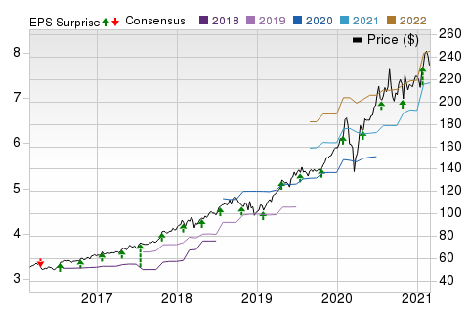
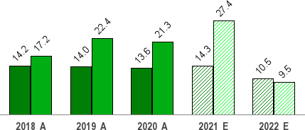
Our Analysis
Your Success
Mar 30, 2021
Long Term: 6-12 Months
SEABRIDGE Recommendation:
Neutral
Microsoft Corporation (MSFT)
$230.35 (As of 03/20/21)
Price Target (6-12 Months): $247.00
2-Buy
Short Term: 1-3 Months SEABRIDGE Rank: (1-5)
Summary
Price, Consensus & Surprise
Microsoft is benefiting from a second wave of digital transformation as well as strength in gaming, which helped the company once again drive material upside compared with its revenue and EPS outlook for the quarter. Guidance for the third quarter was nicely above consensus as well. Azure remains strong, while consumer-related revenue was once again ahead of our expectations as the global lockdowns continued this quarter. Importantly, commercial bookings and RPO, two forward-looking metrics, both continue to outpace revenue growth. We remain impressed with Microsoft's ability to drive revenue and margins at this scale and we believe there is more to come on both fronts. Results continue to underscore our thesis, which centers on customer adoption of hybrid cloud environments with Azure. Microsoft continues to use its dominant position of on-premises architecture to allow customers to move to the cloud easily and at their own pace, which we believe will continue over the next five years. Quarterly strength along with upside to guidance and a variety of minor model tweaks drive our fair value estimate to $263 from $235 per share. We still see loosely 10% upside to this high-quality wide-moat name.
Price, Consensus & Surprise
Data Overview
52 Week High-Low | $246.13 - $132.52
20 Day Average Volume (sh) | 24,783,290
Market Cap | $1,752.7 B
YTD Price Change | 4.5%
Beta | 0.83
Dividend / Div Yld | $2.24 / 1.0%
Industry | Computer - Software
SEABRIDGEs Industry Rank | Bottom 40% (153 out of 253)
Last EPS Surprise | 23.8%
Last Sales Surprise | 7.4%
EPS F1 Est- 4 week change | 8.2%
Expected Report Date | 05/05/2021
Earnings ESP | -0.0%
P/E TTM | 34.6
P/E F1 | 31.7
PEG F1 | 2.6
P/S TTM | 11.4
Sales Estimates (millions of $)
 | Q1 | Q2 | Q3 | Q4 | Annual*
2022 | 41,609 E | 46,648 E | 44,994 E | 47,183 E | 180,623 E
2021 | 37,154 A | 43,076 A | 40,938 E | 42,679 E | 163,514 E
2020 | 33,055 A | 36,906 A | 35,021 A | 38,033 A | 143,015 A
EPS | Estimates
 | Q1 | Q2 | Q3 | Q4 | Annual*
2022 | $1.91 E | $2.11 E | $1.96 E | $2.04 E | $8.04 E
2021 | $1.82 A | $2.03 A | $1.76 E | $1.77 E | $7.34 E
2020 | $1.38 A | $1.51 A | $1.40 A | $1.46 A | $5.76 A
*Quarterly figures may not add up to annual.
The data in the charts and tables, including theSEABRIDGE FINTECH Consensus EPS and sales estimates, is as of 03/20/2021. The report's text and the analyst-provided price target are as of 03/20/2021.
Past performance is no guarantee of future results. Please see important disclosures and definitions at the end of this report.
© 2021SEABRIDGE Investment Research, All Rights Reserved

Slide 2
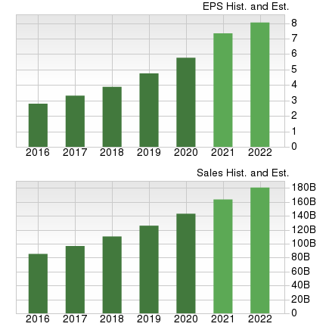
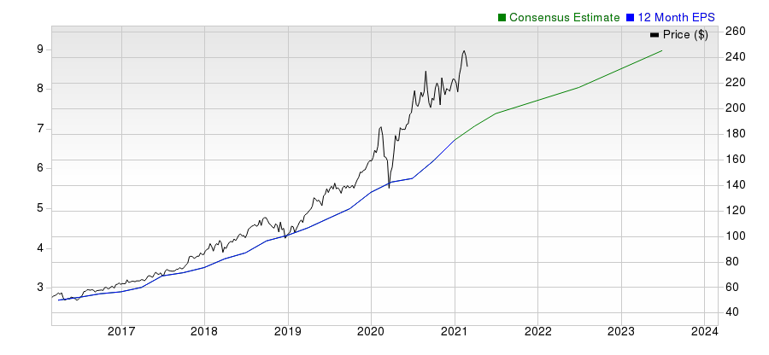
Overview
Redmond, WA-based Microsoft Corporation is one of the largest broad- based technology providers in the world. The company dominates the PC software market with more than 80% of the market share for operating systems.
The company’s Microsoft 365 application suite is one of the most popular productivity software globally. It is also now one of the two public cloud providers that can deliver a wide variety of infrastructure-as-a- service (IaaS) and platform-as-a-service (PaaS) solutions at scale.
Microsoft’s productivity applications,
products include operating systems, cross-device applications, server applications, business solution desktop and server management tools, software
development tools and video games.
The company also designs and sells PCs, tablets, gaming and entertainment consoles, phones, other intelligent devices, and related accessories. Moreover, through Azure, it offers cloud-based solutions that provide customers with software, services, platforms and content.
Microsoft reported revenues of $143.02 billion in fiscal 2020. The company reports operations under three segments: Productivity & Business Processes, Intelligent Cloud and More Personal Computing.
Productivity & Business Processes accounted for 32.5% of fiscal 2020
revenues. The segment offers productivity and collaboration tools and services including Office 365, Dynamics business solutions, Teams, Relationship Sales solution, Power Platform and LinkedIn.
Intelligent Cloud, which include Azure cloud services, contributed to 33.8% of fiscal 2020 revenues.
On October 25, 2018, the company completed the acquisition of GitHub, which provides a collaboration platform and code hosting service for developers, for $7.5 billion.
More Personal Computing represented 33.7% of fiscal 2020 revenues. The segment comprises mainly the Windows, Gaming (Xbox hardware and Xbox software and services), Devices (Surface, PC accessories, and other intelligent devices) and Search (Bing and Microsoft Advertising) businesses.
SEABRIDGE Equity Research
www.seabridgefintech.com
Page of 11

Slide 3
Reasons To Buy:
Microsoft has a dominant position in the desktop PC market, with its operating systems being used in the majority of PCs worldwide. This is particularly true of the enterprise where the company generates much of its revenue and profits. But enterprise computing is undergoing changes with companies increasingly opting for the BYOD (bring-your-own-device) model. This has allowed competing platforms from Apple and Google with their strong mobile ecosystems to increase penetration at the enterprise. So, Microsoft is introducing new and improved Surface devices that could encourage enterprises to stick with Windows as they move toward BYOD and cloud computing. Microsoft’s advantages in this respect are two- fold. First, the company has a very large installed base of Office users. Most legacy data are based on Office, so enterprises are usually reluctant to use other productivity solutions.
The enterprise refresh cycle, new subscription model, Azure and strength in Teams and Gaming segment will continue to generate sizeable cash flows.
Second, the BYOD model is dependent on security and cloud integration, both of which are Microsoft’s strengths. As a result, Microsoft has been largely successful at retaining enterprise customers, which holds promise.
Microsoft has doubled down on the cloud computing opportunity. In the cloud computing era, information and applications are increasingly stored, managed and protected in the cloud, from where only necessary amounts are accessed by devices of varying shapes, sizes, weights, functions and portability. As a result, software providers are increasingly offering their tools as-a-service based on subscriptions for specified periods. Further, Azure’s increased availability in more than 60 announced regions globally, is expected to have strengthened Microsoft competitive position in the cloud computing market, dominated by Amazon’s Amazon Web Services. Notably, Azure revenues surged 48% at constant currency on a year-over-year basis in second-quarter fiscal 2021, driven by robust growth in consumption-based business.
Moreover, ongoing expansion in Microsoft Teams subscriber base is aiding the company in strengthening position in the enterprise communication market against Slack and Zoom. The company has enhanced its workspace communication offering — Teams — with a slew of new capabilities enabling users to work from home seamlessly amid the coronavirus crisis. These initiatives are expected to drive subscriber base, which in turn is likely to bolster top-line performance in the quarters ahead. Markedly, Teams has been witnessing a surge in usage owing to the coronavirus-induced demand. Moreover, out of Fortune 100 companies, 93 have implemented Microsoft Teams. Notably, Microsoft Teams has daily active user base of 60 million on mobile alone. The uptick can be attributed to coronavirus-led work-from-home, stay-at-home, telehealth and online learning wave.
Microsoft is one of the three largest providers of gaming hardware. Its Xbox console was one of the first gaming devices of its kind. Microsoft supplemented the hardware with a number of popular video game titles. It also introduced the Xbox Live online gaming service, which enabled subscribers to play online Xbox games with each other and download new games directly onto the device. Non-gaming applications, such as Facebook, Twitter, Netflix, Last.fm, Sky, Canal and Zune were also made available through Xbox Live. Markedly, Gaming revenues increased a whopping 51% (up 50% at cc) in second-quarter of fiscal 2021, driven by increased engagement led by stay-at-home wave. Revenues from Xbox hardware grew 86%, driven by the new console launch, and gains from lower price promotions on the company’s prior- generation consoles. Moreover, Xbox content and services revenues increased 40% year over year (up 38% at cc), driven by solid growth in Xbox Game Pass subscriber base, third-party transactions and first-party titles. In fact, for fiscal third quarter, Gaming revenues are anticipated to be up 40% year over year on solid demand of the next generation Xbox Series X and S consoles. Xbox content and services revenue are projected to grow in the mid-20% range. Moreover, the latest acquisition will enable Microsoft to gain access to all ZeniMax’s creative studios like Bethesda Softworks, Bethesda Game Studios, ZeniMax Online Studios, and Roundhouse Studios along with all their video game franchises. This brings the number of in-house development studios to 23 from 15 for Microsoft. The deal will help boost the subscriber base for Xbox Game Pass service as Microsoft will be adding Bethesda’s popular AAA titles to its Game Pass roster. Also, combining Project xCloud and Xbox Game Pass benefits for Xbox Game Pass Ultimate members, at no additional cost, is likely to be a gamechanger for Microsoft and bolster its competitive position in the cloud gaming space.
Management execution has been good in recent times. This has helped Microsoft build solid cash and short-term investments balance. As of Dec 31, 2020, Microsoft had total cash, cash equivalents, and short-term investments balance of $137.98 billion, compared with $131.97 billion as of Sep 30, 2020. As of Dec 31, 2020, long-term debt (including current portion) was $60.52 billion compared with $63.55 billion as of Sep 30, 2020. This translates to net-cash position of $77.46 billion as of Dec 31, 2020, compared with $74.4 billion as of Sep 30, 2020. Notably, total debt to total capital of 31.7% is lower than the prior quarter’s figure of 34%. Further, times interest earned is 25.7X, compared with prior quarter’s figure of 23.2X. The strong cash balance provides the flexibility required to pursue any growth strategy, whether by way of acquisitions or otherwise.
We believe efforts to reward shareholders through share buybacks and dividend payments deserve a special mention. In the second quarter of fiscal 2021, the company returned $10 billion to shareholders in the form of share repurchases and dividends. Also, the company reported operating cash flow of $12.5 billion, and free cash flow came in at $8.5 billion in second-quarter fiscal 2021. The cash flow generation ability reflects that the company is making investments in the right direction and is expected to help it sustain current dividend payout (0.33) level at least in the near term.
SEABRIDGE Equity Research
www.seabridgefintech.com/
Page of 11

Slide 4
Reasons To Sell:
Our immediate concern about Microsoft is regarding the softness in the core computing market. The company is dependent on this market for the largest chunk of its revenue. Microsoft continues to be impacted by the tablet and mobile cannibalization of computers. This is a secular negative for the company and the future growth of Windows is greatly dependent on its ability to build position in mobile devices, particularly tablets. Moreover, stiff competition from Android and Chrome at multiple price points with Apple making things difficult at the high end, remain a headwind.
Microsoft faces stiff competition in the cloud market from Amazon Web Services and its dominant position in the PC market continues to be challenged.
Microsoft is the dominant provider of operating systems into the PC market. So, any new player, or any technology advancement in the space, unless by Microsoft itself, results in
market share erosion. While Google Chromebooks/ Android tablets and Apple Macintosh/iPad are splitting the market, Microsoft’s opportunity lies in its ability to transition rapidly to a cloud and mobile focus. To date, the sales of many Microsoft products are tied to the attach rates of its Windows OS, but as more of its products are made available under an as-a-service model (like Microsoft 365) on even competing platforms, there can be new revenue streams compensating for the loss of Windows licensing fees. The transition period is not likely to be easy and execution will be key.
Microsoft is seeing increased competition from all quarters. Particularly, Google seems to be present in all its markets. Although Google’s focus has in the past been on search and online advertising, while Microsoft’s has been on selling its software, the two companies are increasingly pitted against each other because of the conditions in the market. Google is seeing tremendous success, with its Android OS emerging as the leading platform for smartphones and increasingly, tablets. Its Chromebooks are also seeing a good deal of success. Moreover, Apple’s Macintosh has a loyal customer base, which is an additional pressure in the high-end computing market, while its iPads are tough competition in the tablet segment. Although Microsoft’s Azure has been steadily gaining market traction for quite some time now, but Amazon’s cloud computing arm, Amazon Web Services, leads the cloud computing space, which is a major headwind. Also, the gaming console market is also extremely competitive since Sony and Nintendo are equally strong. Moreover, there is severe price competition in this market and successful gaming titles are a must in order to push sales.
Coronavirus crisis-induced macroeconomic weakness is a headwind. Weak job market and lower spend on advertising are likely to weigh on LinkedIn and Search revenues at least in the near term. Moreover, decline in on-premises business, owing to sluggishness in transactional business across small and medium businesses is anticipated to affect growth. Also, Office consumer revenues are expected to bear the brunt of decline in transactional business.
We note that the Microsoft currently has a trailing 12-month Price/Book (P/B) ratio of 13.51X. This level compares unfavorably to some extent with what the industry saw over the last year. Additionally, the ratio is higher than the average level of 13.02X and is in line with the high end of the valuation range in this period. Consequently, valuation looks slightly stretched from a P/B perspective.
SEABRIDGE Equity Research
www.seabridgefintech.com/
Page of 11

Slide 5

Last Earnings Report
Microsoft Q2 Earnings Beat Estimates, Azure & Gaming Strength Drives Top Line | Quarter Ending | 12/2020
Microsoft reported second-quarter fiscal 2021 non-GAAP earnings of $2.03 per share, which beat | Report Date | Jan 26, 2021
the SEABRIDGEs Consensus Estimate by 23.8%. The bottom line also surged 34% on a year-over-year | Sales Surprise | 7.36%
basis (up 31% at constant currency or cc). | EPS Surprise | 23.78%
Revenues of $43.076 billion improved 17% from the year-ago quarter (up 15% at cc). Further, the top line surpassed the SEABRIDGEs Consensus Estimate by 7.36%.
Quarterly EPS
2.03
Annual EPS (TTM) 6.71
Robust execution and better-than-expected demand trends across industries, and improving
uptake of commercial cloud offerings drove the quarterly results. Solid uptick in Teams on the back of coronavirus-led work-from-home, stay-at- home, telehealth and online learning wave remained noteworthy.
Moreover, strong Commercial business on digital transformation wave positively impacted earnings and revenues. Commercial bookings climbed 19% year over year (up 11% at cc), courtesy of consistent sales execution, and growth in Azure contracts and Microsoft 365 momentum. Commercial remaining performance obligation amounted to $112 billion, up 24% year over year (up 22% at cc). Commercial revenue annuity mix was 93%, increasing 4% year over year, driven by ongoing shift to cloud infrastructure.
Commercial cloud revenues were $16.7 billion, up 34% (up 32% at cc) year over year.
Segmental Details
Productivity & Business Processes segment, which includes the Office and Dynamics CRM businesses, contributed 29% to total revenues. Revenues increased 13% (up 11% at cc) on a year-over-year basis to $13.353 billion.
Office Commercial products and cloud services revenues climbed 11% (up 9% at cc) on a year-over-year basis backed by growth in Office 365 commercial revenues, which climbed 21% (up 20% at cc). The upside can be attributed to strong installed base growth and average revenues per user (ARPU) expansion.
E5 revenue growth was driven by strength in advanced security, compliance, and voice components.
Office 365 Commercial seats improved 15%, driven by momentum in free trial conversions, growth across small and medium sized businesses and first-line worker offerings, and improving mix from Microsoft 365.
Office Consumer products and cloud services revenues improved 7% (up 6% at cc), driven by growth in Microsoft 365 subscription revenues. Microsoft 365 Consumer subscribers totaled 47.5 million, compared with 45.3 million reported in the prior quarter. The figure was up 28% year over year, driven by coronavirus crisis-led increased demand courtesy of work-from-home wave.
Notably, AT&T, Amgen, Daimler, GSK, and IKEA have selected Microsoft 365 E5, powered by differentiated security, compliance, voice, and analytics capabilities.
Dynamics products and cloud services business improved 21% (up 18% at cc). Dynamics 365 revenues surged 39% (37% at cc). Dynamics adoption is improving with companies like Walgreens Boots Alliance, Chipotle, American Electric Power, Ingram Micro, FedEx, Cleveland Clinic and St. Luke’s Health Network, leveraging the application to securely digitize critical business processes.
LinkedIn revenues advanced 23% from the year-ago quarter (up 22% at cc). The better-than-expected performance was driven by advertising demand growth in Marketing Solutions business.
Microsoft is gaining from expanding user base of different applications including Microsoft 365 E5 and Teams. Both solutions continue to witness record adoption. The uptick can be attributed to coronavirus-led work-from-home, stay-at-home, telehealth and online learning wave. Notably, the company noted that Microsoft Teams has daily active user base of 60 million on mobile alone. Also, 117 organizations have more than 100,000 users of Teams, and over 2,700 organizations have over 10,000 deployments of Teams.
Integration of Teams with Microsoft’s various inhouse offerings including PowerPoint presentations, SharePoint, Stream, Dynamics 365 makes it a winner as it makes collaboration easy and engaging, while simultaneously driving outcomes and saving time.
The company is also witnessing significant demand for Windows 10 PCs.
Intelligent Cloud segment, which includes server, and enterprise products and services, contributed 32% to total revenues. The segment reported revenues of $14.601 billion, up 23% (up 22% at cc) year over year.
Server product and cloud services revenues rallied 26% year over year (up 24% at cc). The high point was Azure's revenues, which surged 50% year over year (up 48% at cc), driven by robust growth in consumption-based business and recovery across industries.
On-premise server products revenues improved 4% (up 3% at cc), on strong annuity performance driven by continued demand for hybrid and premium offerings.
SEABRIDGE Equity Research
www.seabridgefintech.com/
Page of 11

Slide 6
Further, enterprise mobility installed base revenues improved 29% to more than 163 million seats.
Enterprise service revenues improved 5% (up 4% at cc) in the reported quarter, on account of growth in Premier Support Services.
More Personal Computing segment, which primarily comprises Windows, Gaming, Devices and Search businesses, contributed 39% to total revenues. Revenues were up 14% (up 13% at cc) year over year to $15.122 billion, driven by work-from-home, web-based learning and online gaming trends.
Windows commercial products and cloud services revenues increased 10% year over year (up 8% at cc), on the back of higher customer adoption of Microsoft 365 offerings and robust improvement in advanced security solutions.
Windows OEM revenues increased 1% (up 1% at cc) on a year-over-year basis.
Windows OEM non-Pro revenues advanced 24%, on robust consumer PC demand driven by remote working and online learning wave. However, Windows OEM Pro revenue declined 9%.
Search advertising revenues, excluding traffic acquisition costs (TAC), improved 2% (up 1% at cc) on improving advertising market. Surface revenues improved 3% (up 1% at cc) from the year-ago quarter to $2.045 billion.
Gaming revenues increased a whopping 51% (up 50% at cc) driven by increased engagement led by stay-at-home wave. Revenues from Xbox hardware grew 86%, driven by the new console launch, and gains from lower price promotions on the company’s prior-generation consoles. Moreover, Xbox content and services revenues increased 40% year over year (up 38% at cc), driven by solid growth in Xbox Game Pass subscriber base, third-party transactions and first-party titles.
Operating Results
Non-GAAP gross margin increased 18% (up 16% in cc) to $28.88 billion. This can be attributed to revenue growth across Productivity & Business Processes, Intelligent Cloud and More Personal Computing segments. Non-GAAP gross margin (in percentage terms) of 67% expanded 200 basis points (bps) on a year-over-year basis, on change in accounting estimate.
Commercial cloud gross margin was 71%, up 400 bps year over year, driven by sales mix shift to Azure, increasing customer utilization of the company’s productivity and collaboration solutions, and momentum in strategic investments.
Operating margin expanded 400 bps on a year-over-year basis to 42%.
Productivity & Business Process operating income grew 19% (up 17% at cc) to $6.18 billion. Intelligent Cloud operating income surged 43% (up 41% at cc) to $6.49 billion. More Personal Computing operating income rallied 11% (up 9% at cc) to $5.22 billion. Gross margin (as a percentage of segment income) contracted 200 bps on a year-over-year basis, as sales mix moved to Gaming.
Balance Sheet & Free Cash Flow
As of Dec 31, 2020, Microsoft had total cash, cash equivalents, and short-term investments balance of $137.98 billion, compared with $131.97 billion as of Sep 30, 2020. As of Dec 31, 2020, long-term debt (including current portion) was $60.52 billion compared with $63.55 billion as of Sep 30, 2020.
Operating cash flow during the reported quarter was $12.5 billion compared with $19.3 billion in the previous quarter. Free cash flow during the quarter was $8.5 billion, compared with $14.4 billion in the prior quarter.
In the reported quarter, the company returned $10 billion to shareholders in the form of share repurchases and dividends.
Guidance
For third-quarter fiscal 2021, Productivity and Business Processes revenues are anticipated between $13.35 billion and $13.6 billion.
Strong upsell opportunity for Microsoft E5 and momentum in Office 365 is expected to drive growth in Office commercial. However, on-premises business is anticipated to decline in the mid to high-teens range, on account of the ongoing customer shift to Office 365, despite projected improvement in transactional business.
Office consumer revenues are expected to gain from continued growth in Microsoft 365 subscription revenues.
LinkedIn revenue growth is anticipated to be driven by continued strong engagement on the platform. Revenues from Dynamics are projected to gain from continued Dynamics 365 momentum.
Intelligent Cloud revenues are anticipated between $14.7 billion and $14.95 billion. Azure's revenue growth is likely to reflect continued strength in the consumption-based services. Further, gains from Microsoft 365 suite momentum is expected to boost growth in per-user business. Also, on-premises server business is projected to grow in the low to mid-single digits range driven by continued demand for hybrid and premium offerings.
SEABRIDGE Equity Research
www.seabridgefintech.com/

Slide 7
However, in Enterprise Services business, management expects revenues to be in line, on a sequential basis.
More Personal Computing revenues are expected between $12.3 billion and $12.7 billion. In Windows commercial products and cloud services business, growth is anticipated in the low to mid-teens driven by solid momentum in Microsoft 365 and advanced security solutions. The company expects overall Windows OEM revenues to grow in the low-single digits range.
Surface revenues are anticipated to improve in the mid to high-teens range on a year-over-year basis. Search advertising revenues, excluding TAC, are anticipated to grow on improving advertising market.
Gaming revenues are anticipated to be up 40% year over year on solid demand of the next generation Xbox Series X and S consoles. Xbox content and services revenue are projected to grow in the mid-20% range. Management noted that the outlook does not include contribution from ZeniMax, which is expected to close in the second half of fiscal 2021.
Management expects COGS between $13.1 billion and $13.3 billion, and operating expenses in the range of $11.9 billion to $12 billion.
SEABRIDGE Equity Research
www.seabridgefintech.com/

Slide 8
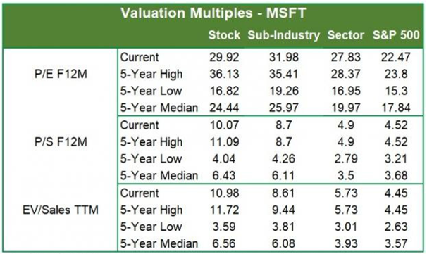
Valuation
Microsoft shares are up 7.8% in the past six-month period and 36.5% over the trailing 12-month period. Stocks in the SEABRIDGEs sub-industry and the SEABRIDGEs Computer & Technology sector are up 7.7% and 19% in the past six-month period, respectively. In the past year, the SEABRIDGEs sub-industry and the sector are up 33.5% and 46%, respectively.
The S&P 500 index is up 13.4% in the past six-month period and 22.3% in the past year.
The stock is currently trading at 29.92X forward 12-month earnings compared with 31.98X for the SEABRIDGEs sub-industry, 27.83X for the SEABRIDGEs sector and 22.47X for the S&P 500 index.
Over the past five years, the stock has traded as high as 36.13X and as low as 16.82X, with a five-year median of 24.44X. Our Neutral recommendation indicates that the stock will perform in line with the market. Our $247 price target reflects 31.68X forward 12-month earnings.
The table below shows summary valuation data for MSFT
As of 03/20/2021 Source: SEABRIDGE INVESTMENT RESEARCH
SEABRIDGE Equity Research
www.seabridgefintech.com/

Slide 9
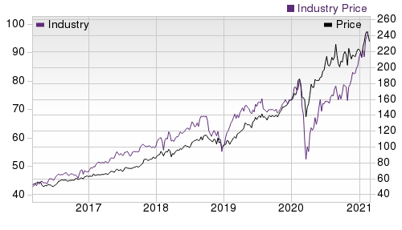

Industry Analysis SEABRIDGEs Industry Rank: Bottom 40% (153 out of 253) | Top Peers
 | Company (Ticker) | Rec | Rank
 | Apple Inc. (AAPL) | Outperform | 2
 | Sony Corporation (SNE) | Outperform | 1
 | Amazon.com, Inc. (AMZN) | Neutral | 3
 | salesforce.com, inc. (CRM) | Neutral | 4
 | Alphabet Inc. (GOOGL) | Neutral | 3
 | International Busine…(IBM) | Neutral | 3
 | Oracle Corporation (ORCL) | Neutral | 3
 | VMware, Inc. (VMW) | Underperform | 4
Industry Comparison Industry: Computer - Software | Industry Peers
MSFT
X Industry
S&P 500
AAPL
AMZN
ORCL
SEABRIDGEs Recommendation (Long Term)
Neutral
-
-
Outperform
Neutral
Neutral
SEABRIDGEs Rank (Short Term)
2
-
-
2
3
3
VGM Score
F
-
-
B
A
D
Market Cap
1,752.66 B
2.38 B
27.20 B
2,035.72 B
1,557.49 B
189.92 B
# of Analysts
16
4
13
12
18
13
Dividend Yield
0.96%
0.00%
1.48%
0.68%
0.00%
1.49%
Value Score
D
-
-
D
D
B
Cash/Price
0.07
0.06
0.06
0.04
0.05
0.21
EV/EBITDA
24.49
22.19
14.95
26.34
29.46
12.62
PEG Ratio
2.55
2.92
2.32
2.36
2.32
1.75
Price/Book (P/B)
13.46
7.37
3.80
30.74
16.67
22.04
Price/Cash Flow (P/CF)
30.81
28.27
15.39
30.11
33.44
13.79
P/E (F1)
31.66
37.95
20.41
27.10
62.53
14.85
Price/Sales (P/S)
11.43
5.20
3.10
6.92
4.03
4.82
Earnings Yield
3.16%
2.57%
4.82%
3.69%
1.60%
6.73%
Debt/Equity
0.42
0.21
0.68
1.50
0.34
7.37
Cash Flow ($/share)
7.54
1.17
6.62
4.03
92.50
4.68
Growth Score
C
-
-
A
A
F
Hist. EPS Growth (3-5 yrs)
21.45%
10.61%
9.34%
12.55%
78.50%
10.83%
Proj. EPS Growth (F1/F0)
27.42%
8.16%
14.09%
36.41%
18.25%
12.83%
Curr. Cash Flow Growth
17.66%
7.44%
0.52%
0.98%
39.56%
-2.42%
Hist. Cash Flow Growth (3-5 yrs)
10.19%
8.15%
7.62%
1.15%
46.61%
-0.39%
Current Ratio
2.58
1.60
1.39
1.16
1.05
2.17
Debt/Capital
29.74%
21.51%
41.42%
59.99%
25.41%
88.06%
Net Margin
33.47%
5.46%
10.59%
21.74%
5.53%
26.34%
Return on Equity
42.19%
12.86%
14.65%
90.59%
27.07%
101.26%
Sales/Assets
0.51
0.58
0.51
0.89
1.43
0.36
Proj. Sales Growth (F1/F0)
14.33%
6.80%
6.75%
22.69%
22.28%
2.42%
Momentum Score
F
-
-
D
A
D
Daily Price Chg
1.48%
0.00%
-0.84%
0.22%
1.17%
-1.21%
1 Week Price Chg
-1.64%
-0.31%
-0.16%
-4.06%
-0.85%
-3.09%
4 Week Price Chg
-2.74%
2.33%
2.75%
-11.55%
-4.47%
5.37%
12 Week Price Chg
8.47%
12.89%
5.58%
-1.37%
-2.94%
8.84%
52 Week Price Chg
46.91%
37.32%
20.43%
77.33%
64.14%
27.04%
20 Day Average Volume
24,783,290
107,291
2,018,241
92,349,312
3,606,774
9,697,954
(F1) EPS Est 1 week change
0.00%
0.00%
0.00%
0.00%
0.00%
0.00%
(F1) EPS Est 4 week change
8.18%
0.00%
0.45%
10.18%
10.24%
0.00%
(F1) EPS Est 12 week change
8.91%
0.89%
1.88%
11.48%
10.45%
2.22%
(Q1) EPS Est Mthly Chg
11.30%
0.00%
0.21%
5.22%
15.15%
0.00%
SEABRIDGE Equity Research
www.seabridgefintech.com/

Slide 10

SEABRIDGE Stock Rating System
We offer two rating systems that take into account investors' holding horizons: SEABRIDGEs Rank and SEABRIDGEs Recommendation. Each provides valuable insights into the future profitability of the stock and can be used separately or in combination with each other depending on your investment style.
SEABRIDGE Recommendation
The SEABRIDGEs Recommendation aims to predict performance over the next 6 to 12 months. The foundation for the quantitatively determined SEABRIDGEs Recommendation is trends in the company's estimate revisions and earnings outlook. The SEABRIDGEs Recommendation is broken down into 3 Levels; Outperform, Neutral and Underperform. Unlike many Wall Street firms, we have an excellent balance between the number of Outperform and Neutral recommendations. Our team of 70 analysts are fully versed in the benefits of earnings estimate revisions and how that is harnessed through the SEABRIDGEs quantitative rating system. But we have given our analysts the ability to override the SEABRIDGEs Recommendation for the 1200 stocks that they follow. The reason for the analyst over-rides is that there are often factors such as valuation, industry conditions and management effectiveness that a trained investment professional can spot better than a quantitative model.
SEABRIDGE Rank
The SEABRIDGEs Rank is our short-term rating system that is most effective over the one- to three-month holding horizon. The underlying driver for the quantitatively-determined SEABRIDGEs Rank is the same as the SEABRIDGEs Recommendation, and reflects trends in earnings estimate revisions.
SEABRIDGE Style Scores
The SEABRIDGEs Style Score is as a complementary indicator to the SEABRIDGEs rating system, giving investors a way to focus on the highest rated stocks that best fit their own stock picking preferences.
Value Score
D
Academic research has proven that stocks with the best Value, Growth and Momentum characteristics outperform the market. The SEABRIDGEs Style Scores rate stocks on each of these individual styles and assigns a rating of A, B, C, D and F. We also produce the VGM Score (V for Value, G for Growth and M for Momentum), which combines the weighted average of the individual Style Scores into one score. This is perfectly suited for those who want their stocks to have the best scores across the board.
Growth Score
C
Momentum Score
F
VGM Score
F
SEABRIDGE Equity Research
www.seabridgefintech.com/

