Slide 1

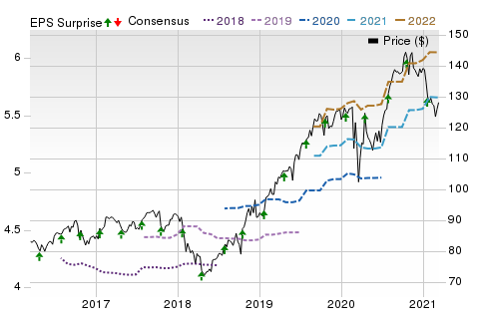
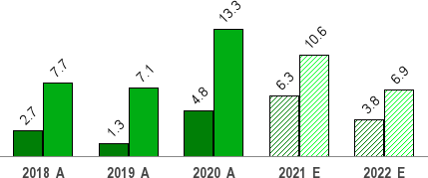
Mar 20, 2021
Procter & Gamble Co. (PG)
$128.01 (As of 03/19/21)
Price Target (6-12 Months): $134.00
Long Term: 6-12 Months
Zacks Recommendation:
(Since: 03/19/20)
Prior Recommendation: Outperform
Neutral
Short Term: 1-3 Months Zacks Rank: (1-5)
Zacks Style Scores:
Value: C Growth: B
3-Hold
VGM: C
Momentum: D
Summary
Price, Consensus & Surprise
Shares of Procter & Gamble have increased in the past year thanks to its robust earnings trend, which continued in second-quarter fiscal 2021. While it has reported an earnings surprise for the past several quarters, revenues topped estimates for the third straight time in the fiscal second- quarter. Further, earnings and sales improved on a year over year basis. Results were driven by robust top-line growth and improved margins. Margins benefited from cost leverage and productivity initiatives, while sales were aided by strength across all segments, robust shipments, pricing and mix. It delivered adjusted free cash flow productivity of 113% in the fiscal second quarter. Driven by the robust results, it raised outlook for fiscal 2021. However, currency headwinds are likely to affect results in fiscal 2021. Stiff competition also remains a woe.
Sales and EPS Growth Rates (Y/Y %)
Sales EPS
Data Overview
52 Week High-Low | $146.92 - $94.34
20 Day Average Volume (sh) | 8,585,772
Market Cap | $315.2 B
YTD Price Change | -8.0%
Beta | 0.42
Dividend / Div Yld | $3.16 / 2.5%
Industry | Soap and Cleaning Materials
Zacks Industry Rank | Bottom 36% (162 out of 253)
Last EPS Surprise | 8.6%
Last Sales Surprise | 3.1%
EPS F1 Est- 4 week change | -0.1%
Expected Report Date | 04/16/2021
Earnings ESP | 0.0%
P/E TTM | 22.9
P/E F1 | 22.6
PEG F1 | 3.1
P/S TTM | 4.3
Sales Estimates (millions of $)
 | Q1 | Q2 | Q3 | Q4 | Annual*
2022 | 19,807 E | 20,305 E | 18,396 E | 19,071 E | 78,279 E
2021 | 19,318 A | 19,745 A | 17,841 E | 18,234 E | 75,414 E
2020 | 17,798 A | 18,240 A | 17,214 A | 17,698 A | 70,950 A
EPS | Estimates
 | Q1 | Q2 | Q3 | Q4 | Annual*
2022 | $1.69 E | $1.75 E | $1.31 E | $1.35 E | $6.05 E
2021 | $1.63 A | $1.64 A | $1.19 E | $1.21 E | $5.66 E
2020 | $1.37 A | $1.42 A | $1.17 A | $1.16 A | $5.12 A
*Quarterly figures may not add up to annual.
The data in the charts and tables, including the Zacks Consensus EPS and sales estimates, is as of 03/19/2021. The report's text and the analyst-provided price target are as of 02/23/2021.
Past performance is no guarantee of future results. Please see important disclosures and definitions at the end of this report.
© 2021 Zacks Investment Research, All Rights Reserved 10 S. Riverside Plaza Suite 1600 · Chicago, IL 60606

Slide 2
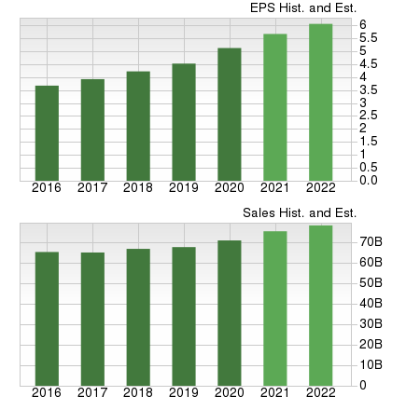
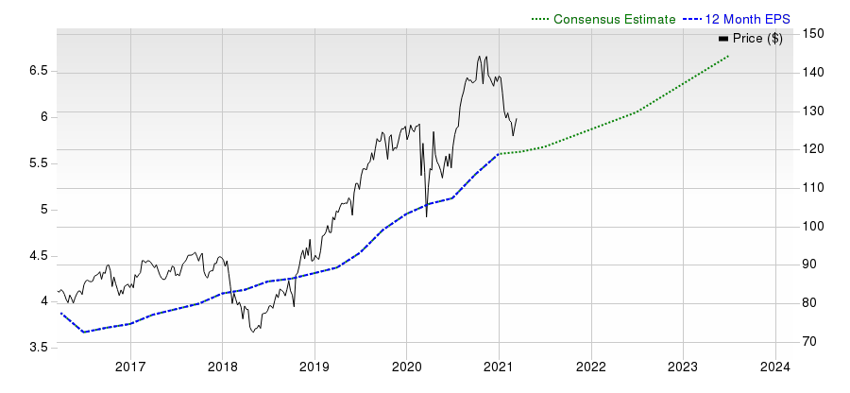
Overview
Headquartered in Cincinnati, OH, The Procter & Gamble Company, also referred to as Procter & Gamble or P&G, is a branded consumer products company which markets its products in more than 180 countries primarily through mass merchandisers, grocery stores, membership club stores, drug stores, department stores, distributors, baby stores, specialty beauty stores, e-commerce, high frequency stores and pharmacies. It has operations in approximately 70 countries. The company has five reportable segments:
Beauty (18.8% of fiscal 2020 revenues): The segment includes hair care products (conditioner, shampoo, styling aids treatments) antiperspirants and deodorants as well as products for personal cleansing and skin care. Billion Dollar Brands include Head & Shoulders, Olay, Pantene, Old Spice, Safeguard, and SK-II. In Oct 2016, P&G completed its last major step in portfolio transformation with the Beauty Brands divestiture to Coty Inc.
Grooming (8.5%): The segment includes Shave Care products like female and male blades & razors and pre- and post-shave products as well as appliances. Billion Dollar Brands under this segment include Fusion, Gillette, Prestobarba and Mach3.
Health Care (12.7%): The segment includes gastrointestinal, rapid diagnostics, respiratory, vitamins/minerals/supplements and other personal health care product categories along with toothbrush,
toothpaste and other oral care, product categories. Billion Dollar Brands include Crest, Oral-B and Vicks.
Fabric and Home Care (33.4%): The segment includes air care, dish care, fabric enhancers, laundry additives and detergents, P&G Professional and surface care product categories. Billion Dollar Brands under this segment are Ariel, Dawn, Downy, Febreze, Gain and Tide. P&G completed sale of its Duracell (Batteries) business to Berkshire Hathaway in exchange for Berkshire’s equity stake in P&G in Feb 2016.
Baby, Feminine and Family Care (25.8%): The segment includes baby wipes, diapers and pants, paper towels, tissues, toilet paper, adult incontinence and feminine care products. Billion Dollar Brands include Always, Bounty, Charmin and Pampers.
www.zacks.com

Slide 3
Reasons To Buy:
Robust Earnings Trend: Procter & Gamble stock has been benefiting from its robust earnings and sales surprise trend. While the company has reported an earnings surprise for the past several quarters, revenues topped estimates for the third straight time in second- quarter fiscal 2021. Further, the company’s earnings and sales improved on a year over year basis in the fiscal second quarter. Results were driven by robust top-line growth as well as improved margins. Sales were aided by strength across all segments coupled with robust shipments, pricing and mix. Net sales for the Beauty; Health Care; Grooming; Fabric & Home Care; and Baby, Feminine and Family Care segments rose 6%, 5%, 9%, 12% and 6%, respectively. Cost leverage and productivity initiatives aided margins, which boosted the bottom line. Shares of Procter & Gamble have gained 2.6% in the past year compared with the industry’s growth of 2.4%.
P&G’s strong momentum continued in Q2 as reflected by underlying brands strength and appropriate strategies, which led to organic sales growth of 8%. It expects organic sales up 5-6% in FY21.
Strategies & Brand Strength Aid Organic Sales: Procter & Gamble’s products play a key role in meeting the daily health, hygiene and cleaning needs of consumers around the world. This led to increased consumer demand for its hand soaps, detergents and surface cleaning products during the pandemic. The company witnessed continued strong momentum in the fiscal second quarter as reflected by underlying strength in brands and appropriate strategies, which aided organic sales growth. On an organic basis (excluding the impact of acquisitions, divestitures and foreign exchange), revenues improved 8% based on a 5% rise in organic shipment volumes as well as one and two percentage point gains in pricing and mix, respectively. The company reported a positive mix owing to uneven growth of premium home care products and appliances along with strength in the North American business mainly due to an increase in the pandemic-led consumption and inventory.
Moreover, the company reported organic sales growth across all 10 product categories. Notably, all of the company’s business segments reported growth in organic sales. Organic sales moved up 5% in Beauty, 6% in Grooming, 9% in Health Care, 12% in Fabric & Home Care and 6% in Baby, Feminine and Family Care. Additionally, it witnessed broad-based growth with U.S. and Greater China organic sales up 12% each, focus markets up 10% and enterprise markets that reflect significant impacts from the pandemic up 3%. Also, e-commerce sales increased nearly 50% for the first half of fiscal 2021.
Upbeat View: Driven by the robust fiscal second quarter results, Procter & Gamble has raised its outlook for fiscal 2021. The company now anticipates all-in sales growth of 5-6% compared with the previously mentioned 3-4% increase. It now predicts organic sales growth of 5-6% versus a 4-5% rise mentioned earlier. earnings per share on a reported basis are now expected to increase 8-10% compared with 4-9% growth stated previously. The revised GAAP earnings per share guidance takes into account non-core charges of 16 cents per share due to the early debt retirement project adopted in January 2021. Core earnings per share for fiscal 2021 are now projected to grow 8-10% compared with a 5-8% increase mentioned earlier.
Cost Savings and Productivity Program Aid Margins: Procter & Gamble remains focused on productivity and cost-saving plans to boost margins. The company’s continued investment in business alongside efforts to offset macro cost headwinds and balance top and bottom-line growth underscores its productivity efforts. The company is witnessing cost savings and efficiency improvements across all facets of business driven by its second five-year (fiscal 2017-2021) $10 billion productivity program. The second five-year restructuring plan targets cutting costs in areas including supply chain and cost of goods sold (COGS), marketing and digitization and promotional spend effectiveness. This plan comprises $7 billion in COGS savings ($4.5 billion from raw and packaging materials, $1.5 billion in manufacturing savings and $1 billion from transportation/warehousing/other); $2 billion of marketing cost reductions; $1.5 billion of trade spending savings (10% efficiency); and $1–$2 billion of additional overhead reductions. This brings the total potential savings to $12-$13 billion. However, P&G adjusted the level down to up to $10 billion to take into account the uncertainty associated with operations, especially when projecting out several years.
Notably, the company’s core currency-neutral gross and operating margins reflected significant gains from productivity savings and pricing in second-quarter fiscal 2021. Core gross margin (on a currency-neutral basis) expanded 200 basis points (bps) owing to benefits from gross productivity savings, higher pricing and commodity cost declines. Core currency-neutral operating margin expanded 310 bps in the quarter, including 280 bps of total productivity cost savings.
Strong Free Cash Flows & Shareholder Returns: Procter & Gamble generates strong free cash flow annually. Cash flow provides management the opportunity to invest in product innovations, acquisitions and brand development in addition to regularly paying dividends and repurchasing shares. Notably, the company generated operating cash flow of $5.4 billion in the fiscal second quarter. Moreover, adjusted free cash flow productivity was 113% for the fiscal second quarter. Furthermore, the company returned $5 billion of cash to its shareholders in the fiscal second quarter. This included $2 billion of dividend payouts and $3 billion of share buybacks.
The company ended the fiscal second quarter with long-term debt of $22,514 million, down 6% sequentially. Its debt to capitalization ratio stands at 0.39, reflecting a sequential decline from 0.40. For fiscal 2021, the company expects adjusted free cash flow productivity to be 95- 100%. Additionally, the company anticipates returning $18 billion of cash to shareholders in fiscal 2021, including dividend payments of $8 billion It raised its share repurchase guidance to $10 million for fiscal 2021 compared with $7-$9 billion stated earlier.
www.zacks.com

Slide 4
Reasons To Sell:
Valuation Looks Stretched: Considering price-to-earnings (P/E) ratio, Procter & Gamble looks overvalued when compared with the industry. The stock has a trailing 12-month P/E ratio of 22.6x, which is below the median level of 24.53x and the high level of 27.44x scaled in the past year. On the contrary, the trailing 12-month P/E ratio for the industry is 20.11x. Given these factors, we believe that the stock is stretched from the P/E aspect.
Adverse foreign exchange rates are likely to impact Procter & Gamble sales and earnings in fiscal 2021. Core earnings per share view includes an after-tax currency headwind of $100 million.
Cost Headwinds: Although Procter & Gamble provided an encouraging view for fiscal 2021, core earnings per share guidance includes an impact of $100 million from higher freight costs and $150 million from the combined impact of rising interest expenses and reduced interest income.
Currency Headwinds: Procter & Gamble’s significant international presence exposes it to foreign currency risks, which have been weighing on the company’s performance. Apparently, currency fluctuations hurt earnings by 3 cents per share in second-quarter fiscal 2021. Additionally, gross margin, SG&A expense rate and operating margin reflected adverse impacts from foreign currency of 50 bps, 10 bps and 60 bps, respectively, in the fiscal second quarter. Currency movements are likely to remain neutral to sales growth in fiscal 2021. Also, the fiscal 2021 core earnings per share view takes into account an after-tax headwind of $100 million due to currency woes.
Slowdown of Global Economies: Procter & Gamble remains vulnerable to global economic challenges, which may impact its revenues, profits and cash flows. A global economic slowdown can reduce the personal disposable income of consumers, which in turn, will decrease the company’s sales volumes as consumers move toward cheaper alternatives. Further, it may force the company to shift its product mix to lower-margin products, thereby impacting margins. Management stated that it is likely to continue facing challenges from a volatile macro and geopolitical environment.
Competitive Pressure: Procter & Gamble faces intense competition from other well-established players in the consumer products industry, such as Colgate-Palmolive, Clorox, and Church & Dwight on the basis of pricing, promotional activities and new product introductions. The failure to offer exclusive high-quality products at competitive prices may hamper the company’s market share.
www.zacks.com

Slide 5

Last Earnings Report
Procter & Gamble Q2 Earnings & Sales Beat, FY21 View Up | Quarter Ending | 12/2020
Procter & Gamble posted better-than-expected second-quarter fiscal 2021 results, wherein both | Report Date | Jan 20, 2021
earnings and sales improved year over year. Results have been driven by robust top-line growth | Sales Surprise | 3.12%
as well as improved margins. Encouragingly, management has raised its outlook for fiscal 2021. | EPS Surprise | 8.61%
The company’s earnings of $1.64 per share rose 15% year over year and outpaced the Zacks Consensus Estimate of $1.51 on the back of sturdy sales growth and an improved operating margin. Meanwhile, currency-neutral core earnings per share (EPS) increased 18%.
Quarterly EPS
1.64
Annual EPS (TTM)
5.60
The company reported net sales of $19,745 million, increasing 8% year over year and surpassing the Zacks Consensus Estimate of $19,149 million. Sales growth was attributed to strength across all segments coupled with robust shipments, pricing and mix.
Net sales for the Beauty; Health Care; Grooming; Fabric & Home Care; and Baby, Feminine and Family Care segments rose 6%, 5%, 9%, 12% and 6%, respectively.
On an organic basis (excluding the impact of acquisitions, divestitures and foreign exchange), revenues improved 8% based on a 5% rise in organic shipment volumes as well as one and two percentage point gains in pricing and mix, respectively. The company reported a positive mix owing to uneven growth of premium home care products and appliances along with strength in the North American business mainly due to an increase in the pandemic-led consumption and inventory.
Moreover, all of the company’s business segments reported growth in organic sales. Organic sales moved up 5% in Beauty, 6% in Grooming, 9% in Health Care, 12% in Fabric & Home Care and 6% in Baby, Feminine and Family Care.
Margins
In the reported quarter, gross margin expanded 170 basis points (bps) year over year to 53.1%, including 50 bps of adverse impacts of foreign currency. On a currency-neutral basis, gross margin expanded 200 bps owing to benefits from gross productivity savings, higher pricing and commodity cost declines. This was partly offset by unfavorable product mix and other costs.
Selling, general and administrative expenses (SG&A), as a percentage of sales, declined 100 bps from the year-ago quarter core SG&A expenses, to 25.9%. Adverse currency negatively impacted SG&A expenses by 10 bps. The metric dropped 110 bps on a currency-neutral basis. This can be attributable to gains from robust sales leverage, and savings from overhead and marketing costs, offset by marketing reinvestments, inflation and other expenses.
Moreover, the operating margin expanded 250 bps from the year-ago quarter’s core operating margin. Unfavorable currency hurt operating margin by 60 bps. On a currency-neutral basis, the metric improved 310 bps, driven by 280 bps of total productivity cost savings.
Financials
Procter & Gamble ended the reported quarter with cash and cash equivalents of $11,941 million, long-term debt of $22,514 million and total shareholders’ equity of $48,540 million.
Cash flow from operating activities amounted to $5,380 million for second-quarter fiscal 2021. Moreover, adjusted free cash flow productivity was 113%.
Furthermore, the company returned $5 billion of cash to its shareholders in the fiscal second quarter. This included $2 billion of dividend payouts and $3 billion of share buybacks.
Fiscal 2021 Guidance
Driven by the strong fiscal second-quarter results, management raised its guidance for fiscal 2021. The company now anticipates all-in sales growth of 5-6% compared with the previously mentioned 3-4% increase. It now predicts organic sales growth of 5-6% versus a 4-5% rise mentioned earlier. Currency movements are likely to remain neutral to sales growth in fiscal 2021.
Further, earnings per share on a reported basis are now expected to increase 8-10% compared with 4-9% growth stated previously. The revised GAAP earnings per share guidance takes into account non-core charges of 16 cents per share due to the early debt retirement project adopted this month.
Core earnings per share for fiscal 2021 are now projected to grow 8-10% compared with a 5-8% increase mentioned earlier. This view takes into account an after-tax headwind of $100 million due to currency woes, $100 million from higher freight costs and $150 million from the combined impact of rising interest expenses and reduced interest income.
Adjusted free cash flow productivity is estimated to be 95-100% for fiscal 2021. In addition to this, the company anticipates returning $18 billion of cash to shareholders in fiscal 2021, including dividend payments of $8 billion. It raised its share repurchase guidance to $10 million for fiscal 2021 compared with $7-$9 billion stated earlier.
www.zacks.com

Slide 6
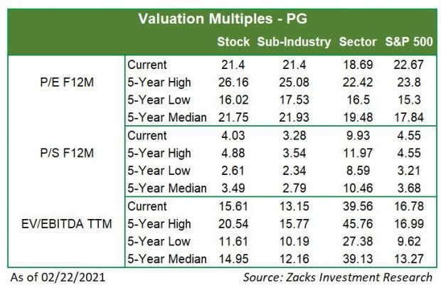
Recent News
Procter & Gamble Declares Dividend – Jan 12, 2021
Procter & Gamble has approved a dividend of 79.07 cents per share on the common shares of Series A and B. The dividend is payable on or after Feb 16 to shareholders with record as on Jan 22.
Valuation
Procter & Gamble shares are down 9% in the year-to-date period but nearly 2.6% over the trailing 12-month period. Stocks in the Zacks sub- industry and the Zacks Consumer Staples sector are down 8.8% and 1.9%, respectively, in the year-to-date period. Over the past year, the Zacks sub-industry and the sector are up 2.4% and 1.3%, respectively.
The S&P 500 index is up 4.5% in the year-to-date period and 23.3% in the past year.
The stock is currently trading at 21.4X forward 12-month earnings, which compares to 21.4X for the Zacks sub-industry, 18.69X for the Zacks sector and 22.67X for the S&P 500 index.
Over the past five years, the stock has traded as high as 26.16X and as low as 16.02X, with a 5-year median of 21.75X. Our Neutral recommendation indicates that the stock will perform in-line with the market. Our $134 price target reflects 22.66X forward 12-month earnings.
The table below shows summary valuation data for PG
www.zacks.com

Slide 7
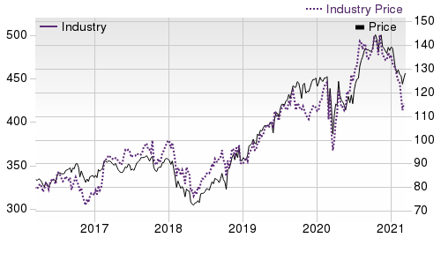

Industry Analysis Zacks Industry Rank: Bottom 36% (162 out of 253)
Top Peers
Company (Ticker) | Rec | Rank
The Estee Lauder Com…(EL) | Outperform | 2
Church & Dwight Co.,…(CHD) | Neutral | 3
ColgatePalmolive Com…(CL) | Neutral | 3
The Clorox Company (CLX) | Neutral | 3
Henkel AG & Co. (HENKY) | Neutral | 4
Nu Skin Enterprises,…(NUS) | Neutral | 3
Reckitt Benckiser Gr…(RBGLY) | Neutral | 2
Unilever PLC (UL) | Underperform | 4
Industry Comparison Industry: Soap And Cleaning Materials
PG X Industry
Industry Peers
S&P 500
CHD
HENKY
UL
Zacks Recommendation (Long Term) Neutral
-
-
Neutral
Neutral
Underperform
Zacks Rank (Short Term)
3
-
-
3
4
4
VGM Score
C
-
-
D
B
B
Market Cap
315.22 B
42.35 B
28.48 B
20.36 B
42.35 B
NA
# of Analysts
8
6.5
13
10
2
3
Dividend Yield
2.47%
1.91%
1.38%
1.22%
1.37%
3.69%
Value Score
C
-
-
C
A
B
Cash/Price
0.04
0.04
0.06
0.01
0.09
NA
EV/EBITDA
16.92
17.19
15.90
17.96
NA
NA
PEG Ratio
3.10
3.42
2.36
3.42
NA
5.87
Price/Book (P/B)
6.61
5.86
3.90
6.83
2.11
3.21
Price/Cash Flow (P/CF)
19.26
19.76
15.91
22.87
12.51
6.64
P/E (F1)
22.62
22.45
21.22
27.39
16.85
18.77
Price/Sales (P/S)
4.26
3.49
3.30
4.16
1.88
NA
Earnings Yield
4.42%
4.45%
4.61%
3.65%
5.92%
5.33%
Debt/Equity
0.47
0.54
0.67
0.60
0.09
0.00
Cash Flow ($/share)
6.65
3.67
6.78
3.63
1.93
8.31
Growth Score
B
-
-
D
B
A
Hist. EPS Growth (3-5 yrs)
8.79%
11.79%
9.32%
12.86%
NA
NA
Proj. EPS Growth (F1/F0)
10.55%
7.85%
14.54%
7.21%
17.62%
3.89%
Curr. Cash Flow Growth
11.93%
9.55%
0.72%
12.83%
-2.86%
0.57%
Hist. Cash Flow Growth (3-5 yrs)
2.25%
9.13%
7.32%
11.02%
5.53%
11.04%
Current Ratio
0.78
0.90
1.39
0.80
1.12
0.78
Debt/Capital
31.69%
34.59%
41.42%
37.50%
8.52%
0.00%
Net Margin
18.72%
16.36%
10.59%
16.05%
NA
NA
Return on Equity
31.43%
31.43%
14.75%
23.72%
NA
NA
Sales/Assets
0.62
1.07
0.51
0.68
NA
NA
Proj. Sales Growth (F1/F0)
6.29%
6.11%
7.02%
5.02%
7.18%
4.75%
Momentum Score
D
-
-
C
F
C
Daily Price Chg
-0.54%
0.17%
-0.12%
1.01%
-0.62%
-1.31%
1 Week Price Chg
1.71%
2.05%
2.96%
3.68%
3.21%
2.05%
4 Week Price Chg
-1.17%
-0.77%
3.72%
-0.55%
5.57%
-0.77%
12 Week Price Chg
-7.05%
-5.95%
8.75%
-4.34%
1.45%
-5.95%
52 Week Price Chg
15.50%
24.05%
72.55%
24.57%
63.90%
8.94%
20 Day Average Volume
8,585,772
1,560,091
2,394,762
1,403,169
64,124
2,983,267
(F1) EPS Est 1 week change
0.00%
0.00%
0.00%
0.00%
0.00%
0.00%
(F1) EPS Est 4 week change
-0.07%
-0.05%
0.00%
-0.05%
-4.97%
0.00%
(F1) EPS Est 12 week change
1.81%
1.81%
2.10%
-0.11%
-1.37%
-2.43%
(Q1) EPS Est Mthly Chg
0.15%
-0.03%
0.00%
-0.06%
NA
NA
www.zacks.com

Slide 8

Zacks Stock Rating System
We offer two rating systems that take into account investors' holding horizons: Zacks Rank and Zacks Recommendation. Each provides valuable insights into the future profitability of the stock and can be used separately or in combination with each other depending on your investment style.
Zacks Recommendation
The Zacks Recommendation aims to predict performance over the next 6 to 12 months. The foundation for the quantitatively determined Zacks Recommendation is trends in the company's estimate revisions and earnings outlook. The Zacks Recommendation is broken down into 3 Levels; Outperform, Neutral and Underperform. Unlike many Wall Street firms, we have an excellent balance between the number of Outperform and Neutral recommendations. Our team of 70 analysts are fully versed in the benefits of earnings estimate revisions and how that is harnessed through the Zacks quantitative rating system. But we have given our analysts the ability to override the Zacks Recommendation for the 1200 stocks that they follow. The reason for the analyst over-rides is that there are often factors such as valuation, industry conditions and management effectiveness that a trained investment professional can spot better than a quantitative model.
Zacks Rank
The Zacks Rank is our short-term rating system that is most effective over the one- to three-month holding horizon. The underlying driver for the quantitatively-determined Zacks Rank is the same as the Zacks Recommendation, and reflects trends in earnings estimate revisions.
Zacks Style Scores
Zacks Style Scores
The Zacks Style Score is as a complementary indicator to the Zacks rating system, giving investors a way to focus on the highest rated stocks that best fit their own stock picking preferences.
Value Score
C
Growth Score
B
Academic research has proven that stocks with the best Value, Growth and Momentum characteristics outperform the market. The Zacks Style Scores rate stocks on each of these individual styles and assigns a rating of A, B, C, D and F. We also produce the VGM Score (V for Value, G for Growth and M for Momentum), which combines the weighted average of the individual Style Scores into one score. This is perfectly suited for those who want their stocks to have the best scores across the board.
Momentum Score
D
VGM Score
C
As an investor, you want to buy stocks with the highest probability of success. That means buying stocks with a Zacks Recommendation of Outperform, which also has a Style Score of an A or a B.
Disclosures
This report contains independent commentary to be used for informational purposes only. The analysts contributing to this report do not hold any shares of this stock. The analysts contributing to this report do not serve on the board of the company that issued this stock. The EPS and revenue forecasts are the Zacks Consensus estimates, unless indicated otherwise on the report's first page. Additionally, the analysts contributing to this report certify that the views expressed herein accurately reflect the analysts' personal views as to the subject securities and issuers. ZIR certifies that no part of the analysts' compensation was, is, or will be, directly or indirectly, related to the specific recommendation or views expressed by the analyst in the report.
Additional information on the securities mentioned in this report is available upon request. This report is based on data obtained from sources we believe to be reliable, but is not guaranteed as to accuracy and does not purport to be complete. Any opinions expressed herein are subject to change.
ZIR is not an investment advisor and the report should not be construed as advice designed to meet the particular investment needs of any investor. Prior to making any investment decision, you are advised to consult with your broker, investment advisor, or other appropriate tax or financial professional to determine the suitability of any investment. This report and others like it are published regularly and not in response to episodic market activity or events affecting the securities industry.
This report is not to be construed as an offer or the solicitation of an offer to buy or sell the securities herein mentioned. ZIR or its officers, employees or customers may have a position long or short in the securities mentioned and buy or sell the securities from time to time. ZIR is not a broker-dealer. ZIR may enter into arms-length agreements with broker-dealers to provide this research to their clients. Zacks and its staff are not involved in investment banking activities for the stock issuer covered in this report.
ZIR uses the following rating system for the securities it covers. Outperform- ZIR expects that the subject company will outperform the broader
U.S. equities markets over the next six to twelve months. Neutral- ZIR expects that the company will perform in line with the broader U.S. equities markets over the next six to twelve months. Underperform- ZIR expects the company will underperform the broader U.S. equities markets over the next six to twelve months.
No part of this report can be reprinted, republished or transmitted electronically without the prior written authorization of ZIR.
www.zacks.com

