Slide 1
Online News Popularity
Competition 2
Cristina Pellegrino, Tyler Sirowich, Frank Zhao

Slide 2
Questions

Slide 3
Main
Which attributes of a news article contribute most to predicting its popularity?
Model
Which model is the best predictor in terms of F1 Bias and AUC Bias?
Question
Use
How can writers, editors, and readers take this into consideration?

Slide 4
Increase dataset to include more recent years
Add more features to dataset
Next Steps
Run more iterations of evaluation
Researching and breaking this down into smaller groups for popularity

Slide 5
赠送图标

Slide 6
赠送图标

Slide 7
Main
Model
Question
Use

Slide 8
Random Forest
Our Team
Our Audience
Purpose
Cristina Pellegrino
Tyler Sirowich
Frank Zhao
Writers of the articles
Editors of the company
Readers of the articles
Attributes that contribute most to popular news article
Popular articles = More than 1400 interactions

Slide 9
Feature Engineering
Altered min/max keyword features
Set constraints
Target variable - binary
Changed names

Slide 10
赠送图标
zzzzzzzzzzzzzzzzzzzzzz

Slide 11
赠送图标

Slide 12
Data
01
Feature | Variable Name
url | Article URL Location
time delta | Days between article publication and dataset acquisition
Identifiers
Feature | Variable Name
num_hrefs | Number of links
num_self_hrefs | Number of links to other articles published by Mashable
self_reference_min_shares | Min. shares of referenced articles in Mashable
self_reference_max_shares | Max. shares of referenced articles in Mashable
self_reference_avg_sharess | Avg. shares of referenced articles in Mashable
02
Links
03
Feature | Variable Name
num_imgs | Number of images
num_videos | Number of videos
Digital Media

Slide 13
Data
Feature | Variable Name
weekday_is_monday | Was article published on a Monday?
weekday_is_tuesday | Was article published on a Tuesday?
. . . | . . .
weekday_is.sunday | Was article published on a Sunday?
is_weekend | Was article published on the weekend?
04
Time
Feature | Variable Name
n_tokens_title | Number of words in the title
n_tokens_content | Number of words in the content
n_unique_tokens | Rate of unique words in the content
n_non_stop_words | Rate of non-stop words in the content
n_non_stop_unique_tokens | Rate of unique non-stop words in the content
average_token_length | Average length of the words in the content
05
Word-Level
Features

Slide 14
Data
Feature | Variable Name
num_keywords | Number of keywords in the metadata
kw_min_min | Worst keyword (min. shares)
kw_max_min | Worst keyword (max. shares)
kw_avg_min | Worst keyword (avg. shares)
kw_min_max | Best keyword (min. shares)
kw_max_max | Best keyword (max. shares)
kw_avg_max | Best keyword (avg. shares)
kw_min_avg | Avg. keyword (min. shares)
kw_max_avg | Avg. keyword (max. shares)
kw_avg_avg | Avg. keyword (avg. shares)
Continue
On
Features
06
Feature | Variable Name
data_channelis lifestyle | Is data channel Lifestyle?
data_channelis entertainment | Is data channel Entertainment?
data_channel_is_bus | Is data channel Business?
data_channel_is_socmed | Is data channel Social Media?
Is data channel Tech? | Is data channel Tech?
data_channel_is_world | Is data channel World?

Slide 15
Data
Feature | Variable Name
LDA_00 | Closeness to LDA topic 0
LDA_01 | Closeness to LDA topic 1
global_subjectivity | Text subjectivity
global_sentiment_polarity | Text sentiment polarity
global_rate_positive_words | Rate of positive words
global_rate_negative_word | Rate of negative words
rate_positive_words | Rate of positive words among non-neutral
rate_negative_words | Rate of negative words among non-neutral
avg_positive_polarity | Avg. polarity of positive words
. . . | . . .
07
Others
08
Target
Feature | Variable Name
shares | Number of shares(Target)

Slide 16
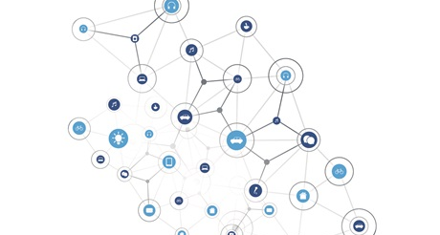
Shape Of Data Including Target
Shape of Data
61 features from different categories
39644 rows of data
39644 Rows
61 Features

Slide 17
Take It Into Consideration ?
Writers
Know what to include
Put out better articles
Editors
Allocate time
Increase effectiveness
Readers
Know what articles to pursue

Slide 18
论文背景概述
我们因梦想而伟大，所有的成功者都是大梦想家：在冬夜的火堆旁，在阴天的雨雾中，梦想着未来。有些人让梦想悄然绝灭，有些人则细心培育、维护。在阴天的雨雾中，梦想着未来。有些人让梦想悄然绝灭，有些人则细心培育、维护。
论文背景
我们因梦想而伟大，所有的成功者都是大梦想家：在冬夜的火堆旁，在阴天的雨雾中，梦想着未来。有些人让梦想悄然绝灭，有些人则细心培育、维护，。
论文背景
我们因梦想而伟大，所有的成功者都是大梦想家：在冬夜的火堆旁，在阴天的雨雾中，梦想着未来。有些人让梦想悄然绝灭，有些人则细心培育、维护。

Slide 19
实验结论
结论一
在此处输入正文内容，该段文本由世人皆苦小店编辑提供。在此处输入正文内容，该段文本由世人皆苦小店编辑提供。
结论二
在此处输入正文内容，该段文本由世人皆苦小店编辑提供。在此处输入正文内容，该段文本由世人皆苦小店编辑提供。
结论三
在此处输入正文内容，该段文本由世人皆苦小店编辑提供。在此处输入正文内容，该段文本由世人皆苦小店编辑提供。

Slide 20
论文摘要
国内外研究现状
研究目的与意义
研究思路及过程
研究结果与结论
研究创新与不足
国外研究现状列表
为客户提供有效服务，是我们工作的方向和价值评价的标尺，成就客户就是成就我们自己；
为客户提供有效服务，是我们工作的方向和价值评价的标尺，成就客户就是成就我们自己；
国内研究现状列表
为客户提供有效服务，是我们工作的方向和价值评价的标尺，成就客户就是成就我们自己；
为客户提供有效服务，是我们工作的方向和价值评价的标尺，成就客户就是成就我们自己；

Slide 21
论文摘要
国内外研究现状
研究目的与意义
研究思路及过程
研究结果与结论
研究创新与不足
国内外现状
国内
国外
关键词
关键词
关键词
关键词
关键词
关键词
在此处输入相关正文内容
在此处输入相关正文内容
在此处输入相关正文内容
在此处输入相关正文内容
该段文本由世人皆苦小店编辑提供
该段文本由世人皆苦小店编辑提供
该段文本由世人皆苦小店编辑提供
该段文本由世人皆苦小店编辑提供

Slide 22
论文摘要
国内外研究现状
研究目的与意义
研究思路及过程
研究结果与结论
研究创新与不足
时间背景
所研究问题的发展概况
发展概况一
发展概况一
发展概况一
在此处输入正文内容，该段文本由世人皆苦小店编辑提供。
在此处输入正文内容，该段文本由世人皆苦小店编辑提供。在此处输入正文内容
在此处输入正文内容，该段文本由世人皆苦小店编辑提供。在此处输入正文内容，该段文本由世人皆苦小店编辑提供。
2010年之前
2010年-2018年
2018年以后

Slide 23
Features | Data Type | Description
x23 | Integer | Avg. keyword (min. shares)
x25 | Integer | Avg. keyword (avg. shares)
x4 | Integer | Max. shares of referenced articles in Mashable
x5 | Integer | Avg. shares of referenced articles in Mashable
x13 | Nominal | Was article published on a Saturday?
x15 | Boolean | Was article published on the weekend?
x30 | Nominal | Is data channel Tech?
x17 | Integer | Worst keyword (min. shares)
x18 | Integer | Worst keyword (max. shares)
x24 | Integer | Avg. keyword (max. shares)
x27 | Nominal | Is data channel Entertainment?
x28 | Nominal | Is data channel Business?
x29 | Nominal | Is data channel Social Media?
x40 | Float | Closeness to LDA topic 2
y (Target) | Boolean | Shares (>=1400=1, <1400=0)
结论之一
我们因梦想而伟大，所有的成功者都是大梦想家：在冬夜的火堆旁，在阴天的雨雾中，梦想着未来。有些人让梦想悄然绝灭，有些人则细心培育、维护。在阴天的雨雾中，梦想着未来。
结论之二
我们因梦想而伟大，所有的成功者都是大梦想家：在冬夜的火堆旁，在阴天的雨雾中，梦想着未来。有些人让梦想悄然绝灭，有些人则细心培育、维护。在阴天的雨雾中，梦想着未来。
结论之三
我们因梦想而伟大，所有的成功者都是大梦想家：在冬夜的火堆旁，在阴天的雨雾中，梦想着未来。有些人让梦想悄然绝灭，有些人则细心培育、维护。在阴天的雨雾中，梦想着未来。
得出结论

Slide 24
Random Forest
Methods
Continuous Features
Select K Best
Correlation
All Features
RFE
Ridge
Select From Model
Tree Based
Voting System

Slide 25
Features | Data Type | Description
x23 | Integer | Avg. keyword (min. shares)
x25 | Integer | Avg. keyword (avg. shares)
x4 | Integer | Max. shares of referenced articles in Mashable
x5 | Integer | Avg. shares of referenced articles in Mashable
x13 | Nominal | Was article published on a Saturday?
x15 | Boolean | Was article published on the weekend?
x30 | Nominal | Is data channel Tech?
x17 | Integer | Worst keyword (min. shares)
x18 | Integer | Worst keyword (max. shares)
x24 | Integer | Avg. keyword (max. shares)
x27 | Nominal | Is data channel Entertainment?
x28 | Nominal | Is data channel Business?
x29 | Nominal | Is data channel Social Media?
x40 | Float | Closeness to LDA topic 2
y (Target) | Boolean | Shares (>=1400=1, <1400=0)
Methods
Continuous Features
Select K Best
Correlation
All Features
RFE
Ridge
Select From Model
Tree Based
Voting System

Slide 26
Which attributes of a news article contribute
most to predicting its popularity?
Model | Accuracy | Precision | Recall | F1 Bias | F1 Variance | AUC Bias | AUC Variance
XG Boost | 0.64 | 0.65 | 0.71 | 0.6687 | 0.0087 | 0.7307 | 0.0072
Random Forest | 0.60 | 0.63 | 0.65 | 0.6629 | 0.0074 | 0.7279 | 0.0072
Logistic Regression | 0.62 | 0.64 | 0.68 | 0.6411 | 0.0084 | 0.6919 | 0.0088
SVM | 0.62 | 0.64 | 0.66 | 0.6381 | 0.0064 | 0.689 | 0.0084
Naive Bayes | 0.61 | 0.66 | 0.56 | 0.5377 | 0.007 | 0.6873 | 0.0085
Decision Tree | 0.56 | 0.59 | 0.58 | 0.5888 | 0.0083 | 0.5911 | 0.0081

Slide 27
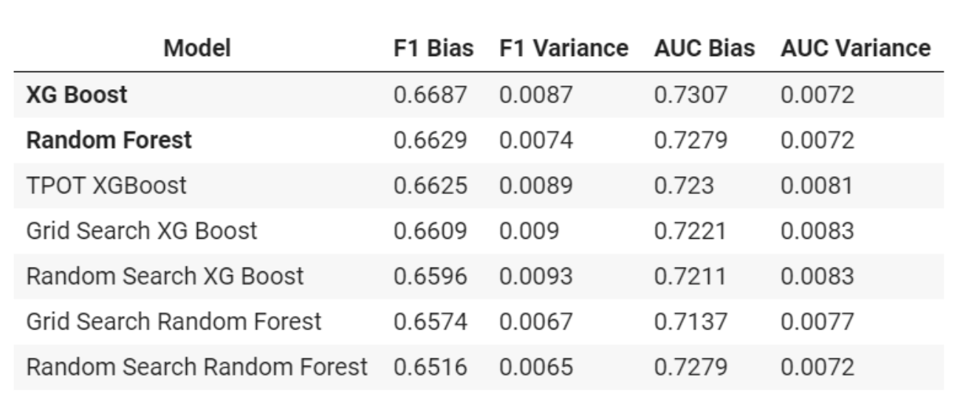
Which model is the best predictor in terms of F1 Bias and AUC Bias?

Slide 28
Which attributes of a news article contribute
most to predicting its popularity?

Slide 29
Which attributes of a news article contribute
most to predicting its popularity?
Model | Accuracy | Precision | Recall | F1 Bias | F1 Variance | AUC Bias | AUC Variance
XG Boost | 0.64 | 0.65 | 0.71 | 0.6687 | 0.0087 | 0.7307 | 0.0072
Random Forest | 0.60 | 0.63 | 0.65 | 0.6629 | 0.0074 | 0.7279 | 0.0072
Logistic Regression | 0.62 | 0.64 | 0.68 | 0.6411 | 0.0084 | 0.6919 | 0.0088
SVM | 0.62 | 0.64 | 0.66 | 0.6381 | 0.0064 | 0.689 | 0.0084
Naive Bayes | 0.61 | 0.66 | 0.56 | 0.5377 | 0.007 | 0.6873 | 0.0085
Decision Tree | 0.56 | 0.59 | 0.58 | 0.5888 | 0.0083 | 0.5911 | 0.0081

Slide 30
赠送图标

Slide 31
赠送图标

