Slide 1
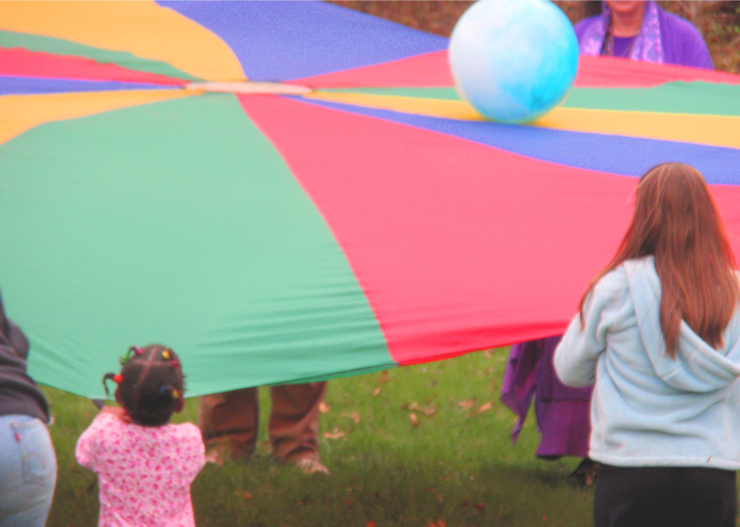
Bodily-Kinesthetic Activities
Parachute games
Follow the leader
Dancing
Tag
Note. Parachute Play. From Harrow, 2011. CC BY N-C 2.0.

